Slide 1
The Basics of Using Acrobat Pro DC to Create Accessible PDF Documents
Rob Haverty, Senior Product Manager, Document Cloud Accessibility
Revised January 2019

Slide 2
Session Description
Trying to work on PDF documents in Acrobat Pro DC for the first time can be daunting. In this session we will highlight some of the key aspects to fixing an inaccessible PDF and the easiest way to do so in Acrobat Pro DC.
There is a lot to know to become an expert. The goal of this session is to lay the groundwork to make it easier to create accessible PDFs.

Slide 3
Fixing Tags
Content Shall be Tagged in the Logical Reading Order
Common areas for review:
  Tables
  Figures
  Artifacts
  Lists
Unique considerations depending on the source document and means of conversion:
  Scanned Document
  Role Mapping
  Links
  Form Fields
Reminder: Different results depending on the conversion/tagging method (e.g. PDFMaker vs. MakeAccessible)

Slide 4
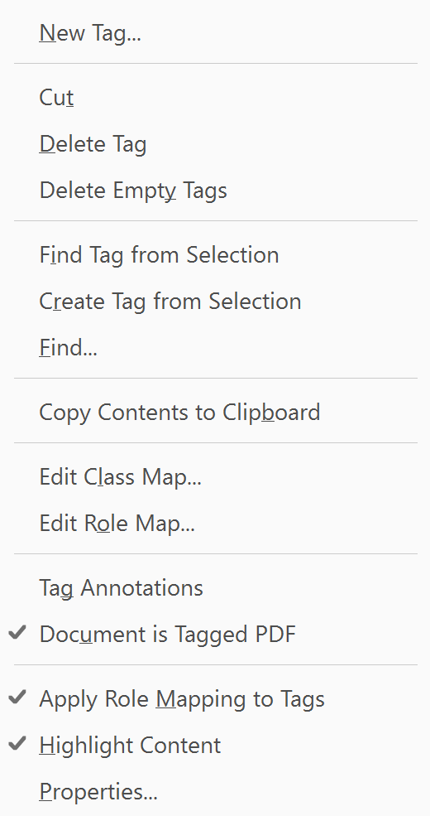
Editing in the Tag Tree – The Basics
Covered in specific exercises later.
New Tag
  Select where you want the new tag inserted in the Tag Tree (inserts below selected tag)
  Right click to open the Context Menu
  Select “New Tag” and the tag type
Move Tags
  “Drag and Drop” or “Cut and Paste”
Change Tag
  F2

Slide 5
Fixing Tags - Headings Basics
Heading Hierarchy
    PDF/UA allows for multiple H1 tags
    PDF/UA requires heading tags be in sequential order (WCAG does not)
Exercise – Incorrect Heading Hierarchy
  Demo Doc with Errors

Slide 6
Fixing Tags – List Basics (Single level)
According to the PDF/UA ISO standard, a list must have the List <L> tag and List Item <LI> tags. They may also have the Label <Lbl> and List Body <Lbody> tags.
Open document and convert to PDF Demo Doc with Errors
Open Tag Tree
Find mis-tagged list items (usually will have a <P> tag)
Create <L> tag
Change list items <P> tags to <LI> tags and make them children of the <L> Tag

Slide 7
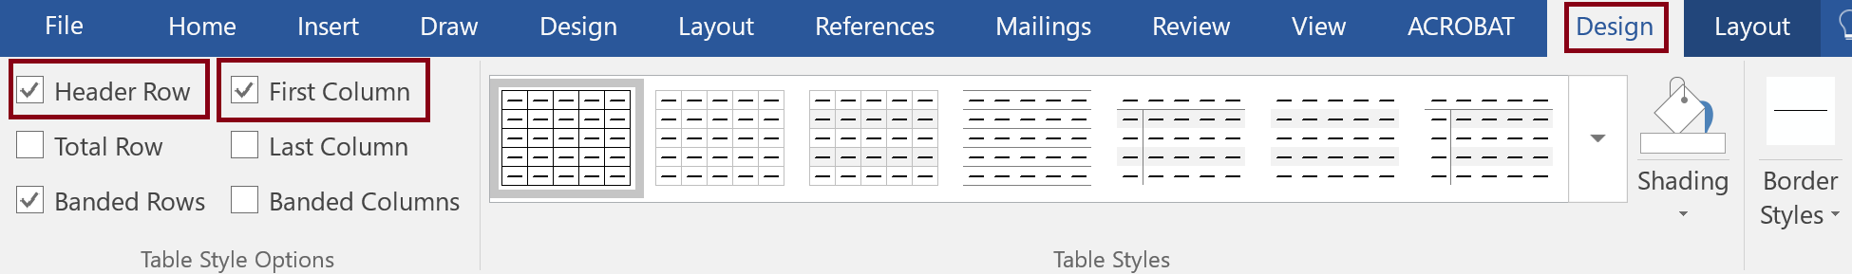
Table Header Cells - Office
Word
  Header Row (Column Headers)
  First Column (Row Headers)

Slide 8
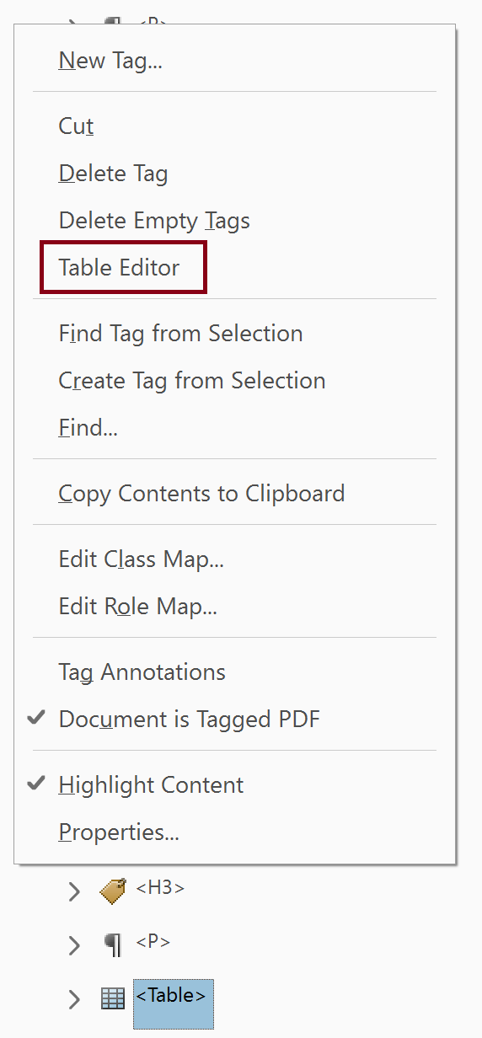
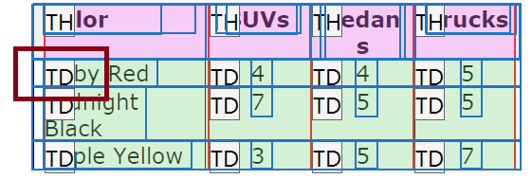
Fixing Tags – Basic Table
Column and Row Headers need to be tagged with the <TH> tag and data cells with the <TD> tag
Convert document to PDF Demo Doc with Errors
Open Table Editor (context menu in Tag Tree or Reading Order tool)
Select and change <TH> tags to <TD> tags and add Scope

Slide 9
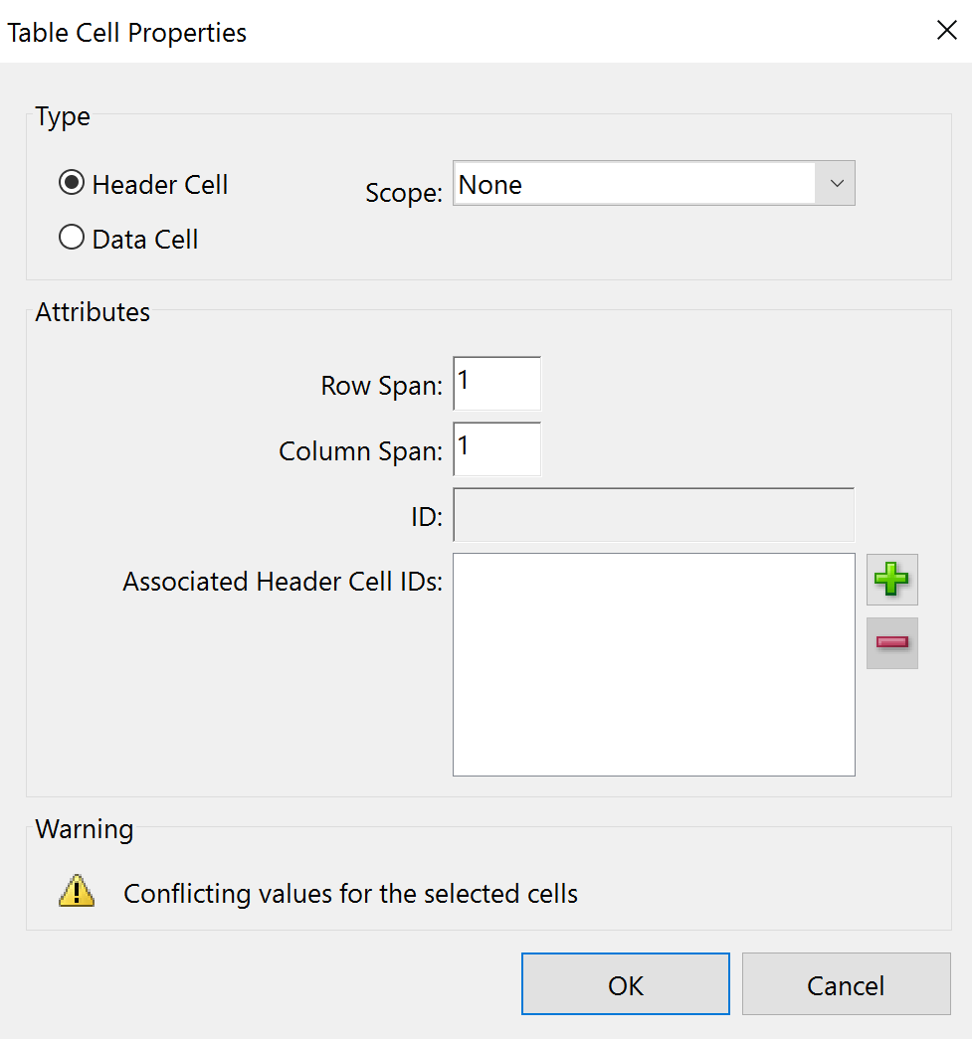
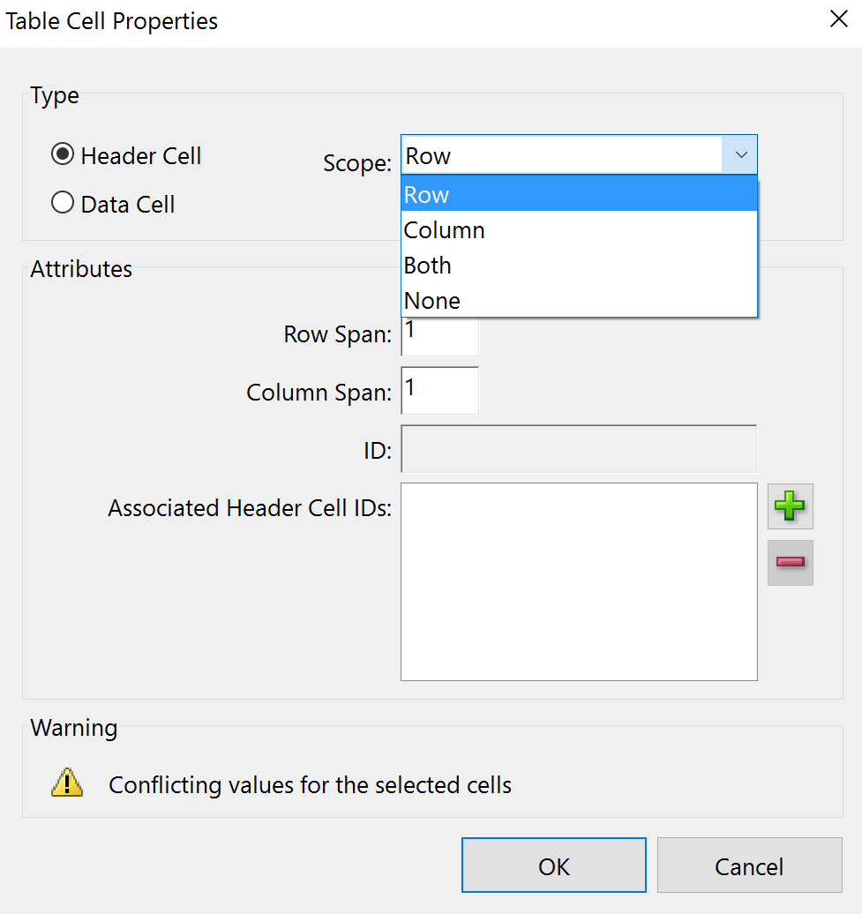
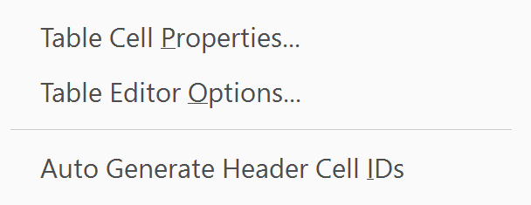
Table Header Cells - Acrobat
Select Header Cell radio button for a <TH> tag
  Row Headers should have a scope of “Row”
  Merged Headers need both Scope and Span (Span for number or rows or columns

Slide 10
Tables with Merged Cells
Use document Demo Doc with Errors
Add scope and span to Merged Cells

Slide 11
Artifacts
An artifact is content that does not provide meaningful information such as decorative images or line spaces. Artifacts should not be present in the Tag Tree.
Continue using document Demo Doc with Errors
Open document in Acrobat
Open the Tag Tree (this step is not necessary but for illustration only)
Note the empty <P> tags, we will come back and check for them after creating the artifact tags
Access the Reading Order tool from the Tag Panel or Order Panel
  Tag Panel select Reading Order
  Order Panel select “Show reading order panel”
Select item number for content to be artifacted
Select “Background/Artifact” from the Reading Order tool
Return to the Tag Tree and note that the previous empty <P> tag is now gone. (again, this step is unnecessary and only for illustration)

Slide 12
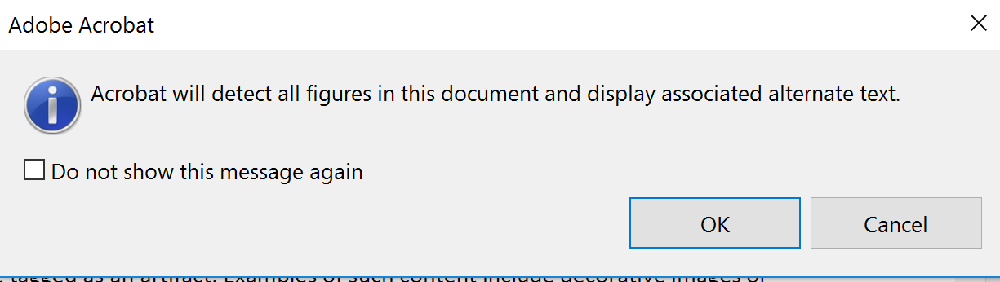
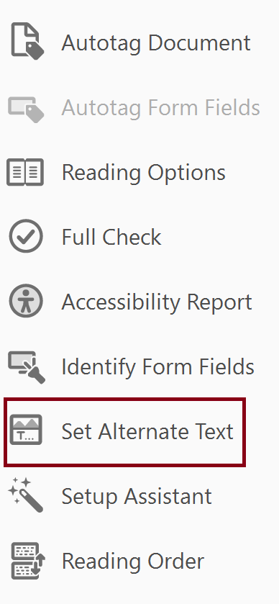
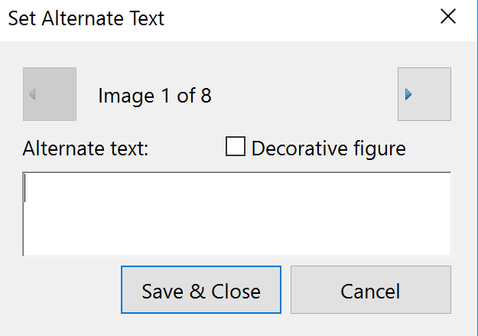
Images
Use document Demo Doc with Errors
Figures with Captions (Artifact?)
Without Captions (Alternative Text)
  Select the Accessibility Tool

Slide 13
Resources

Slide 14
Acrobat Pro DC Helpful Links and Resources
Acrobat DC Accessibility
  https://www.adobe.com/accessibility/products/acrobat.html
Adobe Acrobat DC Accessibility Features
  https://www.adobe.com/accessibility/products/acrobat/acrobat-accessibility-features.html
Acrobat Reader DC Accessibility features
  https://helpx.adobe.com/reader/using/accessibility-features.html
Acrobat DC and Reader DC Accessibility Blogs
  https://theblog.adobe.com/document-cloud/ (search for PDF or Accessibility)
Using the Acrobat Pro DC Accessibility Checker
  https://www.adobe.com/accessibility/products/acrobat/using-acrobat-pro-accessibility-checker.html
Create and verify PDF accessibility
  https://helpx.adobe.com/acrobat/using/create-verify-pdf-accessibility.html
Acrobat Pro DC PDF Accessibility Repair Workflow
  https://www.adobe.com/accessibility/products/acrobat/acrobat-pro-dc-pdf-accessibility-repair-workflow.html

Slide 15
Adobe Accessibility Resources
Recordings and Materials from Adobe Webinars on Creating Accessible PDF Documents
  http://adobe.lookbookhq.com/acrobataccessibility
Adobe Webinars on PDF Accessibility
  https://events-ar.adobeconnect.com/content/connect/c1/881497641/en/events/catalog.html?OWASP_CSRFTOKEN=1e73e0edb7545f3f9fdd08e895e134213f26efe05c1067bb15b4fc6234076238
Adobe Accessibility Website
  www.Adobe.com/Accessibility
Accessibility Compliance
  https://www.adobe.com/accessibility/compliance.html
Follow us on Twitter @AdobeAccess
PDF Standards
  ISO 32000 (free)
  ISO 14289 (PDF/UA) (purchase)

Slide 16
Adobe – Make it an Experience

