Slide 1
The Source Document is Supreme
Rob Haverty, Senior Product Manager, Document Cloud Accessibility
Revised April 2019

Slide 2
Session Description
When creating an accessible PDF, the most important factor in your success is in ensuring that the original source document is fully accessible. Second most is the method used to convert that document into a PDF document.
In this session we will explore making a Word document accessible as the source document and then using the right conversion tools to get to an accessible PDF. The more accessible the source document is, the more accessible the PDF will be and the less work that will need to be done to fix the PDF.

Slide 3
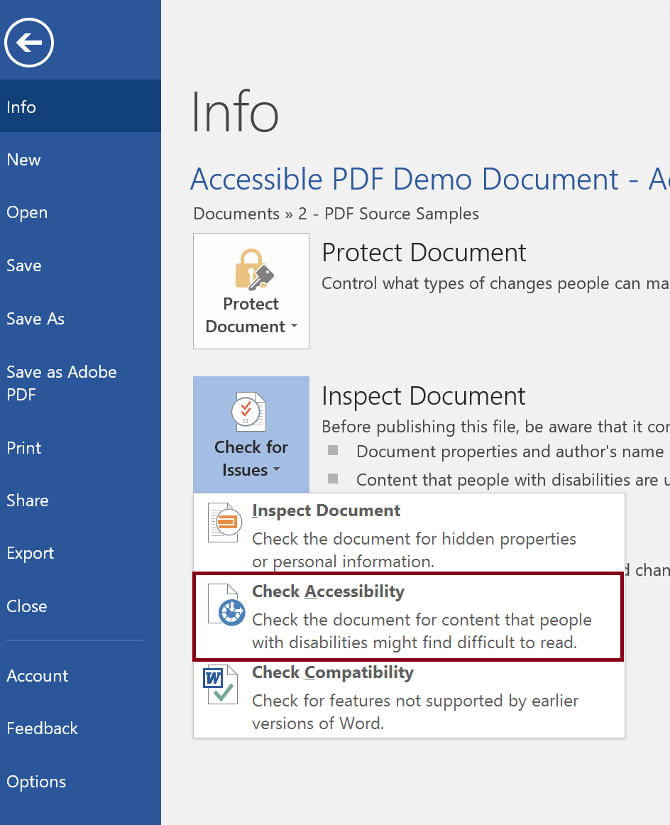
Source Document
The Source Document is Supreme
Things to consider when creating the source document:
Does the authoring tool of the source document allow the author to create an accessible document.
  For Example: Word has an Accessibility Checker to help the author make the document more accessible.
Does the author know how to create an accessible document
  For Example: In Word, are Styles used to apply Headings or are headings “created” by changing the font size and making the font bold?
It is almost always easier to remediate the source document then the converted PDF document.

Slide 4
Creation

Slide 5
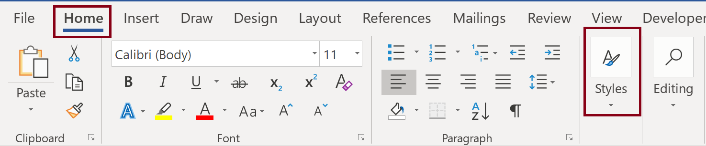
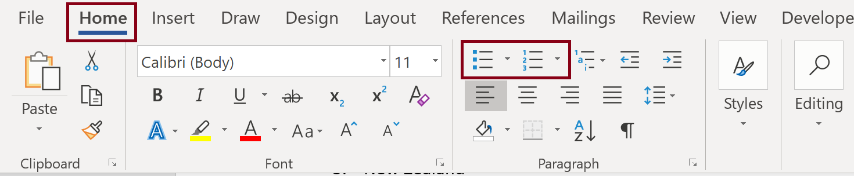
Key Elements in Word
Set Headings using Styles
    Instead of using text formatting like size, bold, or italics
Use Bulleted and Numbered Lists in Paragraph Styles
    Instead of indenting

Slide 6
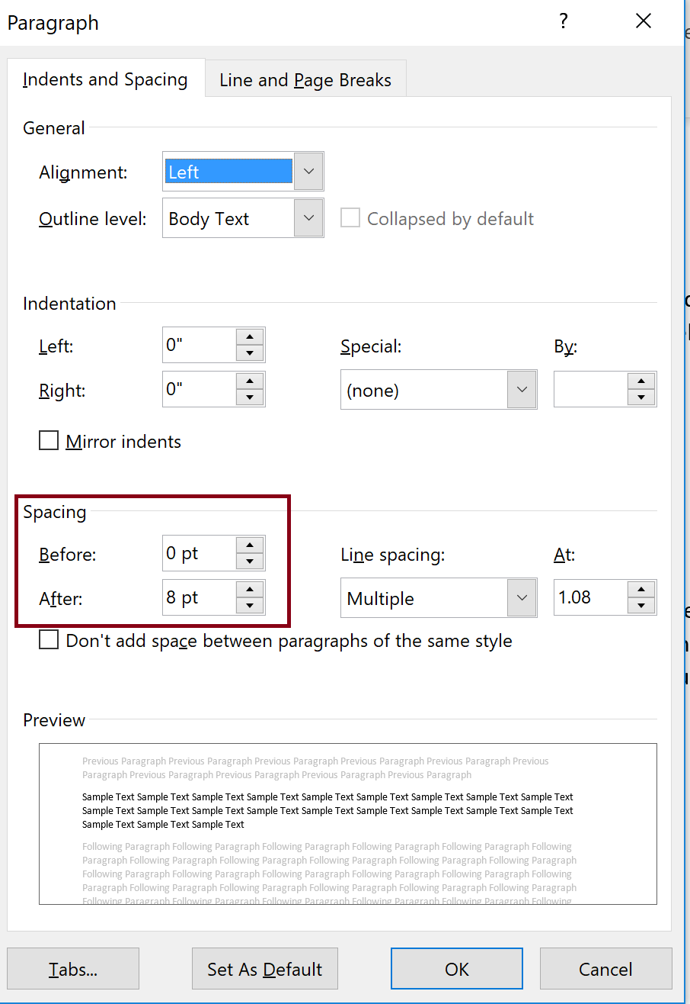
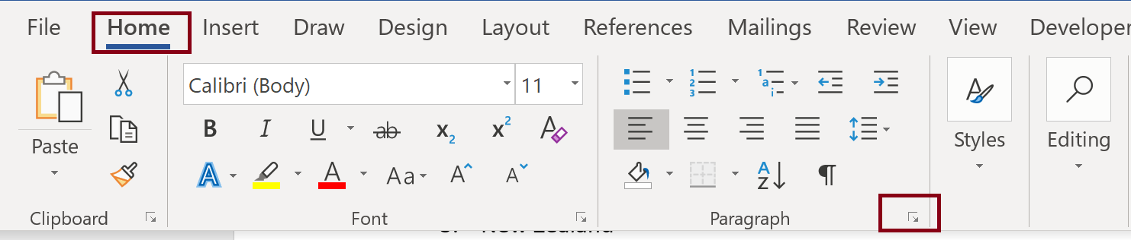
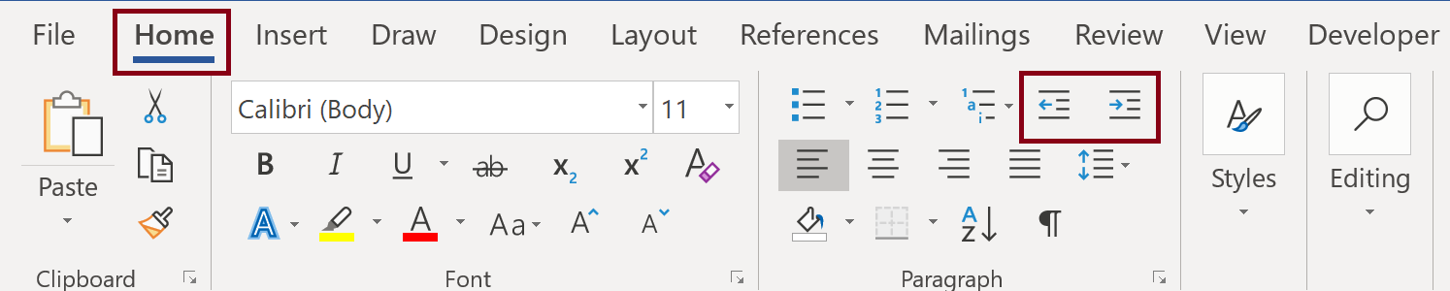
Key Elements in Word
Set Paragraph Spacing before or after paragraphs in Paragraph Styles
    Instead of using blank lines
Use Increase Indent in Paragraph Styles when indenting
    Instead of using tab

Slide 7
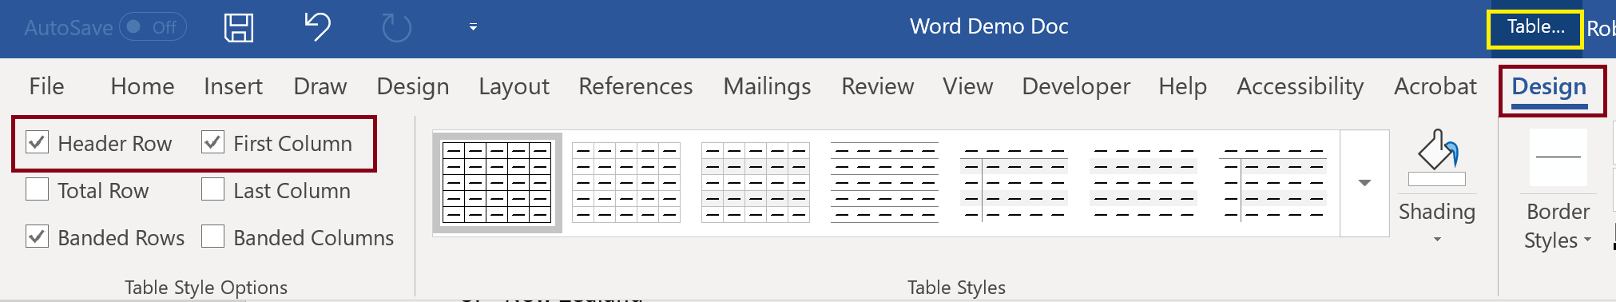
Key Elements in Word
Set Table Header Row and First Column in Table Design
Choose text colors that provide a minimum 4.5:1 contrast ration
    One option is the Colour Contrast Analyser https://developer.paciellogroup.com/resources/contrastanalyser/

Slide 8
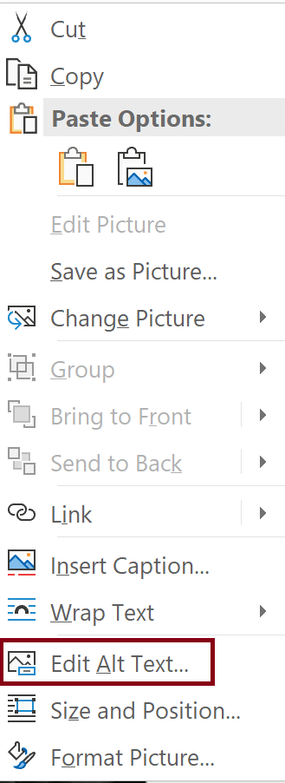
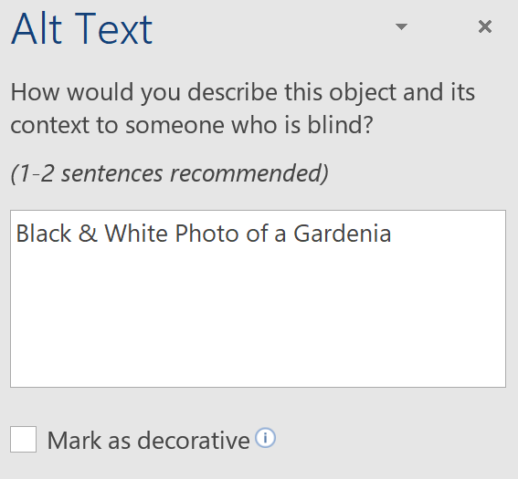
Key Elements in Word
Provide Alternative Text for images that are not decorative.
    Right click on an image and select Edit Alt Text (note option to Mark as decorative)

Slide 9
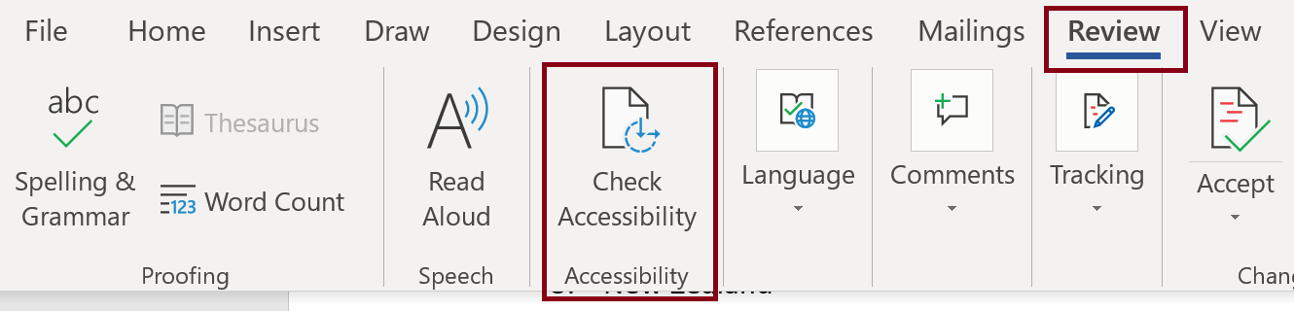
Office Accessibility Checker
On the ribbon, select the Review tab.
Select Check Accessibility.
Review your results. You'll see a list of errors, warnings, and tips with how-to-fix recommendations for each. See Rules for the Accessibility Checker (https://support.office.com/en-us/f1/topic/rules-for-the-accessibility-checker-651e08f2-0fc3-4e10-aaca-74b4a67101c1) for more information.

Slide 10
Conversion

Slide 11
Converting to a PDF from a Source Document
Multiple Methods
Acrobat Plug-in
Application Save As
Export
Print to PDF
Other conversion tools or plug-ins
Varying Results
Tables and Lists may be inaccurately tagged
Resulting PDF may be untagged
Custom tags may be created

Slide 12
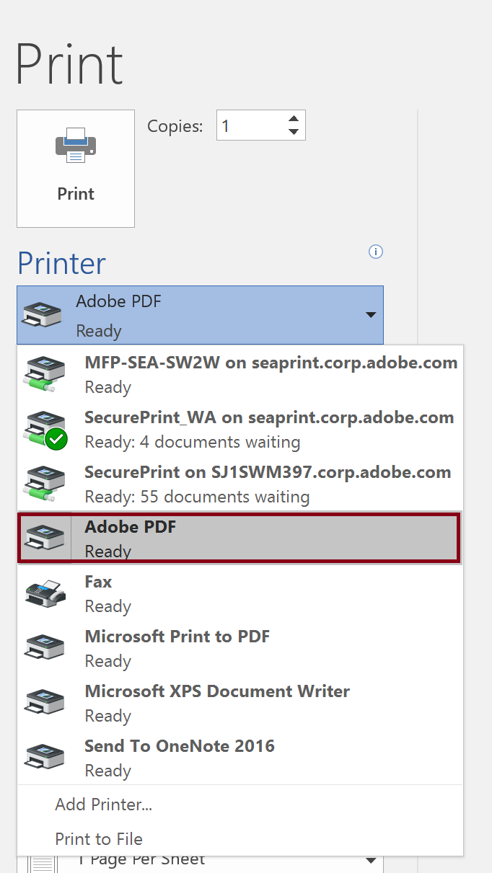
PDF Conversion from Word – Adobe Process
Acrobat Plug-in (Office Ribbon)
Print to PDF

Slide 13
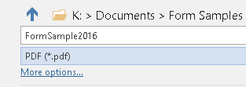
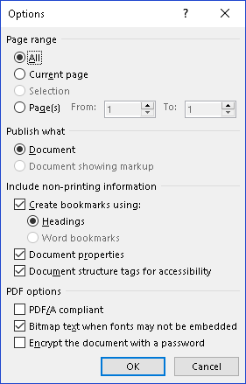
PDF Conversion from Word – Microsoft Office Process
Office Save As
Under More Options, open Options and make sure Headings are used for Bookmarks is checked.

Slide 14
Resources

Slide 15
Acrobat Pro DC Helpful Links and Resources
Acrobat DC Accessibility
  https://www.adobe.com/accessibility/products/acrobat.html
Adobe Acrobat DC Accessibility Features
  https://www.adobe.com/accessibility/products/acrobat/acrobat-accessibility-features.html
Acrobat Reader DC Accessibility features
  https://helpx.adobe.com/reader/using/accessibility-features.html
Acrobat DC and Reader DC Accessibility Blogs
  https://theblog.adobe.com/document-cloud/ (search for PDF or Accessibility)
Using the Acrobat Pro DC Accessibility Checker
  https://www.adobe.com/accessibility/products/acrobat/using-acrobat-pro-accessibility-checker.html
Create and verify PDF accessibility
  https://helpx.adobe.com/acrobat/using/create-verify-pdf-accessibility.html
Acrobat Pro DC PDF Accessibility Repair Workflow
  https://www.adobe.com/accessibility/products/acrobat/acrobat-pro-dc-pdf-accessibility-repair-workflow.html

Slide 16
Adobe Accessibility Resources
Recordings and Materials from Adobe Webinars on Creating Accessible PDF Documents
  http://adobe.lookbookhq.com/acrobataccessibility
Adobe Webinars on PDF Accessibility
  https://events-ar.adobeconnect.com/content/connect/c1/881497641/en/events/catalog.html?OWASP_CSRFTOKEN=1e73e0edb7545f3f9fdd08e895e134213f26efe05c1067bb15b4fc6234076238
Adobe Accessibility Website
  www.Adobe.com/Accessibility
Accessibility Compliance
  https://www.adobe.com/accessibility/compliance.html
Follow us on Twitter @AdobeAccess
PDF Standards
  ISO 32000 (free)
  ISO 14289 (PDF/UA) (purchase)

Slide 17
Adobe – Make it an Experience

