Slide 1
A College Course in 5 Weeks
Dorothy Hirata • Instructional Design Manager • dso@hawaii.edu

Slide 2
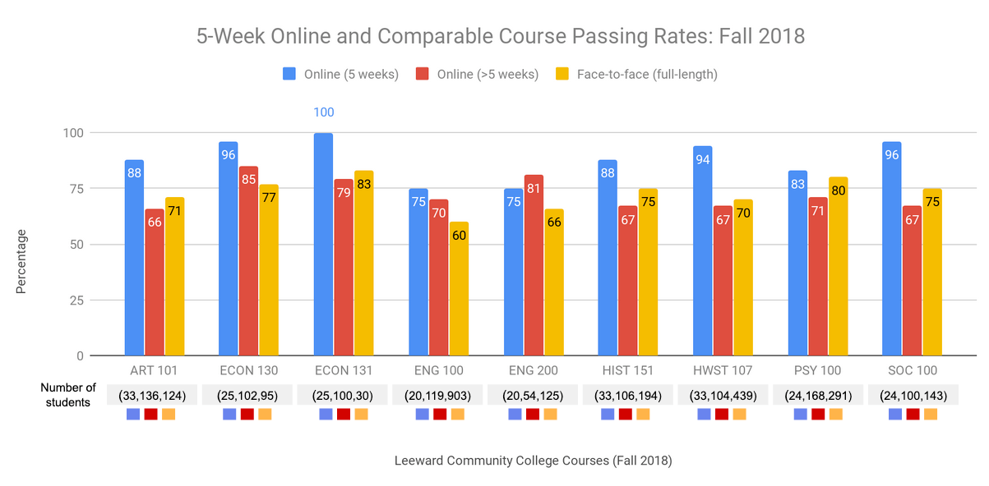
Notes:
When courses are well designed, faculty participate in professional development, that in fact 5 week success rates (in blue) are high, even better that face to face courses in our pilot.

Slide 3
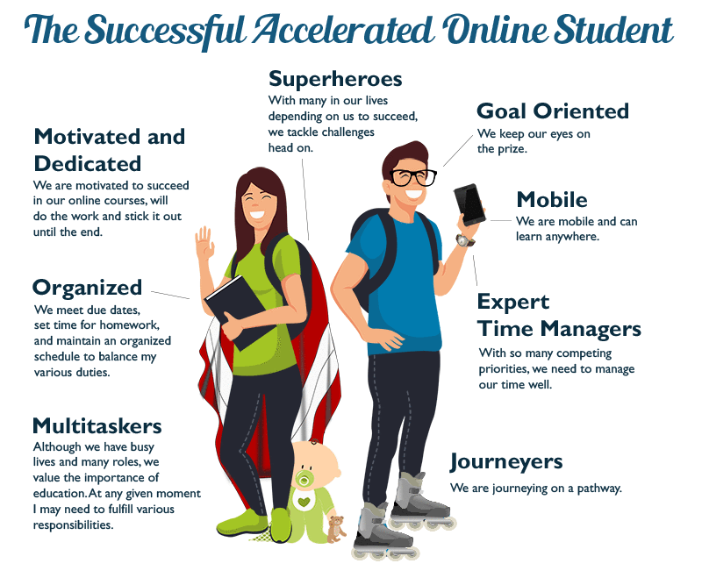
Notes:
Here is an illustration our ID team worked on profiling a successful accelerated online student.

Slide 4
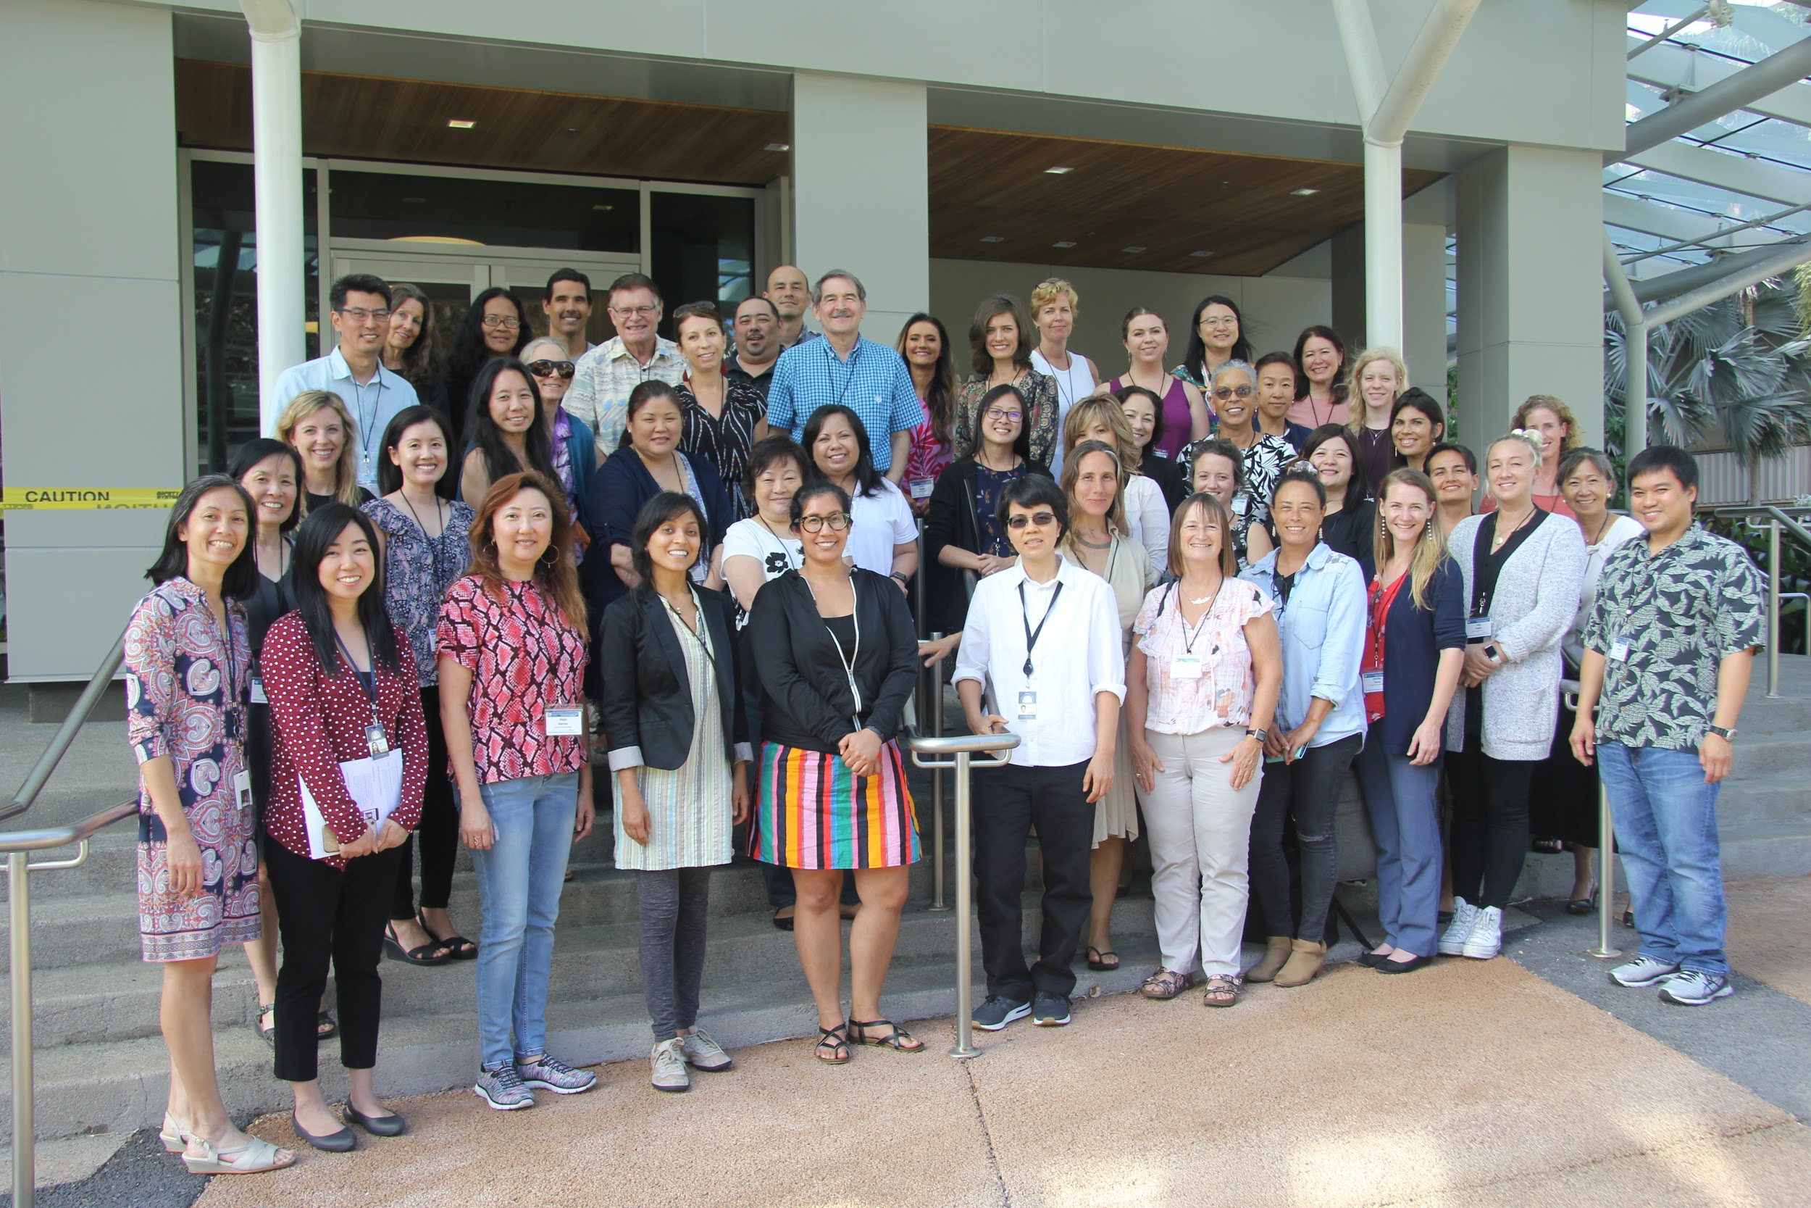
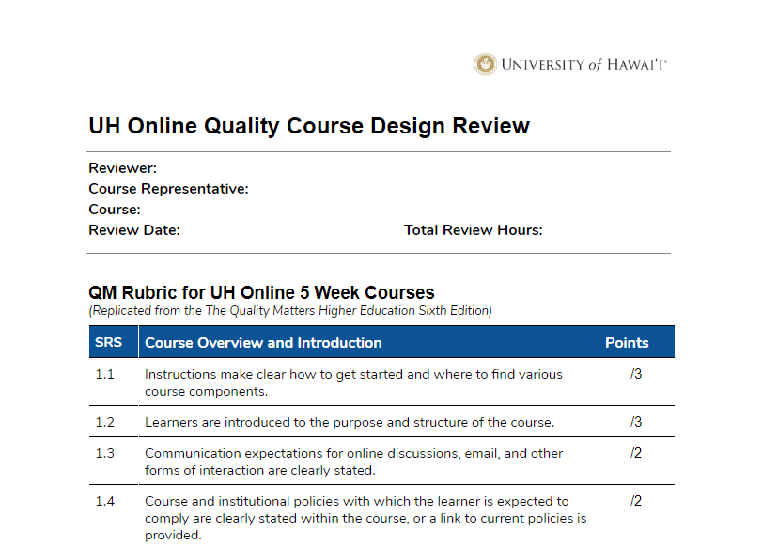
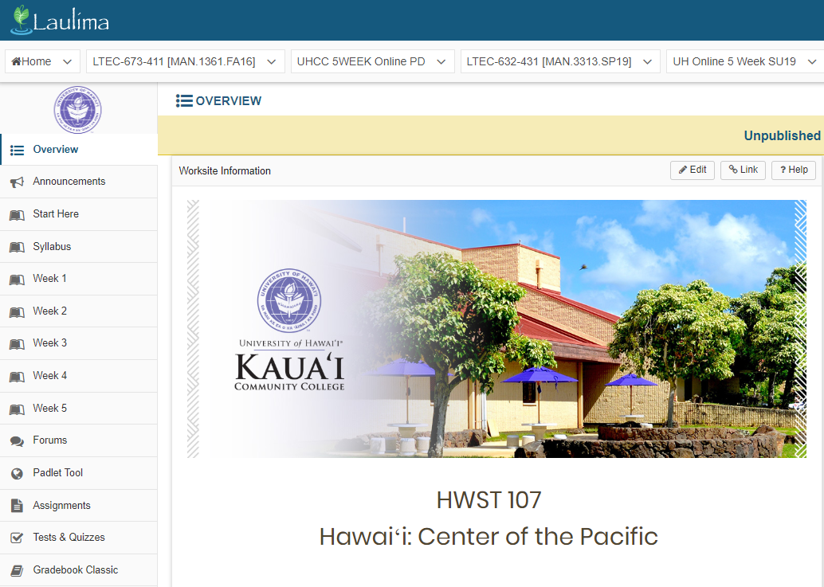
UH Online 5 Weeks Professional Development 2019
Faculty PD Reflections
Notes:
Intensive 5 Week Online PD w/ 2 days F2F with UH IDs
Design & Develop 5 Week Accelerated Online Course
UH Online Quality Course Design Review

Slide 5
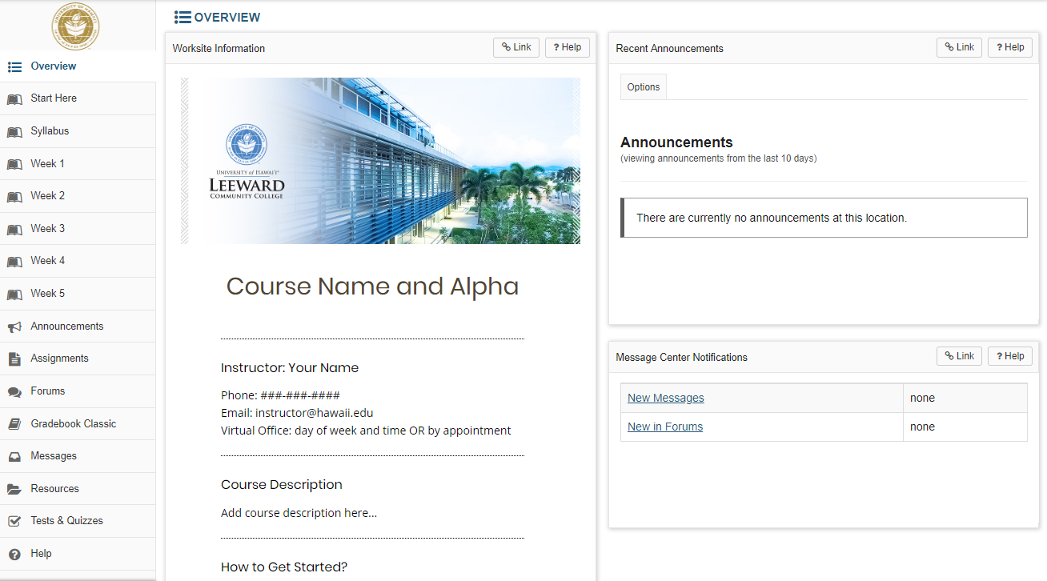
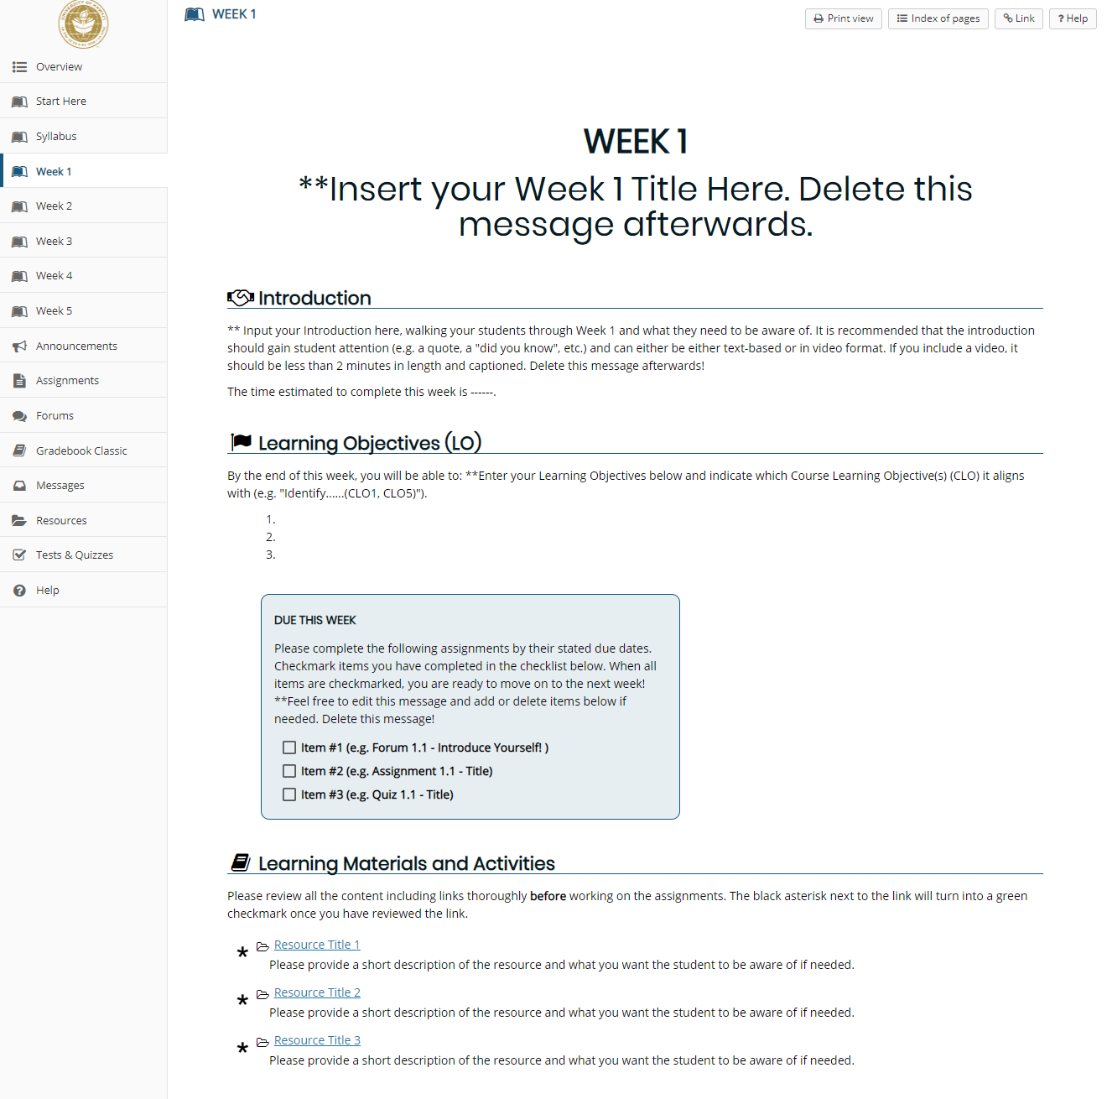
Improved Laulima Templates
Notes:
In 2019, we have improved the Laulima templates available for instructors teaching 5 week courses.
There are additional banner templates for each campus as well as CSS style sheets with corresponding colors and icons.
In addition, accessibility guidelines were also taken into consideration when creating these templates.
Lastly, there is a process in place for faculty to request import of the template into their own course.

Slide 6
Integrated Student Support
http://uhonline.hawaii.edu
Notes:
UH Online Inquiry Data - since May 1st
164 request information inquiries
Highest areas of interest - Business, Education, Nursing, Accounting, Psychology, Liberal Arts
Highest inquiries from Hawaii
Other states: California, Nevada, Utah, Colorado, Minnesota, North Dakota, Iowa...lots along East Coast
Most inquiries are interested in Bachelor’s degree
71% inquiries have attended college before

Slide 7
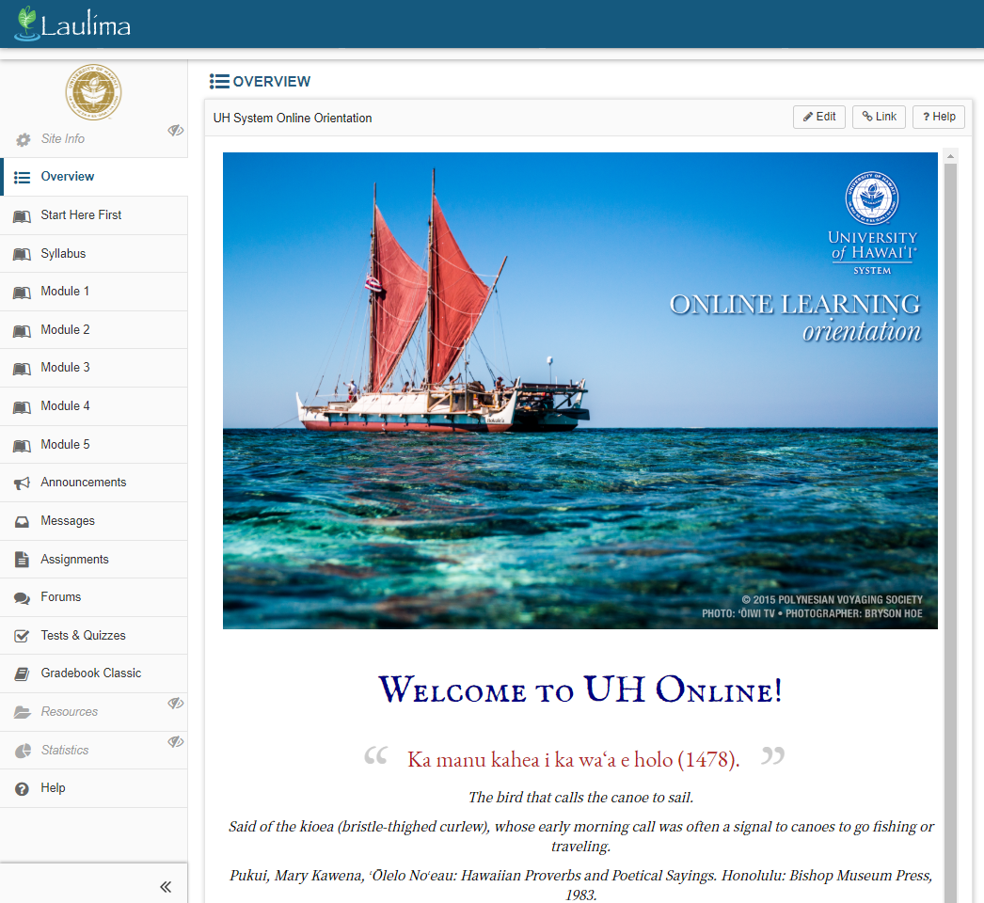
Online Orientation
Modules:
Basics of Online Learning
Communication & Engagement
Self-Management Strategies
Technology
Support & Resources
Notes:
Five modules:
Basics of Online Learning
Communication & Engagement
Self-Management Strategies
Technology
Support & Resources
Each module should take about 5-15 minutes to complete. Assignments will take additional time. The entire orientation should only take approximately 1-1.5 hour(s) for students to complete.
Graded orientation activities:
3 assignments
2 quizzes
1 discussion forum
1 message to Facilitator

Slide 8
Contact Us
Hae Okimoto, PhD hae@hawaii.edu, 956-3504
Dorothy Hirata, PhD dso@hawaii.edu, 956-2789
Davilla Gose, PhD drgose@hawaii.edu, 956-2937
Notes:
For questions or more information, feel free to contact us. Mahalo!

