Slide 1
Hawaiʻi Data Science Institute
Gwen Jacobs
ITS -Director of Cyberinfrastructure gwenj@hawaii.edu

Slide 2

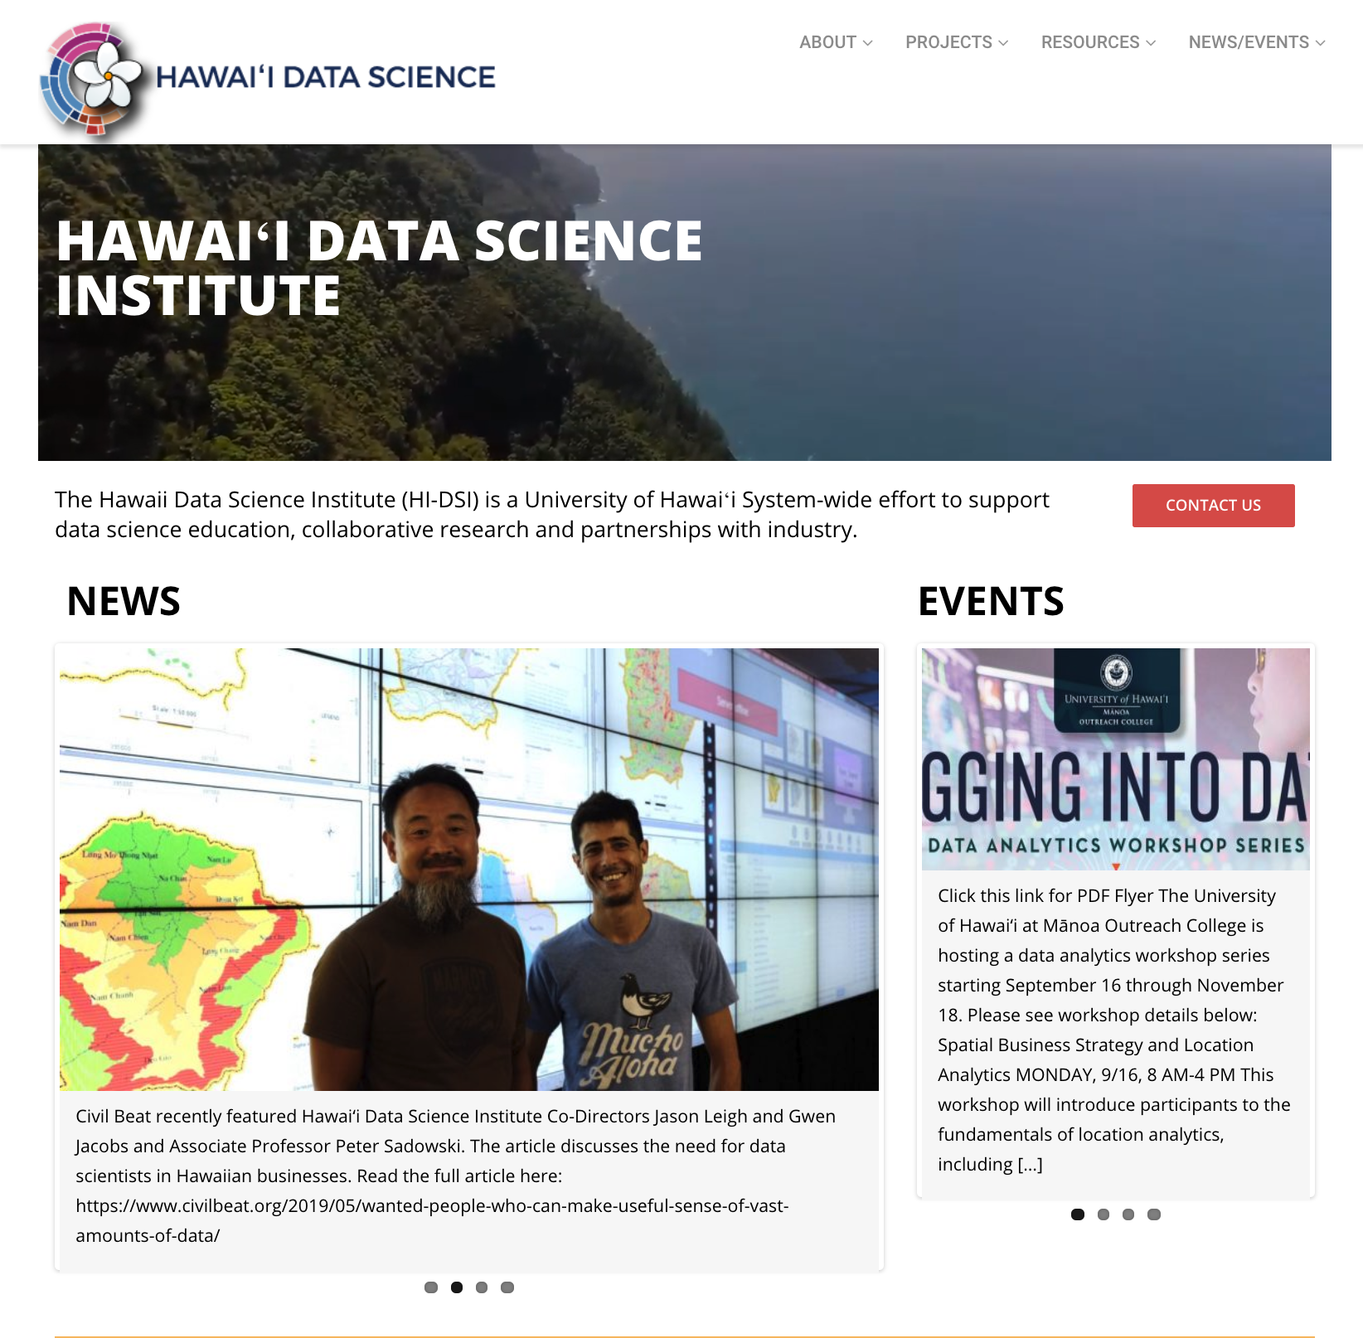

HIDSI one of three virtual institutes

Slide 3

A UH Systemwide initiative to catalyze research and training capacity in data science, computation, and visualization.
AUDIENCE
STUDENTS
RESEARCHERS
INDUSTRY
Coordinate and
participate in the establishment of a cross-disciplinary curriculum in data science.
Forge strategic collaborative partnerships with the industry and government agencies.
Promote and support cross-disciplinary research around data science.

Slide 4











DATA SCIENCE EDUCATION
Data science education using open-source, community driven tools
Examples
Wrangling, Visualization and Analysis
Interaction and Authoring
Sharing and Discovery

Slide 5
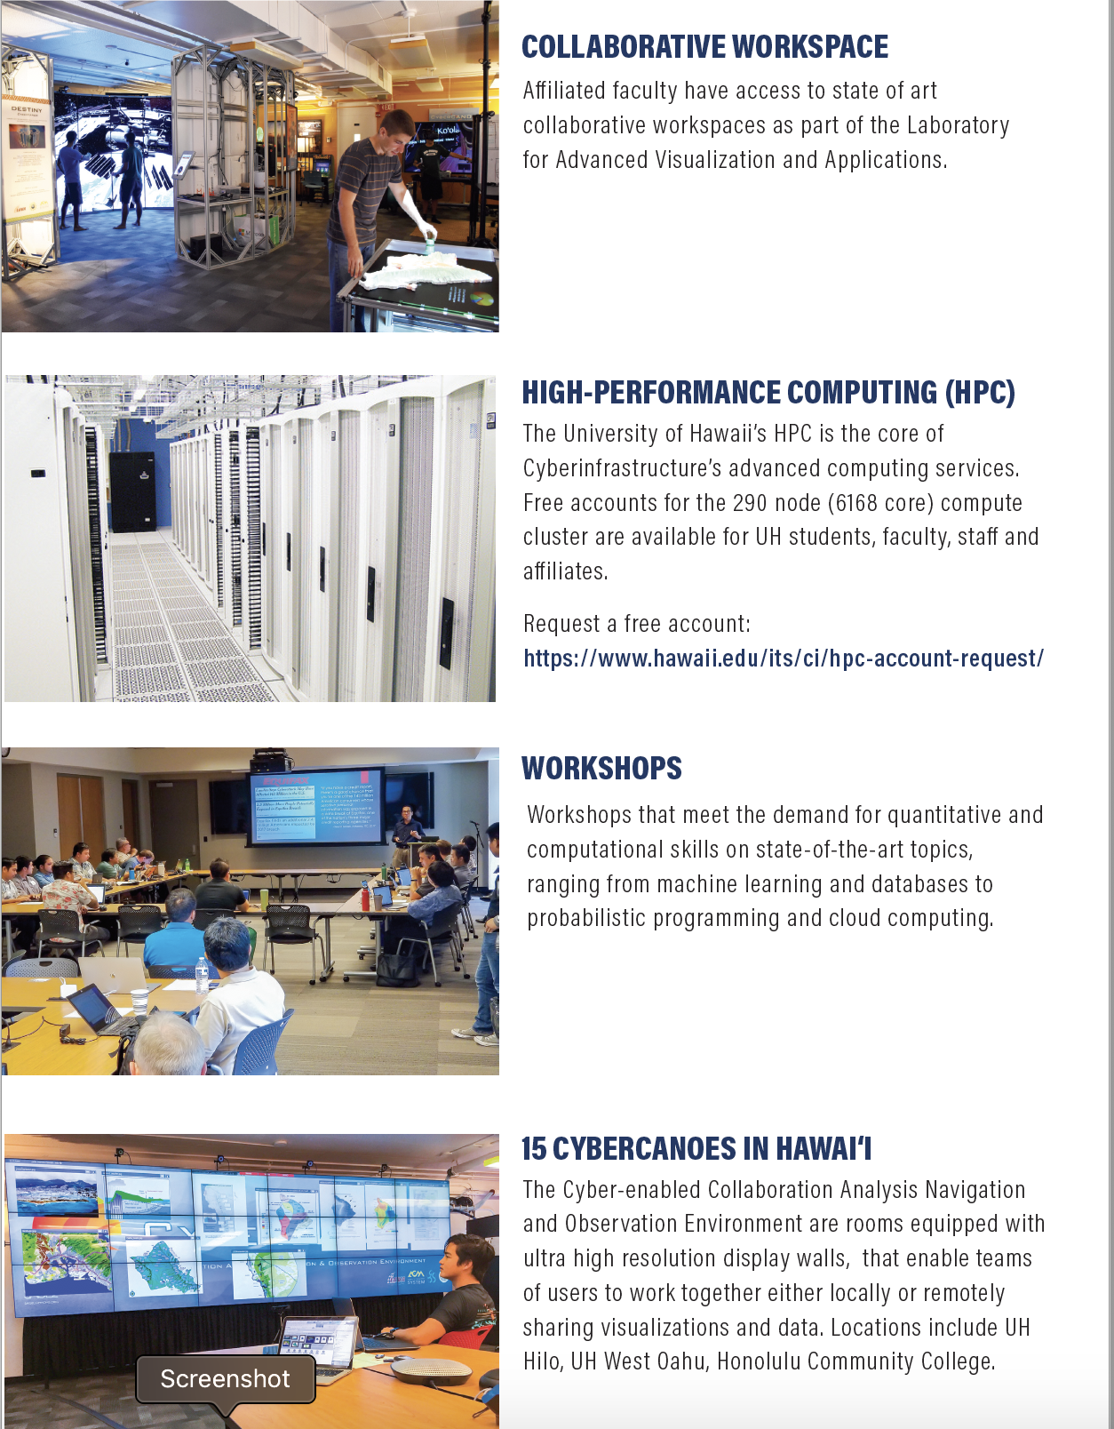
Collaborative Research
AI for Oceanography
Cloud Dynamics and Machine Learning
Deep learning for Particle Physics
C-MAIKI: Microbiome
Smart Yields – data science for precision agriculture
First Hawaiian Bank – data analytics

Slide 6






OUTREACH & INDUSTRY
COLLABORATIONS
We are establishing collaborations to:
  Identify industry-academia research opportunities
  Partner on student internship opportunities.
  Identify core competencies for workforce development

Slide 7
Funding
$1M in seed funding
  Thank you – President Lassner
  and Provost Bruno!
NSF Recommended for funding:
  "MRI Acquisition High Performance Computing Cluster for Data Intensive Research” PI: G. Jacobs, Co-I J. Leigh
    NSF MRI CISE-CNS Proposal #7940775
    Total Award Amount: $ 973,823
    Total Period Covered: 08/01/19 – 07/31/22
    Location of the project: University of Hawai‘i
  “Collaborative Proposal: Frameworks: Project Tapis: Next Generation Software for Distributed Research.
    PI: Stubbs, J Co-Iʻs: G. Jacobs, M. Dahan, S. Cleveland
    NSF OAC – Software Institutes
    Total Award Amount: $4,000,0000
    Total Period Covered: 09/01/2019 – 8/31/24
    Location of the Project: University of Texas – Austin, University of Hawaiʻi

Slide 8
Mahalo!
Contact us: http://datascience.hawaii.edu
Co-Directors:
  Jason Leigh – leighj@hawaii.edu. lava.manoa.hawaii.edu
  Gwen Jacobs – gwenj@hawaii.edu hawaii.edu/epscor

