Slide 1

Welcome!
Annual IT All-Campus Workshop v.2019
Garret T. Yoshimi
gyoshimi@hawaii.edu
VP for Information Technology & CIO
University of Hawaii

Slide 2
Welcome!
ITS Mid-Year Update
Keynote – The Growth of Esports: From Sports Stadiums to College Campuses
Networking Break (Garden Level)
Lightning Round Talks
Lunch (Garden Level)
Agenda (Morning)
Notes:
Introduce guests: Brook, Hillary, Doug (Vince, John), (SiteImprove), (RevaComm)
Keynote: Sky

Slide 3
  Regulations, Compliance & Security: Oh My! (Keoni)
  Web Accessibility through SiteImprove (Pacific)
  The Source Document is Supreme (Asia)
    Bring It On! Open Q&A (Keoni)
    Web Accessibility through SiteImprove (Pacific)
    The Basics of Using Acrobat Pro DC to Create Accessible PDF Documents (Asia)
  BREAK (Garden Level) – 2:15pm-2:30pm
  Regulations, Compliance & Security: Oh My! (Keoni)
  Working in SiteImprove (Pacific)
  Website Accessibility (Asia)
    Bring It On! Open Q&A (Keoni)
    Working in SiteImprove (Pacific)
    Website Accessibility (Asia)
  CLOSING (Keoni) – 3:45pm
Agenda (Afternoon)
Tracks
1A-1:15pm
1B-1:45pm
2A-2:30pm
2B-3:00pm

Slide 4
ITS Mid-Year Update
Garret T. Yoshimi
gyoshimi@hawaii.edu
VP for Information Technology & CIO
University of Hawaii

Slide 5
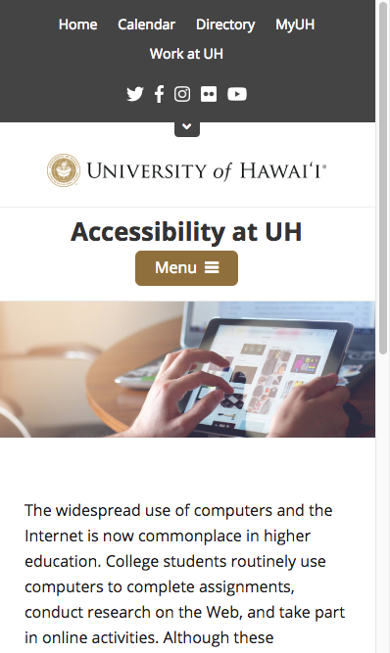
ITSM (Cherwell) Implementation
  Phase 2 – CMDB, incident management expansion
PeopleSoft Upgrade (to v9.2)
Accessibility – VRA Compliance
  SiteImprove
  Adobe DC
  Augusta captioning
UH Online – Systemwide Focus
Security and Compliance
Next Gen Communication Services
Looking Forward, In-Flight

Slide 6
Banner – Piles of Work!
  Persistent refund bug
  Converge with baseline (get out of debt)
Enterprise Reporting
  Jaspersoft
  Report Server
  Visualization, BI and EDW
PIREN Expansion
  Guam (GOREX)
  Adding Australia, Japan, Hong Kong
My Deal With The Devil (Oracle C@C)
And, Security and Compliance
Looking Forward, In-Flight

Slide 7
Holographic presence (e.g., Jedi Council)
  Hawaiki cable system
  American Samoa Community College
Hawaii Data Science Institute (HiDSI)
  Together with LAVA Lab
eSports
Cool Stuff ☺

Slide 8
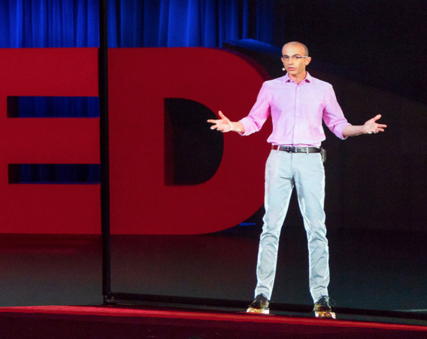
Holographic presence (e.g., Jedi Council)
  Hawaiki cable system
  American Samoa Community College
Hawaii Data Science Institute (HiDSI)
  Together with LAVA Lab
eSports
Cool Stuff ☺

Slide 9
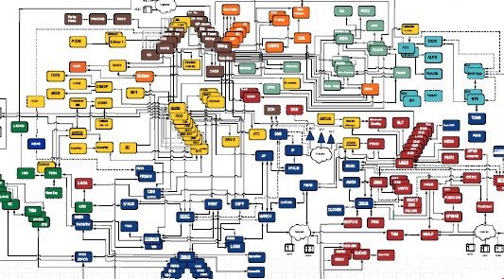
Keeping Up with Demand
Enterprise Applications
Integration – All-to-All
Impacts of Change
Analytics
Workforce!
Looking Forward
Scary Challenges

Slide 10
Even Cooler Stuff!

Slide 11
Serving Our 80,000+ Global Customers
  Students
  Faculty
  Researchers
  Staff
  Collaborators
  Community
Always On – 24x7
Thank You!
Even Cooler Stuff!
Notes:
Ralph Yoshioka: Willard Wilson Award
Allie Tsuruda: WINS SC19 on the routing team for the SC19 conference network

Slide 12
Questions?
Garret T. Yoshimi
gyoshimi@hawaii.edu
VP for Information Technology & CIO
University of Hawaii
Notes:
Note: GA/MFH update

Slide 13
Thank You!
And On With The Show!

