Slide 1
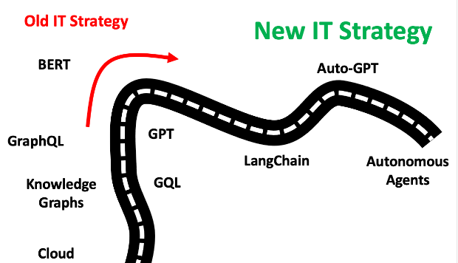



Welcome!
University of Hawaiʻi
State of ITS 2024
Mid-Year ITACW
Hawaiʻi’s University for Today and Tomorrow

Slide 2

2024 State-of-ITS and Mid-Year ITACW Agenda
10:00am Welcome & Webinar Logistics
10:05am State of ITS 2024
Garret Yoshimi, VP for IT & CIO
10:45am Open Forum Q&A
11:00am LMS Migration
Gloria Niles, Director, Online Learning
11:20am Break
11:30am ITS Strategy Update
12:00pm InfoSec + Data Governance + Compliance
12:30pm Wrap-Up and Closing
Notes:
Opening remarks:
LOGISTICS – food, restrooms, breakout rooms upstairs; wireless UHM
Welcome / thank you / agenda (talk about ad hoc meeting space); describe/walk-though breakouts A/B/C
Theme – reset, restore, reinvigorate IT
Reminder: Cybersecurity – highest risk for the institution, we must do better. Back-to-back catastrophic incidents, integral to our remediation efforts are increase presence, awareness and actions going forward; Jodi and her folks will dive into the details today, we’ve dedicated a large portion of our time together to update everyone, and to be available to answer questions. We will move to impose greater standardization and oversight of all critical infrastructure, in particular any assets holding sensitive and regulated data ---

Slide 3

Notes:
Placeholder to switch to Jason
It’s my pleasure to introduce our keynote session – Jason Leigh, Professor, ICS, UH Manoa
Jason is a global leader in data visualization
He’s the Director of the Laboratory for Advanced Visualization and Applications – the famous LAVA Lab … located in former ITS Systems space on the first floor of Keller Hall
Jason is also the Co-Director of the Hawaii Data Science Institute
He’s the co-inventor of the CAVE2 Hybrid Reality Environment, and SAGE: Scalable Adaptive Graphics Environment software

Slide 4

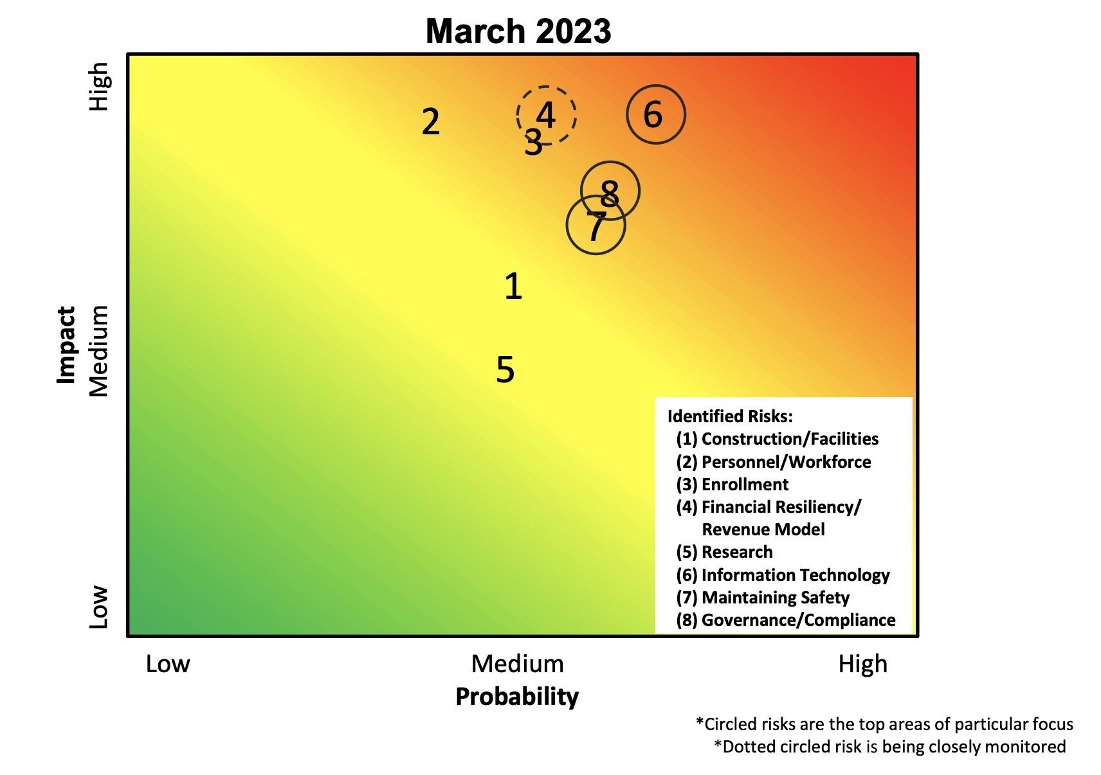
Hawaiʻi’s University for Today and Tomorrow

Slide 5
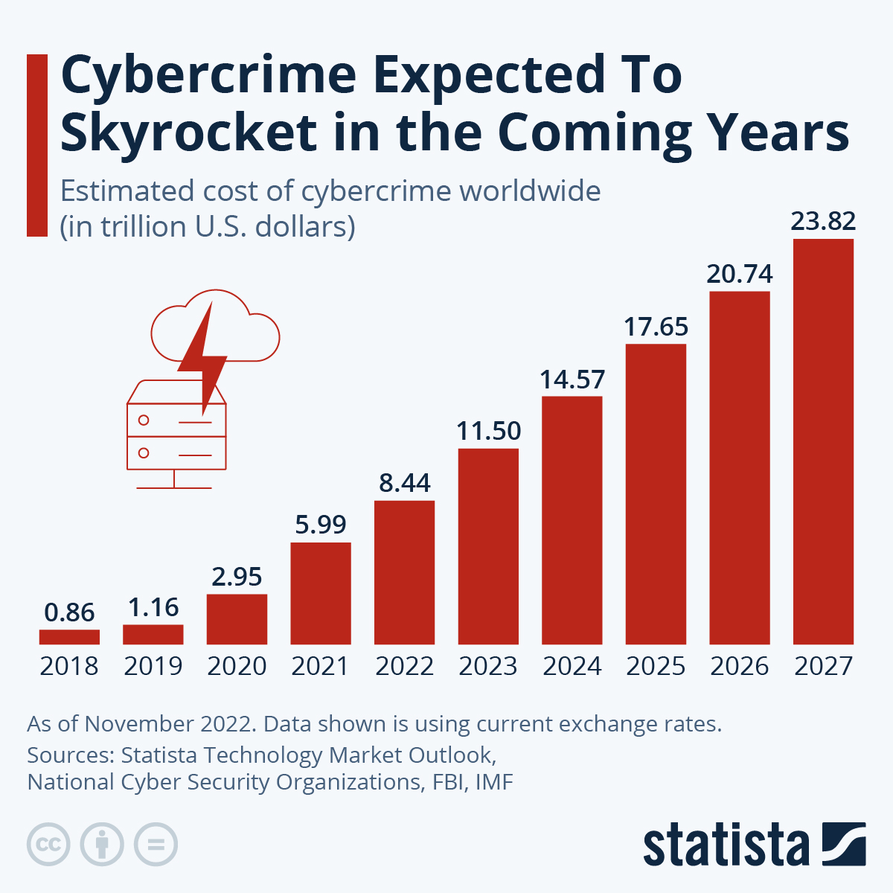
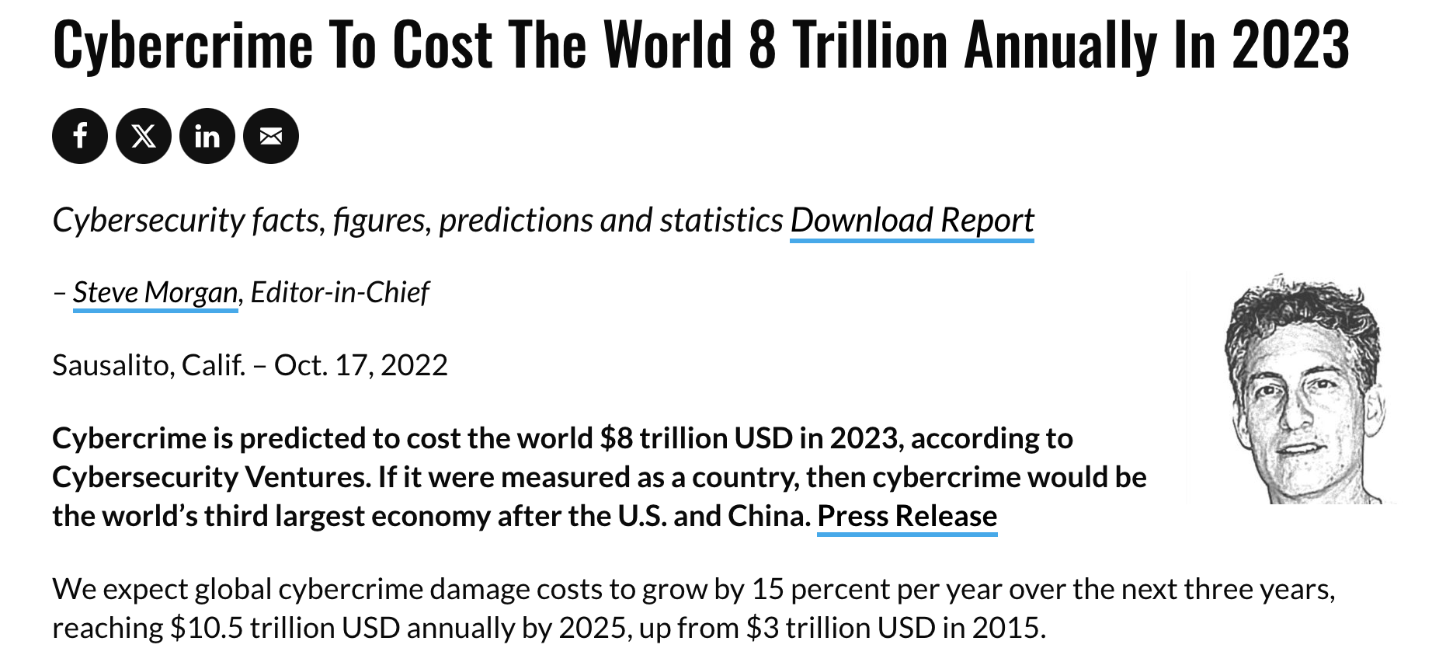
Hawaiʻi’s University for Today and Tomorrow

Slide 6
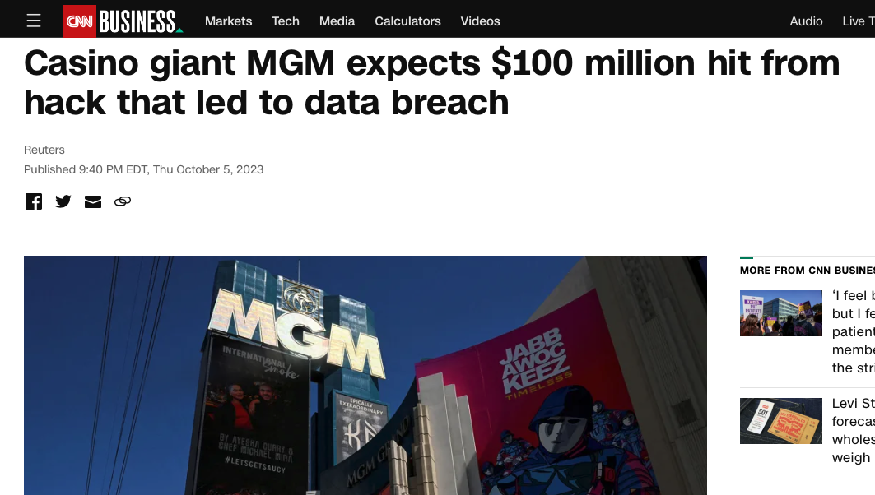
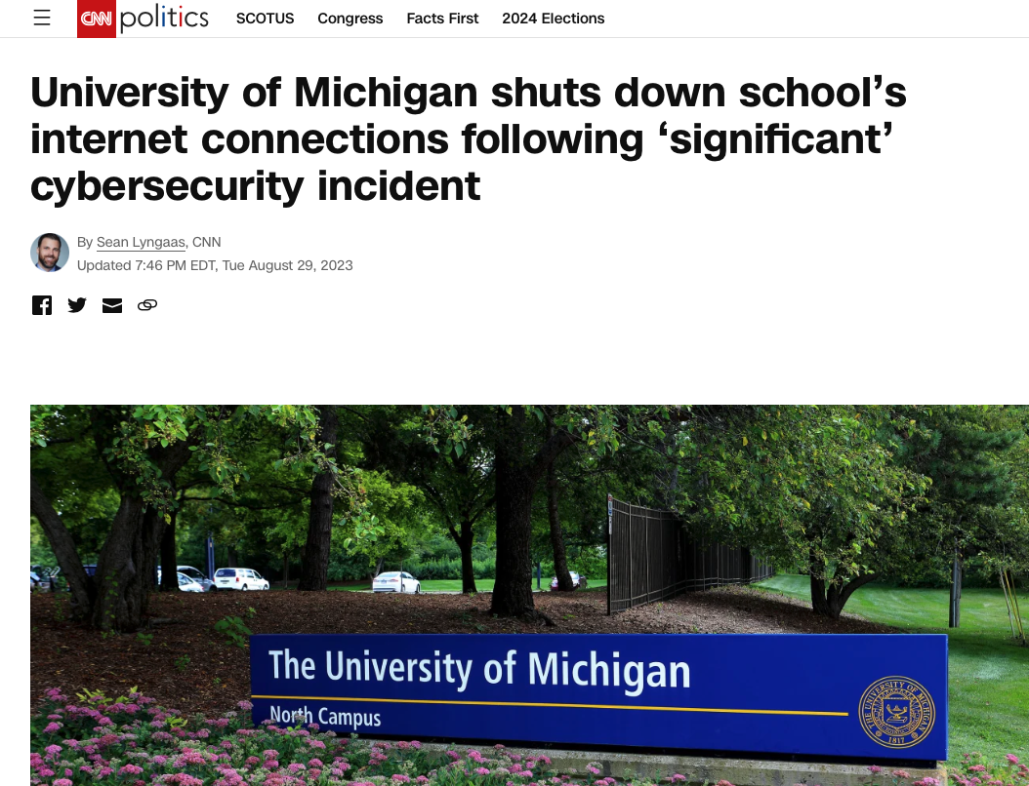
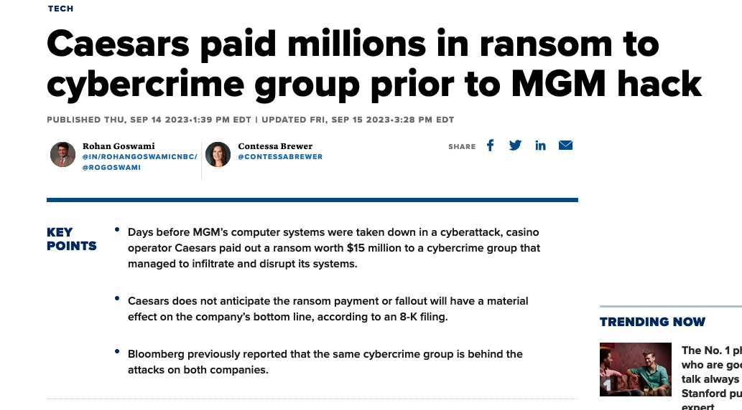
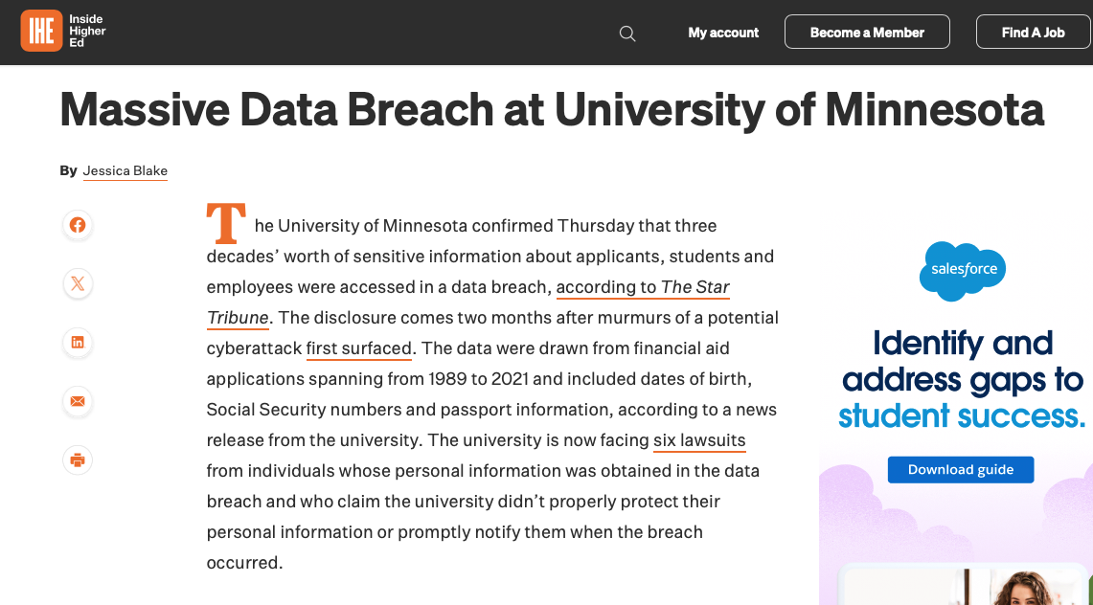
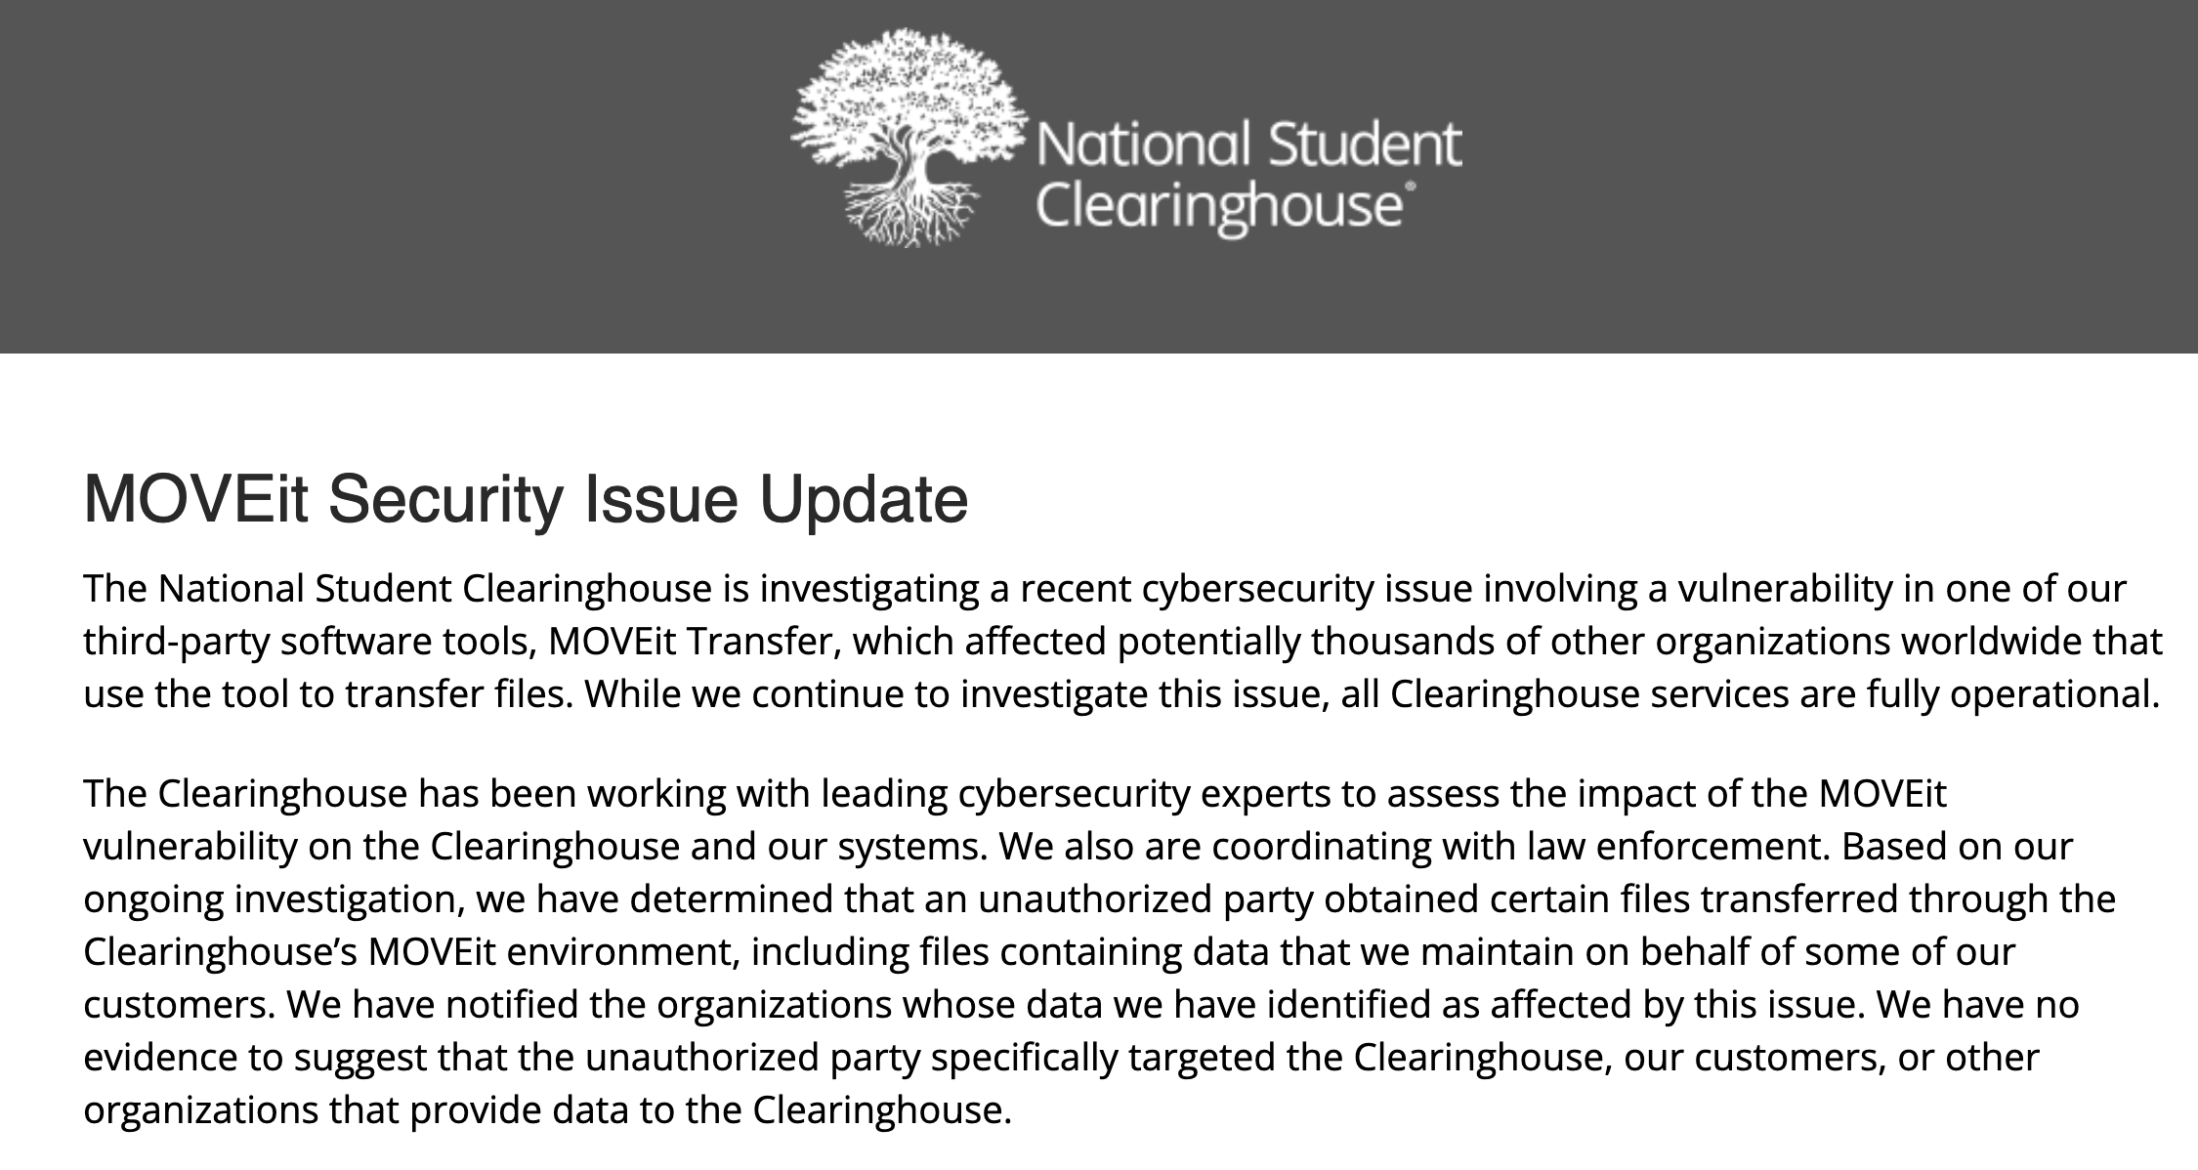
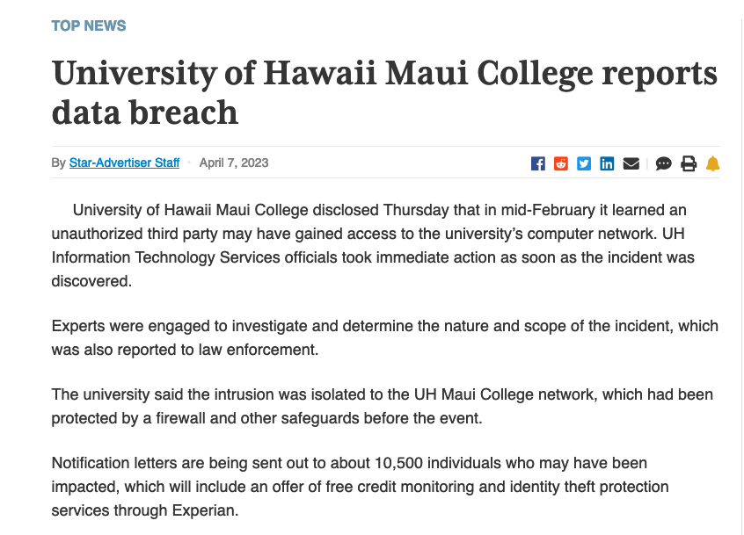
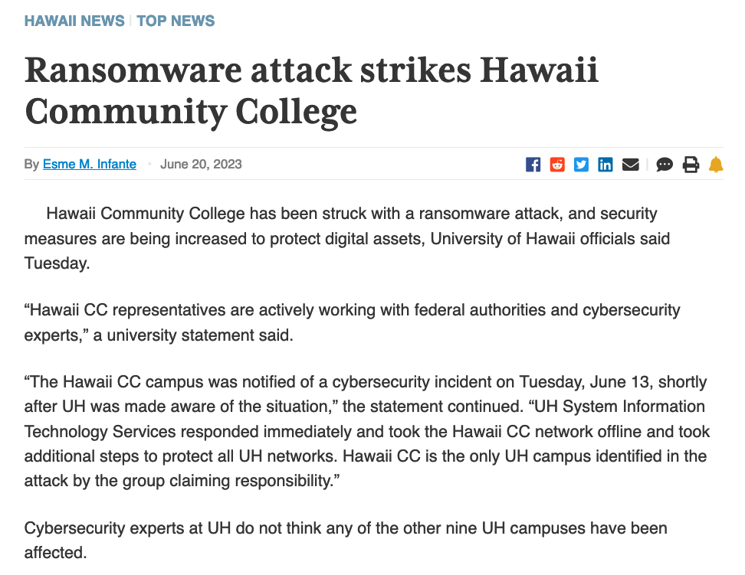
Hawaiʻi’s University for Today and Tomorrow

Slide 7
Hawaiʻi’s University for Today and Tomorrow
2023 – Post Pandemic “Normal”
AY 2023-24 – “New Normal” On-Campus and Online Activity in Flux
Pressure on Enterprise Applications to be more responsive AND adaptable AND pretty AND Amazon-like
Pressure on Infrastructure and Performance
CyberSecurity AND Compliance … Pressure!
  Increasing Global Threats – WHEN, NOT IF
  Increasing Compliance and Governance Requirements
  More in Jodi and Sandra’s Segment Towards the End of the Program
Notes:
Change is the NEW NORMAL
PRESSURES - external and internal, no such thing as doing more with less

Slide 8
Hawaiʻi’s University for Today and Tomorrow
2023 – Post Pandemic “Normal”
Changing Faces Throughout ITS, Campus IT and the IT Industry
Future of Work and IT Workforce
Growing Our Own UH Systemwide Talent Pipeline – Long-Term Solution
Infrastructure + Enterprise + Research
Keeping the Lights On
And Just In Case There’s Not Enough to Do … AI
Notes:
RETIREMENTS … we are working on removing any words starting with “R” in systemwide policies and procedures
Only marginal success in recruitment, except at entry level; pivot to growing the skills, apprenticeship program

Slide 9

Hawaiʻi’s University for Today and Tomorrow
2024 – Looking Forward
Focus + Value + Alignment
Invest in Talent – INTERNAL + ENTRY LEVEL + STATEWIDE POOL
(Remember Succession Planning!)
Mission Critical 2024 NEW Projects
  LMS – It’s Time!
  Baselining Banner, Migration for KFS and ODS
  Expanding Research Engagement
  Working with the “new” Google
  Infrastructure Mixed Private Cloud
  Institutional AI – Building Talent and Resource Pool
  Security-Security-Security + Compliance
AND, Continuing to Keep the Lights On + Our SECOND Decade @ ITC
Notes:
Watchful eye on Pres search
ITS recruitments

Slide 10
Open Forum – Q&A
Drop questions in the Q&A box
We’ll try to keep up!

Slide 11

LMS Migration
Dr. Gloria Niles, Director, Online Learning
Drum Roll Please …

Slide 12

Projected Brightspace by D2L Implementation Strategy
Goal: Full migration to Brightspace by D2L for all courses by Fall 2025
Units: UHCCs, UH Hilo, UH Mānoa, UH West Oʻahu - 2 units per cohort. Cohorts will be determined in consultation with campus administration and announced once determined.
Spring 2024
Jan - Mar
Summer 2024
Apr - Jul
Fall 2024
Aug - Dec
Spring 2025
Jan - May
Summer 2025
May - Jul
Implementation planning
Sandbox environment & summer pilot
Cohort 1 Migration
Cohort 1 Implementation / Cohort 2 Migration
Transition to Laulima archive, and new LMS full implementation
Architecture, network, security, data strategy, technical migration and SIS integration, support structure. Recruit summer pilot.
Sandbox environment of the LMS open to all faculty, introductory training videos for faculty & students, voluntary cohort of summer classes offered as pilot.
Units opting for cohort 1 content migrated in Fall 2024, Spring 2025 course shells open, all courses taught in new LMS Spring 2025.
Units opting for cohort 2 content migrated in Spring 2025, course shells open, all courses taught in new LMS Summer or Fall 2025.
Review Spring 2025 implementation. Most summer 2025 courses taught in new LMS. Laulima archived. All courses taught in new LMS by Fall 2025.

Slide 13
10 Minute Break
Notes:
Run memes

Slide 14

UH System Strategic Plan https://www.hawaii.edu/strategic-plan/
Foundational Principles
Hawaiian Place of Learning
Statewide Need
Diversity and Equity
Sustainability
Stewardship of Resources
Imperatives
Fulfill Kuleana to Hawaiians and Hawai‘i
Develop Successful Students for a Better Future
Meet Hawaiʻi Workforce Needs of Today and Tomorrow
Diversify Hawaiʻi’s Economy through UH Innovation and Research
Notes:
Let’s look at the guidance – the Foundational Principles and Imperatives – that our efforts should be fully aligned with going forward.
Rather than restarting a separate IT Strategic Plan, this year, we’ll look to work on alignment, of current and planned efforts, to make sure the work of IT is “aligned” and “on mission”
Thinking about these as our core guide RAILS (sorry, couldn’t help it ☺ … all of our major efforts will align with these Foundational Principles and Imperatives

Slide 15


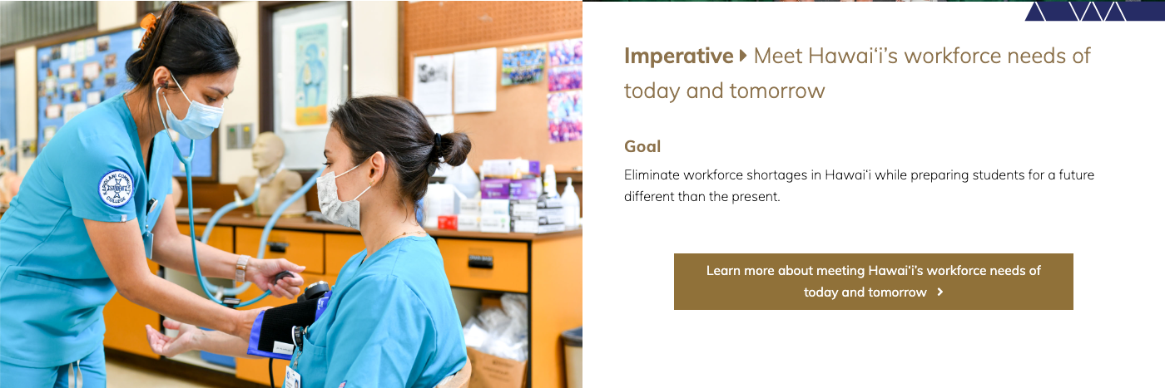
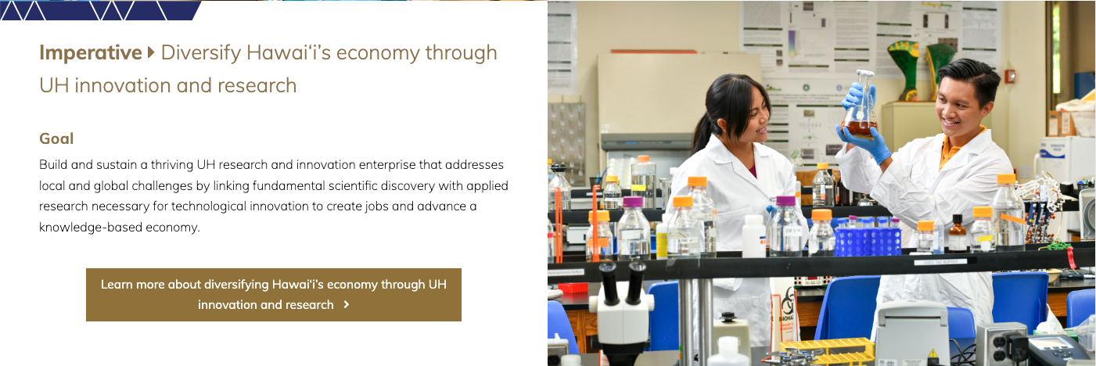
Notes:
Many of our efforts are foundational for all of the imperatives … Core infrastructure, operations, help desk, online learning, administrative functions, classroom infrastructure, cybersecurity, infrastructure resilience > student success, innovation and research
Enterprise apps back-to-baseline > student success
LMS Replacement > student success (and maybe a little bit of kuleana)
Leap-Start program > workforce and student success
Research cyberinfrastructure > innovation and research
Hawaii DSI, LAVA, AI initiatives > innovation and research, workforce
eSports > student success, workforce
Cybersecurity, host and AD management = preparation, threat mitigation, incident response
.. Host consolidation, managed services
.. AD management and exposure mitigation
.. Extending infrastructure to the public cloud
.. MFA for all
.. Proofpoint
… AND, since we have a couple of opportunities to talk strategy further this afternoon, I’d like to drop a special added piece this morning …

Slide 16
ITS Strategy – Align
ITS Strategy Guiderails
Guided by the UH System Strategic Plan
Everything-Everywhere InfoSec Program
Prediction: Mostly Cloudy …
… with Decreasing Chance of Snow(flakes)
Build (Our) Future Workforce
Keep the Lights On
Manage Value (** NOT just CHEAP)
UH System Foundational Principles
Hawaiian Place of Learning
Statewide Need
Diversity and Equity
Sustainability
Stewardship of Resources
Notes:
Mostly Cloudy with a decreasing Chance of Snow
** Balanced cloud strategy – NOT 100% Cloud
.. Performance AND Value
.. Cost Leverage (against Cloud inflation)
** Exit the Custom Application Business
.. Back to Baseline efforts (Banner)
.. Migration to SaaS (LMS, KFS, ODS)
** Enterprise SaaS

Slide 17
ITS Strategy – Align and Execute
Imperatives
Fulfill Kuleana to Hawaiians and Hawai‘i
Develop Successful Students for a Better Future
Meet Hawaiʻi Workforce Needs of Today and Tomorrow
Diversify Hawaiʻi’s Economy through UH Innovation and Research
Strategic Execution
Security – Risk Awareness, Responsibilities, Incident Response; Infrastructure Consolidation
COTS/SaaS Migrations – LMS/Laulima, KFS, ODS
Infrastructure – Achieving Cloud Balance
Workforce Initiatives – Leap-Start, Building Pipeline and Programs, AI, Analytics, Integration, eSports
Leverage Research Activity – Data Science, Broadband
Notes:
Let’s look at the guidance – the Foundational Principles and Imperatives – that our efforts should be fully aligned with going forward.
Rather than restarting a separate IT Strategic Plan, this year, we’ll look to work on alignment, of current and planned efforts, to make sure the work of IT is “aligned” and “on mission”
Thinking about these as our core guide RAILS (sorry, couldn’t help it ☺ … all of our major efforts will align with these Foundational Principles and Imperatives

Slide 18
Shared ITS Strategy Collaboration https://docs.google.com/document/d/1vP0qxi15AdHQEdtavx9PILtRwooc-tZCVhJrWB1pRG0/edit?usp=sharing
Please Join Us in the Document

Slide 19
InfoSec + Data Governance

Slide 20
Thank you for participating!
Feedback and comments to itwkshop@hawaii.edu

Slide 21
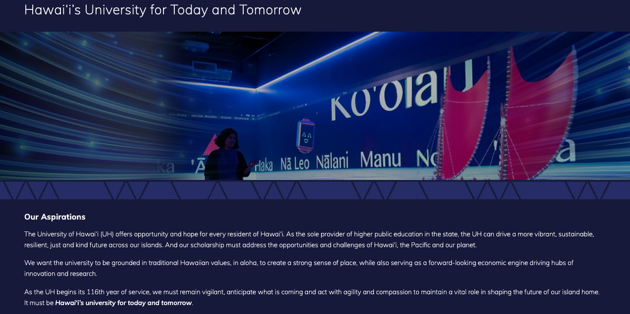

Slide 22


ITS Strategic Plan
ChatGPT: Please craft a modern IT strategic plan for a public higher education institution
Notes:
Last material update was 2018-2019, with almost no material feedback/comments/inputs
Then there was COVID, we paused any thoughts with the pandemic pivot
In 2021-2022, we continued the pause with the new UH System strategic planning effort
Since we’re on a “pause” … there was the opportunity to see what ChatGPT might do to generate a plan … not terribly bad …
With the new UH System strategic plan in place, presented by Deb Halbert in January with our traditional State of ITS conversation … we’re looking to directly align everything that we do, to the newly published UH System strategic plan. We have two open discussion / breakout sessions this afternoon – those interested in attending should come to the sessions to discuss approaches for ITS to improve overall alignment with the UH System strategic plan, including projects, organization, and service delivery.
IN ADDITION TO THE PROJECTS AND INITIATIVES TO SUPPORT THE UH SYSTEM STRATEGIC PLAN, we must take significant actions to improve our institutional security posture, in particular to address server and file share operations for distributed units, use of Active Directory, and systemwide visibility for our InfoSec team to support protection and prevention related to institutional assets and data … POINT TO JODI …
Continue regular webinar briefings - including at this annual event
In person visits for inspection, remediation, training, and consultation to support distributed IT units
External penetration testing, by unit, by campus
Centralization of host resources and critical data storage infrastructure

