Slide 1
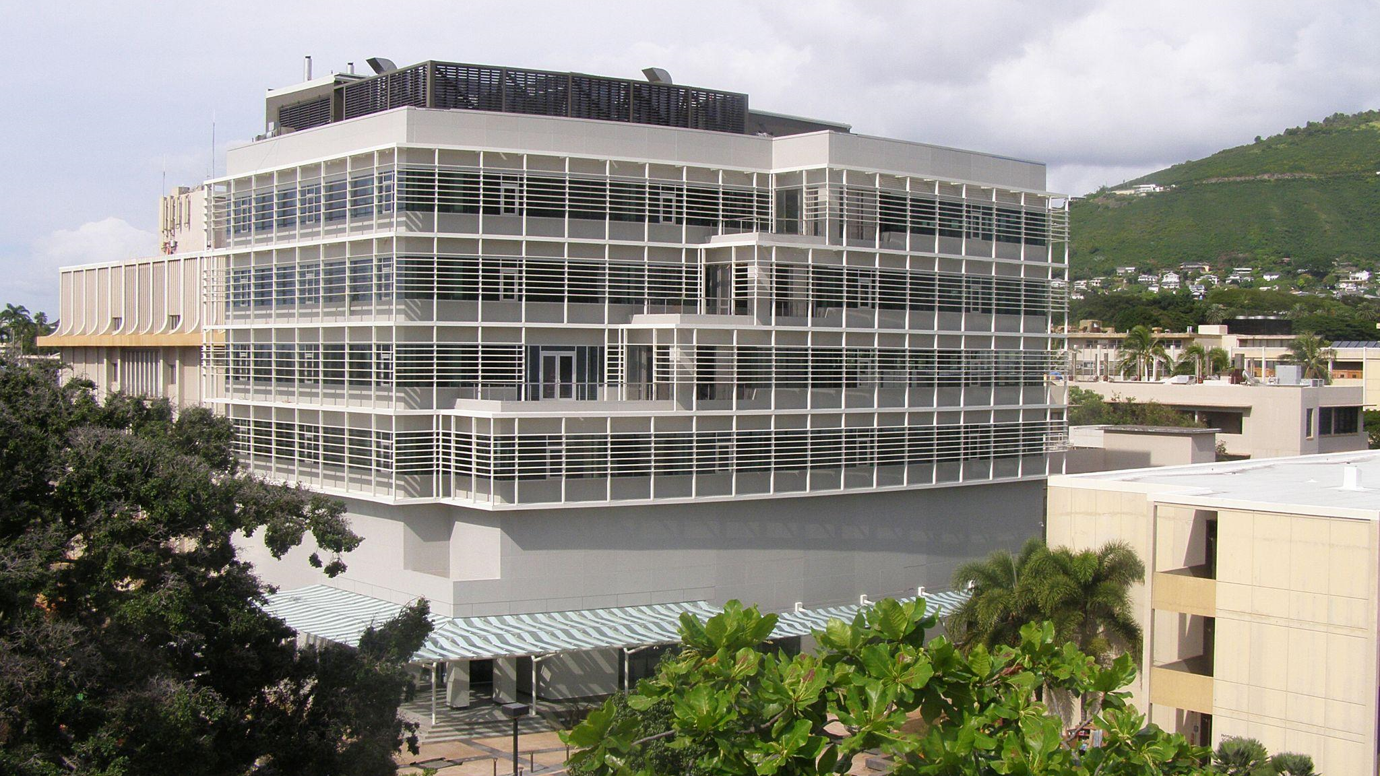
Information Technology Services CYBERINFRASTRUCTURE
Dr. Sean Cleveland
Acting Director of Cyberinfrastructure

Slide 2
ITS Cyberinfrastructure Team
Sean Cleveland, PhD - Acting Director of Cyberinfrastructure
Ron Merrill, PhD - High Performance Computing
David Schanzenbach - Lead Software Architect
Maria Dumanlang - Communications and Graphic Design
Candace Edwards - Project Administrator
Shivana Tanaka - Manager of Student Research Programs
Adriana Comerford - IT Specialist
Jennifer Geis -Cyberinfrastructure Software Engineer, Data Engineer
Jared McLean - Research Software Engineer, Data Visualization Scientist
Andy Yu - Research Software Engineer, Data Scientist
2-6 Graduate & Undergraduate students

Slide 3
Topics
Cyberinfrastructure Updates
Research Update
The Hawaii Data Science Institute Updates
Google Cloud Accelerator Program

Slide 4
ITS Cyberinfrastructure Team
Gwen A Jacobs, PhD - Director of Cyberinfrastructure
Sean Cleveland, PhD – Assoc. Director – Cyberinfrastructure Research Scientist
Ron Merrill, PhD - High Performance Computing
David Schanzenbach - Lead Software Architect
Maria Dumanlang - Communications and Graphic Design
Michelle Choe - Program Manager
Shivana Tanaka - Manager of Student Research Programs
Jennifer Geis -Cyberinfrastructure Software Engineer, Data Engineer
Jared McLean - Research Software Engineer, Data Visualization Scientist
Alan Tsang - Research Software Engineer, Data Scientist
2-6 Graduate & Undergraduate students

Slide 5
What is Cyberinfrastructure?
Cyberinfrastructure refers to the integrated computing systems, data storage and management facilities, advanced instruments, visualization environments and the people who operate and manage them. They are all linked together by software and high-performance networks to improve research productivity and enable breakthroughs not otherwise possible.

Slide 6
Mission
Cyberinfrastructure’s (CI) mission is to support data intensive research and scholarship at UH with state of the art resources, services and expertise
Our focus
Advanced research computing (above the desktop)
Data
Science as a service
Collaborative research
Serving the entire UH System
Since 2014

Slide 7
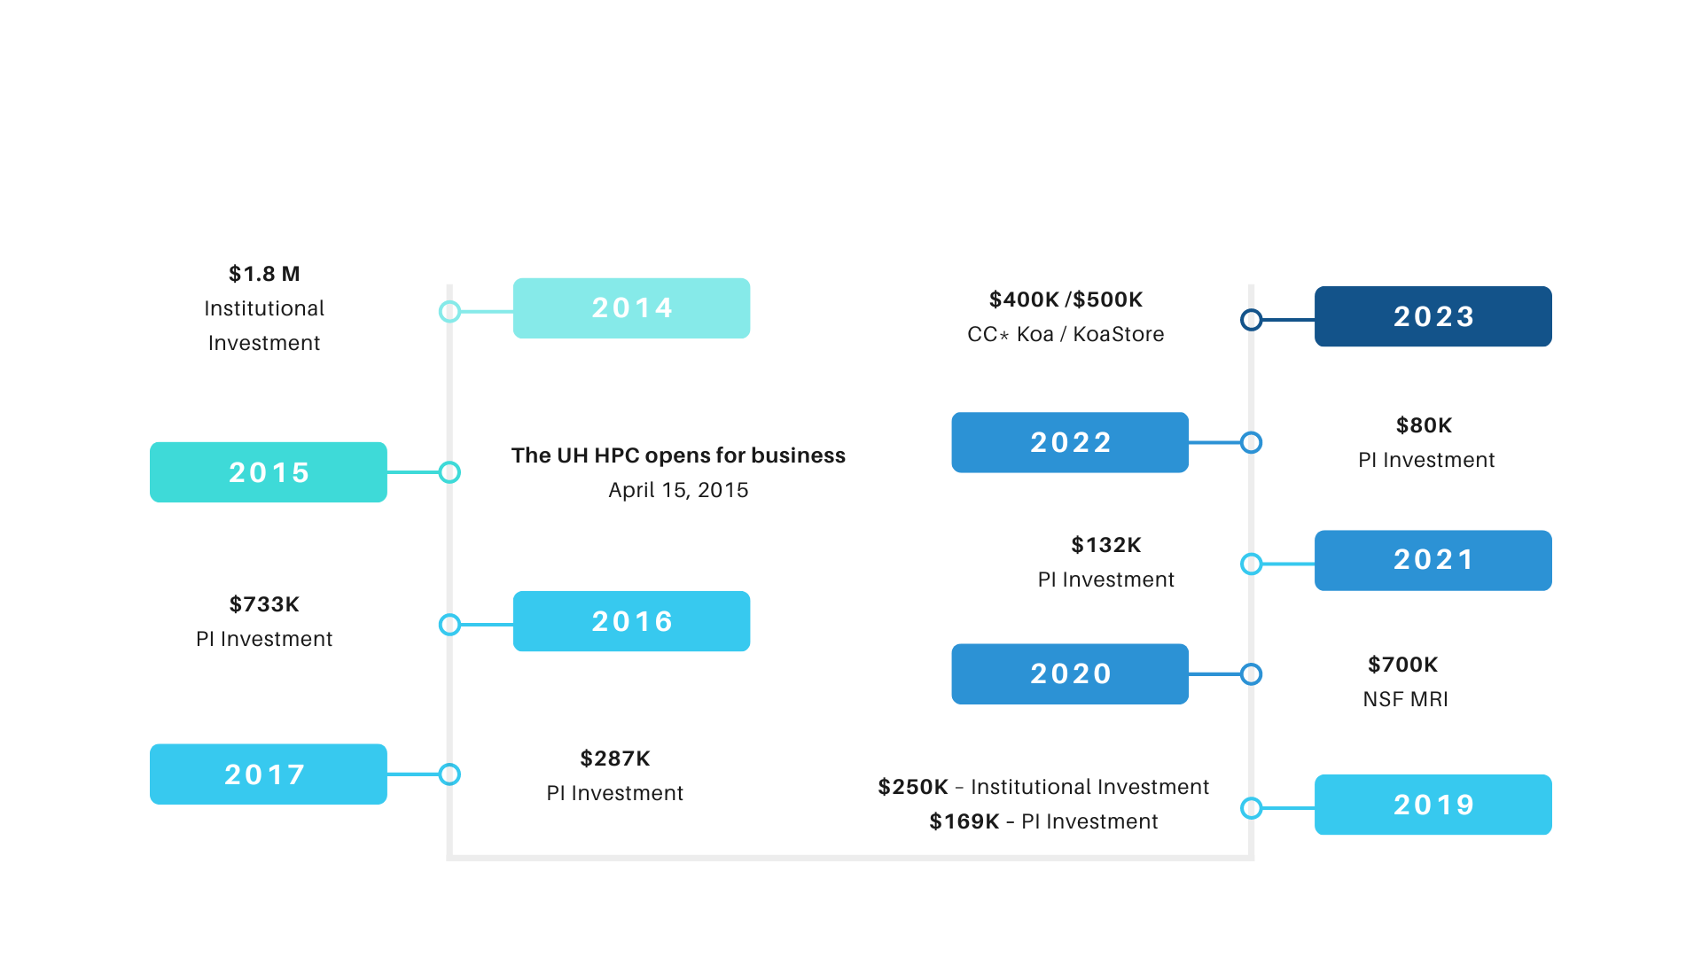
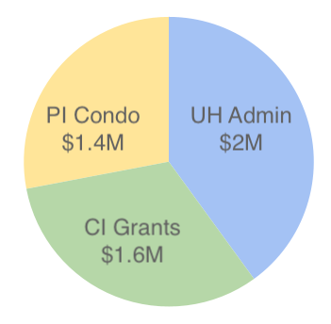
Compute Services
`Ike Wai Scholars
Data Science Fellows
$5.2M

Slide 8
Compute Services
`Ike Wai Scholars
Data Science Fellows
Koa - High Performance Computing (HPC) Cluster
FREE to use for UH faculty, students, staff and affiliates
$5.2 Million in Grant, Researcher and Institutional funds invested since 2014
Koa by the numbers
271 Compute Servers/Nodes
120 GPUs
7,746 cores
62.28 TB of memory
Storage:
50 GB per user home
500 GB per lab
800 TB of scratch
167 user active per month
Faculty, Staff and Departments can invest in Koa by …
Lease community nodes on a per month timeframe
Purchase nodes to integrate into Koa

Slide 9
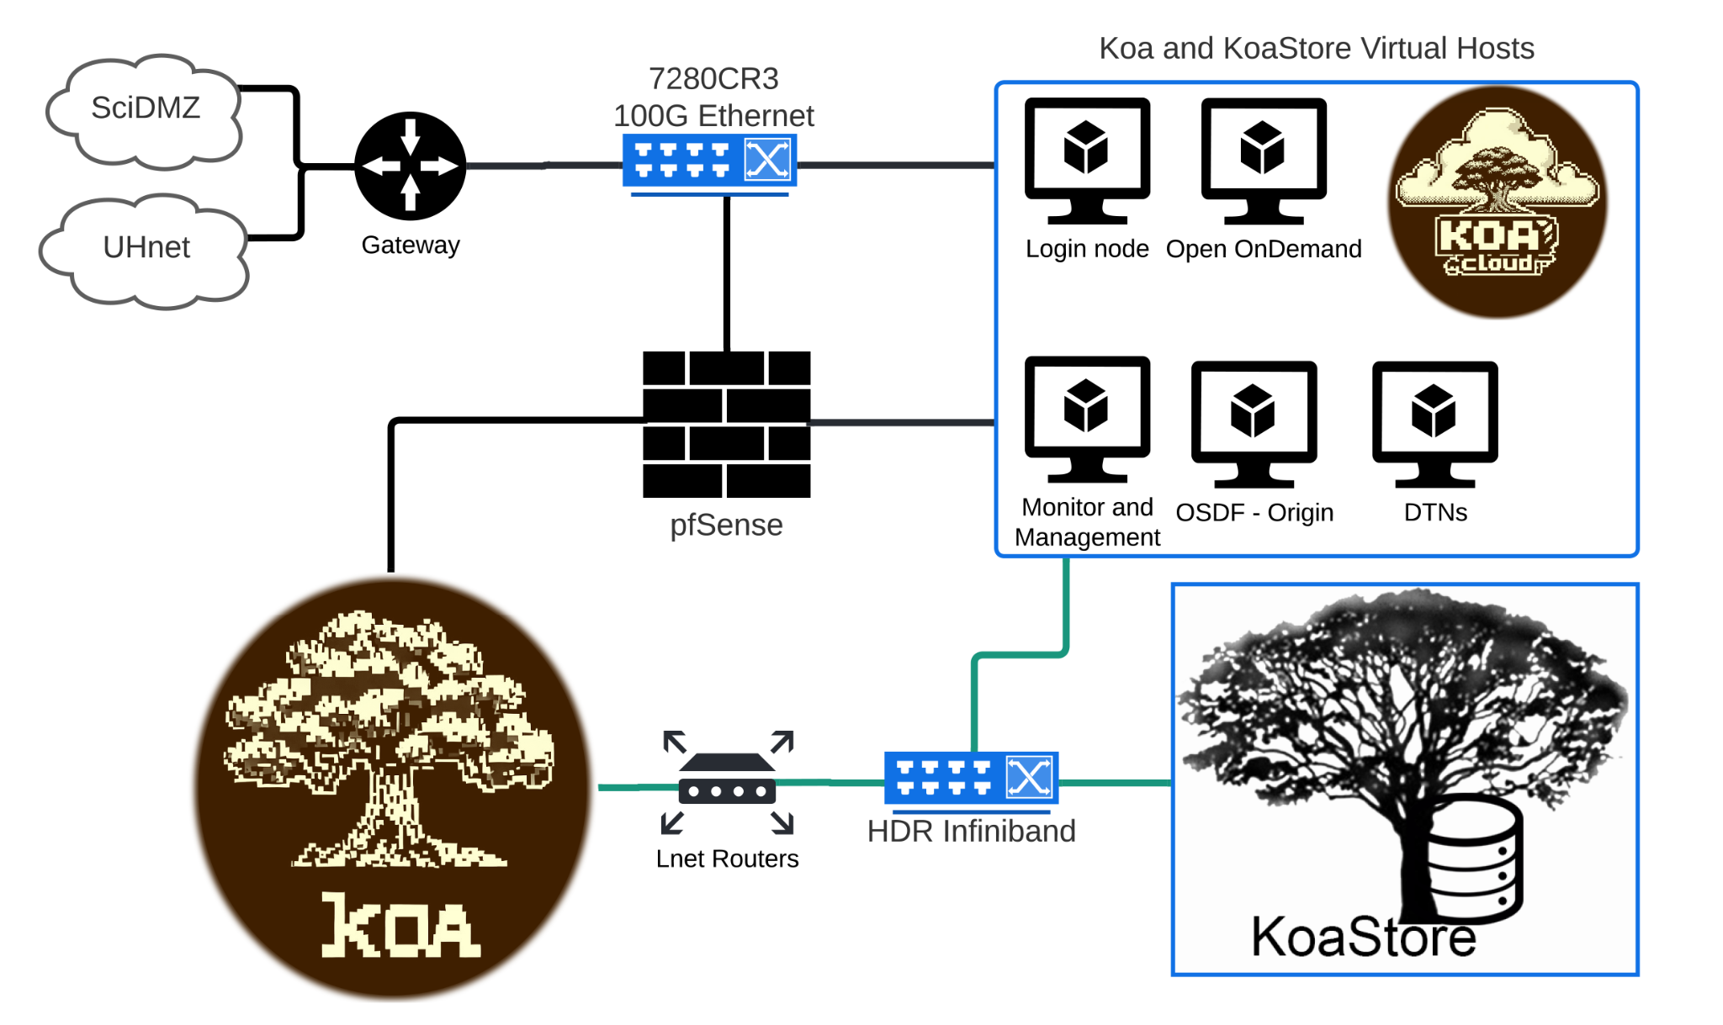
Compute Services
2024 Koa & KoaStore Added
`Ike Wai Scholars
Data Science Fellows
FREE!!! TO UH Faculty/Researchers/Students/Staff!!!!!
30 more GPUs
10 A30 & 20 A4000
720 more high speed CPU cores
750TB more scratch storage
5 more PBs of high-speed storage
(up to 9x faster than previous)
NSF CC* 2022 Awards
-Koa $400K
-KoaStore $500K

Slide 10
We Support Science
435 Active Researchers last year used Mana to support their science
From 128 Departments across 8 Disciplines and 6 Campuses
> 88 research papers acknowledge Mana in enabling the research

Slide 11
Compute Services
2024 Cray Retirement
`Ike Wai Scholars
Data Science Fellows
Shutdown 108 Cray Compute Servers/Nodes
Retired the MANA name
Will retire more of the legacy Cray infrastructure this year.

Slide 12
Compute Services
2024 Highlights
`Ike Wai Scholars
Total Users
CPU Hrs Used
Avg Job Wait
1,390
35.1M
9.5hrs
12.3%
10.7%
-4.7%
Active Users
GPU Hrs Used
Publications
435
608K
36
15.3%
54.4%
176%

Slide 13
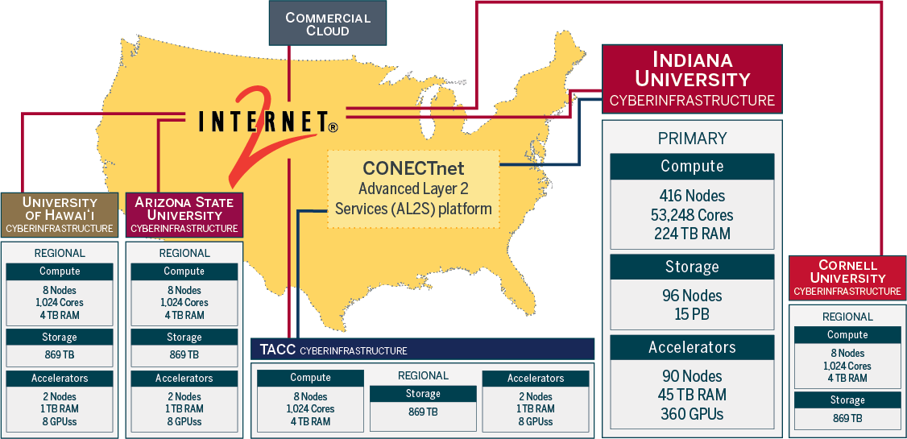
`Ike Wai Scholars
Data Science Fellows
Compute Services
Notes:
Ron End

Slide 14
Compute Services
National Resources
Data Science Fellows
`Ike Wai Scholars
National NSF cloud computing - Jetstream2
UH has a regional portion of the Jetstream2 Cloud
https://jetstream-cloud.org/
National HPC resources - ACCESS
We help with initial access and getting allocations to these resources and helping researcher get their codes running
https://access-ci.org/

Slide 15
Data
Storage Services
`Ike Wai Scholars
Data Science Fellows
Koa Research Storage
A cheap and deep scalable storage system to meet researcher storage demands
Appropriate for research data that is not classified as UH Protected data
Current capacity: 6+ PB
New in 2024 - Served in Two Flavors
KoaCloud:
Dropbox like storage powered by Nextcloud
Remote network share, sync and web client
Leased in 1 year increments at $55/TB/yr
KoaStore:
Additional permanent storage for use on Koa
Leased in 1 year increments at $50/TB/yr
0.6 PB Allocated
1.7 PB Allocated

Slide 16
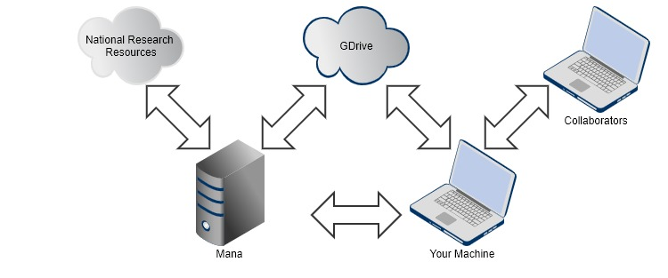
Data
Transfer Services
Data Science Fellows
`Ike Wai Scholars
Help Researchers:
Trouble moving data?
Data transfers slow?
Need to move a lot of data?
Globus
UH System has a subscription for additional features
Access granted for free upon request
Enables the ability to share files/folder on your laptop with other Globus users
Robust data transfer - can resume large transfers
Can transfer from laptop to Koa, or other major resources NCAR/ACCESS etc
Data Transfered
Cloud
627TB
44.7%

Slide 17
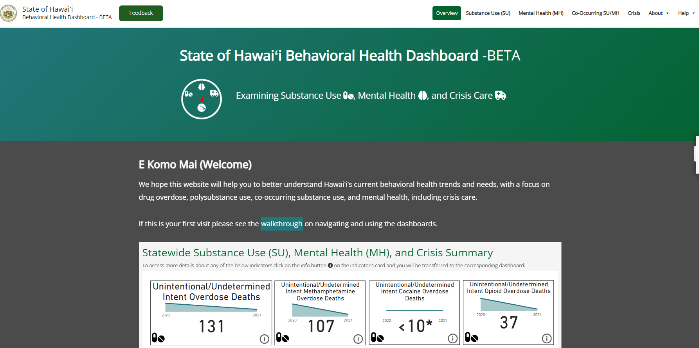
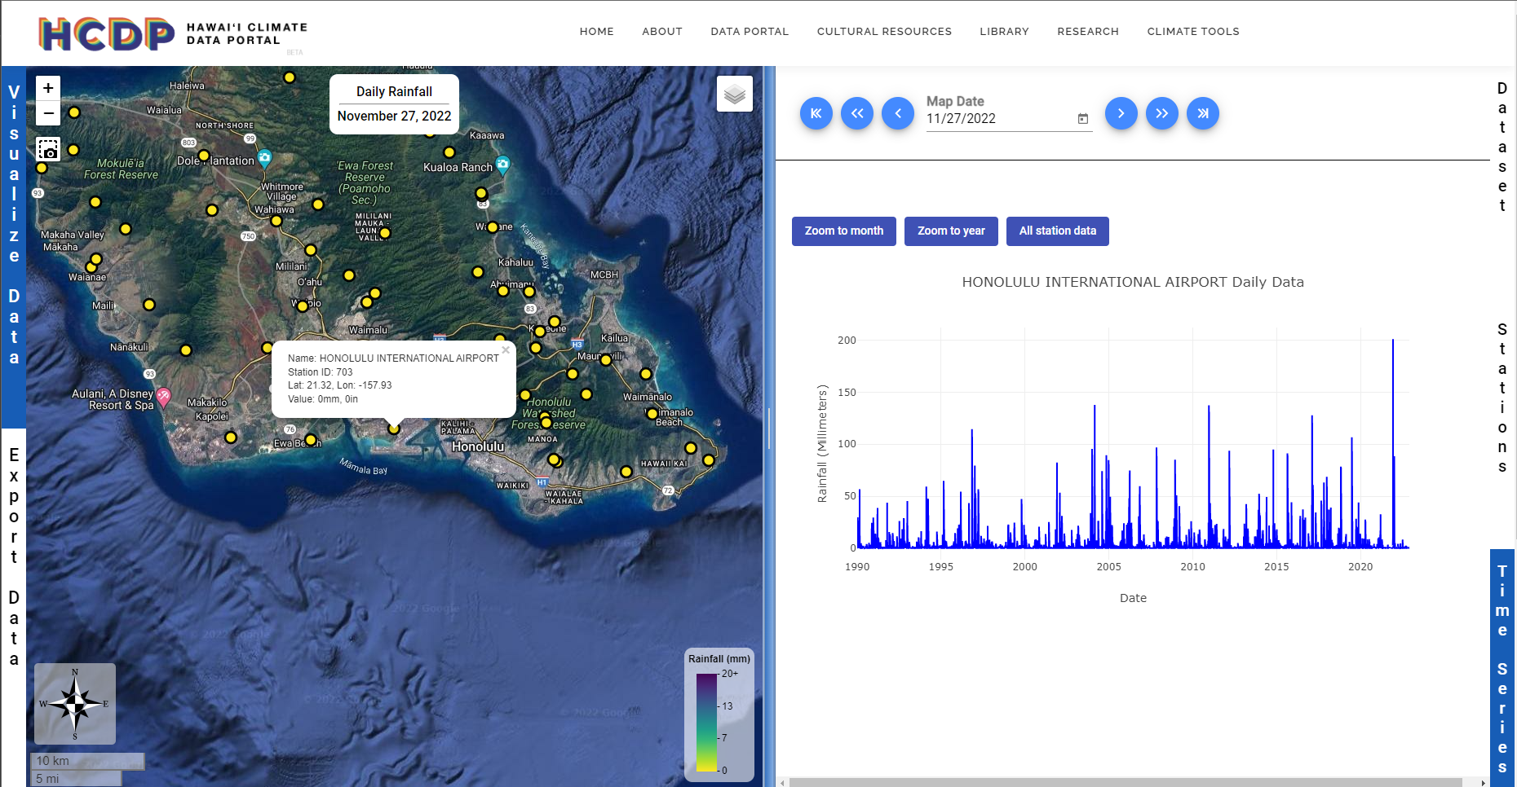
Software Engineering &
Data Science Services
Data Science Fellows
`Ike Wai Scholars
Access professional research software engineers & data scientists
Access graduate data fellows
Highlighted Projects
State of Hawaiʻi Behavioral Health Dashboard
https://bh808.hawaii.gov/
Hawaiʻi Climate Data Portal
https://hawaii.edu/hcdp

Slide 18
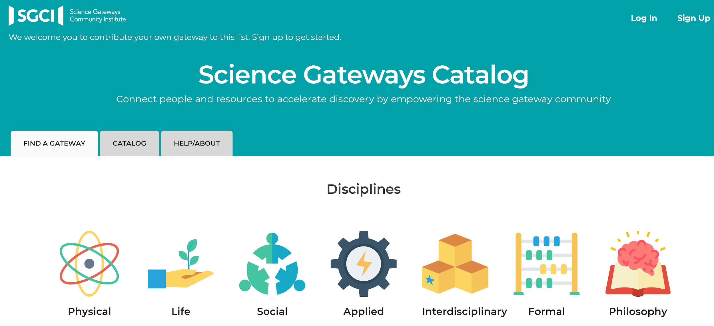
Software Services
Data Science Fellows
`Ike Wai Scholars
Science Gateways
Bringing together data, software and resources related to domains or communities
Help with Data Management Plans
Making data FAIR: Findable, Accessible, Interoperable, Re-usable
Help with Reproducibility
Scientific container environments to combine dependencies, data, code and results

Slide 19
Research Update

Slide 20
CURRENT FUNDING & COLLABORATIONS
Data Science Fellows
`Ike Wai Scholars
Program | Project | Funding
NSF SCIPE | Cyberinfrastructure Pacific Professionals CI-PP - 8/31/2024 | $6.5M
3 - NSF RAPIDs | Wildfire - Monitoring, Computational Modeling and Wildfire Management | $600K
NSF EPSCoR - RII T1 | ChangeHI | $20M
NSF OAC | TAPIS | $5M
NSF OAC | PIREN | $3M
NSF OAC | Jetstream2 | $12M
NSF OAC | CI-TRACS - Cyberinfrastructure Training to Advance Environmental Science | $3M
NSF CISE | SAGE3 | $2.5M
NSF CC* | Koa | $400K
NSF CC* | KoaStore | $500K
NSF CC* | University of Hawaii Manoa Research Networking Upgrades | $472K

Slide 21
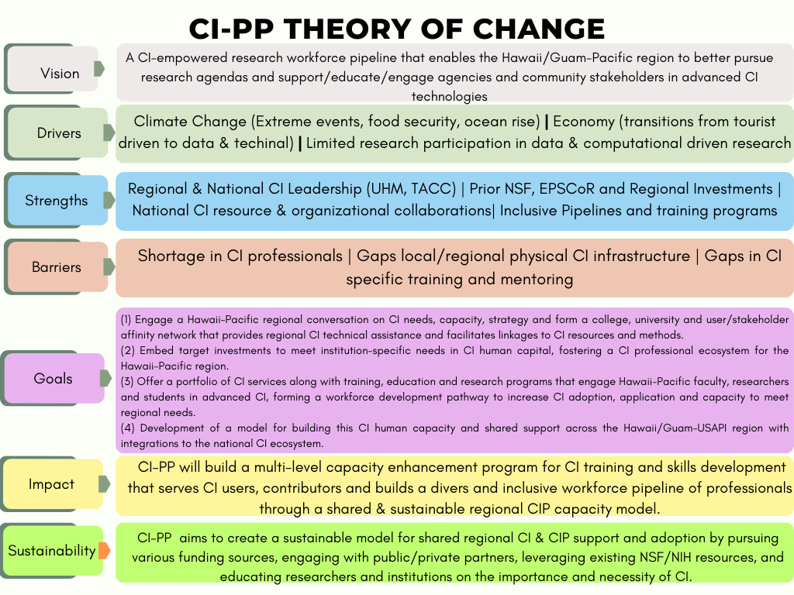
SCIPE: Cyberinfrastructure Pacific Professionals
(CI-PP) $6.5M
Data Science Fellows
`Ike Wai Scholars
Summary:
This project involving the
University of Hawaii System,
Chaminade University of Honolulu(CUH),
University of Guam(UoG)
Texas Advanced Computing Center(TACC)
supports the enhancement of Cyberinfrastructure professional capacity and training for science research, education and practice in the Hawaii/Guam Pacific region.
Hire cyberinfrastructure professionals at UH Hilo, CUH and UoG
>200 undergraduates, 15 graduate students paired with faculty and professional cyberinfrastructure staff
>100 workshops
Coming This Fall

Slide 22
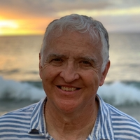
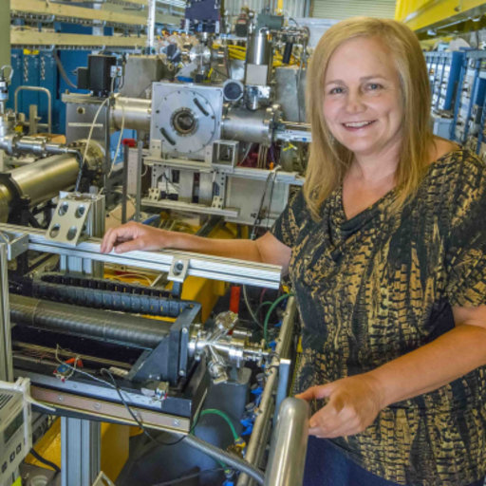
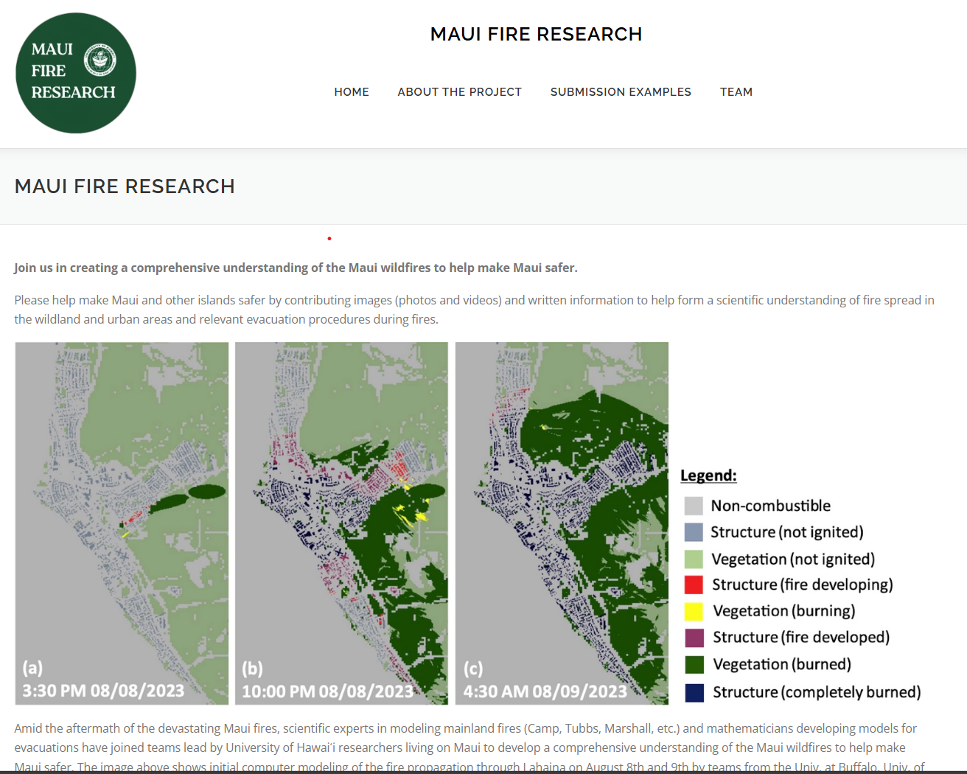
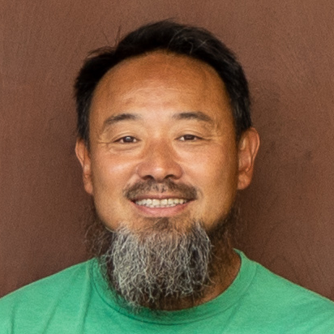
3 NSF RAPID Awards for Wildfire
To HI-DSI Faculty
Data Science Fellows
`Ike Wai Scholars
3 Awards to HI-DSI = $600K
New funding to focus on future prevention of wildfires, trauma-informed education | University of Hawaiʻi System News (hawaii.edu)
David Eder
Alice Koniges
Jason Leigh

Slide 23
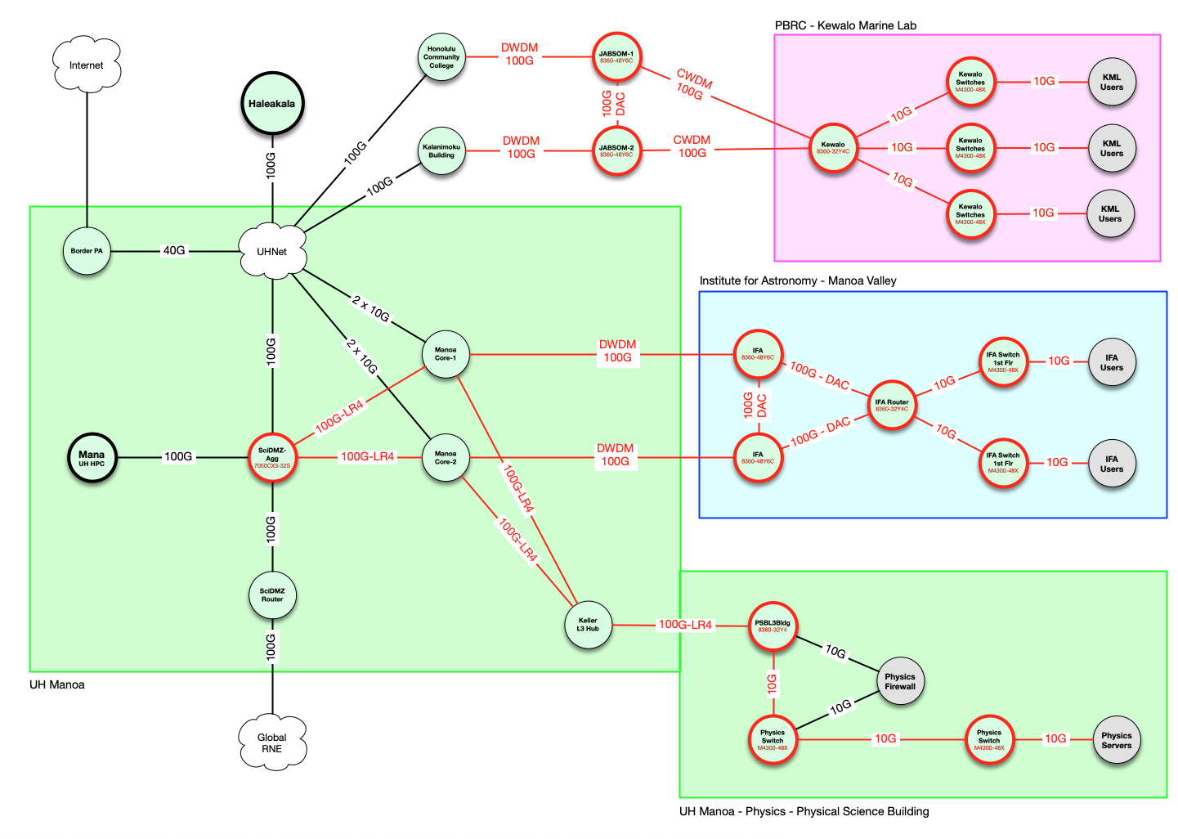
NSF CC*-University of Hawaii Manoa Research Networking Upgrades $472K
Data Science Fellows
`Ike Wai Scholars
Started Last August - Led by Chris Zane
This project provides upgrades for three locations by upgrading connectivity from 1Gbps/10Gbps to 100Gbps and a minimum of 10Gbps to local workstations/clusters.
100Gbps upgraded connectivity to the Institute for Astronomy and the Pacific Biosciences Research Center Kewalo Marine Lab and the Physics building.
SciDMZ aggregation switch upgrades provide support to connect new 100Gbps connections.
Increased capacity enables 100Gbps connectivity between Koa HPC and research locations.
100G connectivity to the Haleakala summit allows high throughput streaming of data for camera systems at the Daniel K. Inoyue Solar Telescope.

Slide 24
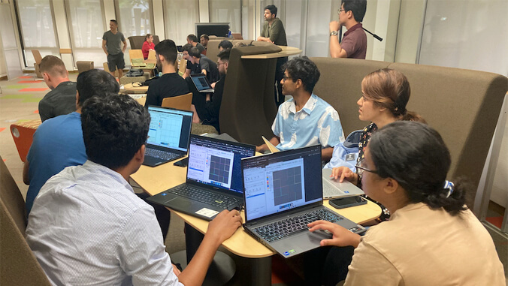
DOE Earthshots $5M - Alice Koniges
Data Science Fellows
`Ike Wai Scholars
Nearly 20 University of Hawaiʻi at Mānoa graduate students across several disciplines participated in a one-week intensive training program on computational modeling to solve complex problems related to Earth and energy. The workshop, hosted at UH Mānoa, is supported by a $5 million grant through the U.S. Department of Energy’s Earthshots Initiative to advance clean energy technologies within the next decade.
The participants learned theoretical and computational skills to model and understand geothermal energy and how partial differential equations are used to model complex physical processes and solved numerically. One of the codes the students learned about is PISALE, which was developed by UH researchers in collaboration with the U.S. Department of Energy (DOE) labs and other universities.

Slide 25
Artificial Intelligence Initiatives
Data Science Fellows
`Ike Wai Scholars
HACC Student winners for their AskUs chatbot have been working with ITS CI this summer on building a AI powered chatbot using Retrieval Augmented Generation (RAG) combined with a Large Language Model (LLM). They are working on some proof of concept that will hopefully lead to some useful tools.

Slide 26
hawaii.edu/epscor
2024 Highlights

Slide 27
VISION
To build the research and training capacity for a workforce that will lead to a climate change resilient economy and communities in Hawaiʻi.

Slide 28
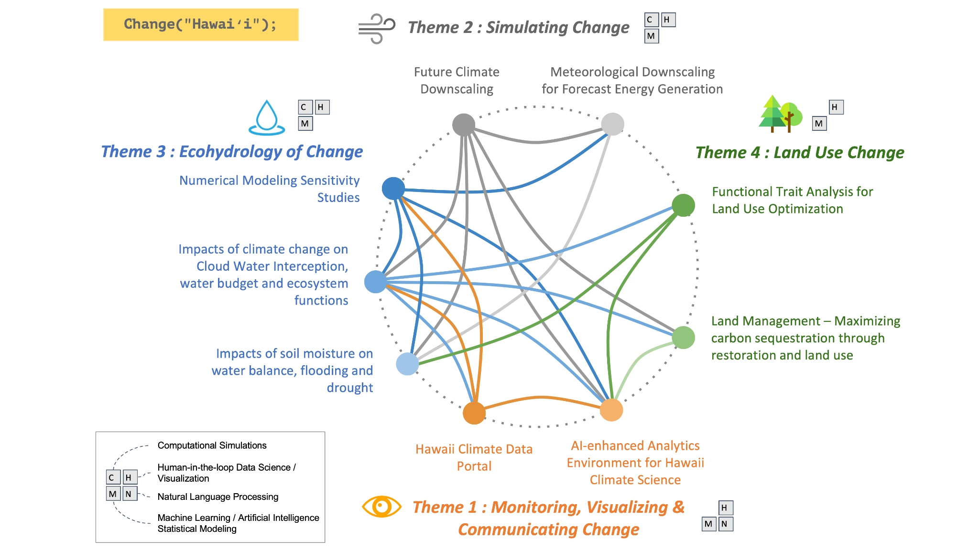
Integrative Research Plan
Change(HI)

Slide 29
Change(HI)
Leadership & Management Team

Slide 30
Change(HI)
Climate Science, Botany &
Social Science Team

Slide 31
Change(HI)
Data Science & Cyberinfrastructure Team
Plus three new faculty hires in:
AI/Machine Learning
Software Engineering
Data Visualization

Slide 32
Change(HI)
Education/Workforce/Broadening Participation
Emerging Areas Teams

Slide 33
Notes:
Shows how the members in each of the themes are distributed at multiple locations and islands
This is necessary to ensure weʻre building capacity for all of Hawaiʻi not just Oahu
Also these islands are where we are deploying sensors so that we are able paint a clearer picture of how climate change will impact us
But this picture does not capture the fact that we are the most isolated populated land mass in the world.
That means when things go bad due to climate change we don’t have much in the way of a plan B.
Hawaiʻi has no redundant energy systems like on the mainland.
If a tsunami or a hurricane knocks out our port we only have 1 week of food.
Even though we are surrounded by ocean, most of our freshwater comes from aquifers. And surprising to most, Hawaiʻi is currently facing drought conditions.
So the change HI project really comes at a pivotal moment for Hawaiʻi, where critical research, training and outreach is necessary to help us deal with climate change.

Slide 34
Cyberinfrastructure: Resources
Koa High Performance Computing Cluster
Jetstream 2 -UH Regional Cloud
OAC #2005506
OAC #2201428
Supporting computational simulations, ML/AI and analysis
800 TB in Lustre scratch space
262 nodes - 7,180 Cores & 144 GPUs
Virtual Machine infrastructure with
1,024 cores, 4TBs RAM, 8 A100 GPUs and 800TB storage
Supporting development and production infrastructure
KoaStore High Performance Research Storage
Tapis Framework - API Middleware
OAC #1931439 and #1931575
OAC #2232862
Connects Compute, Storage, Visualization, Interactive Web and Data Dissemination
6 PB in high-speed Lustre parallel file store that is scalable.
Access on Koa HPC and also KoaCloud (Nextcloud - like Dropbox)
Change-HI has 0.5 PB of dedicated KoaStore storage between HPC and KoaCloud
Change(HI) also leverages ACCESS for Jetstream 2, NCSA Delta and other national resource allocations.

Slide 35
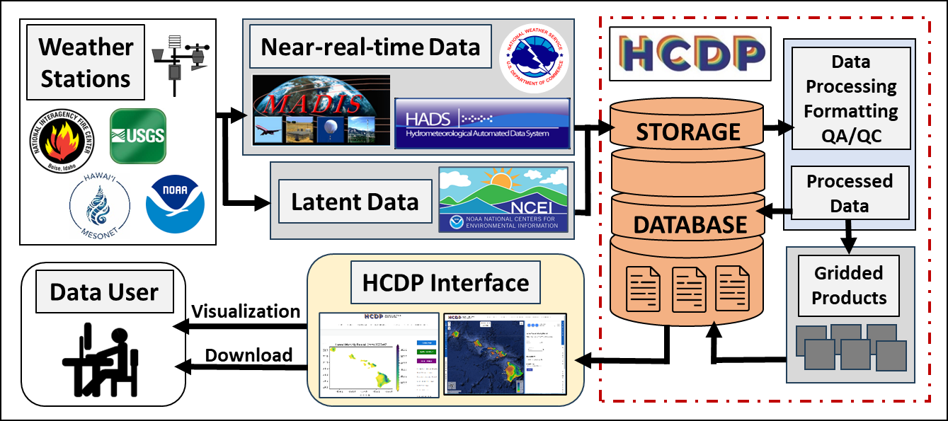
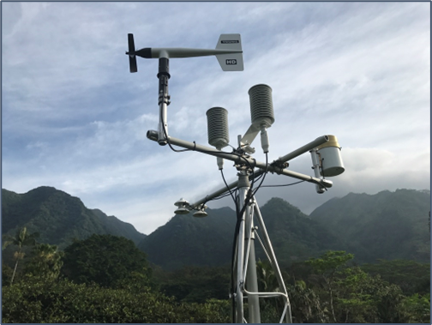
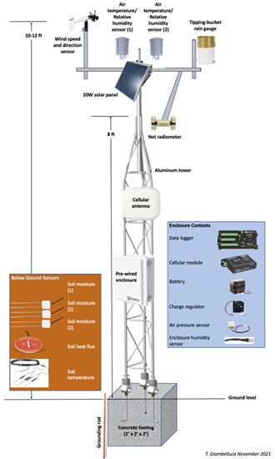
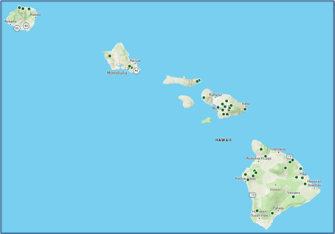
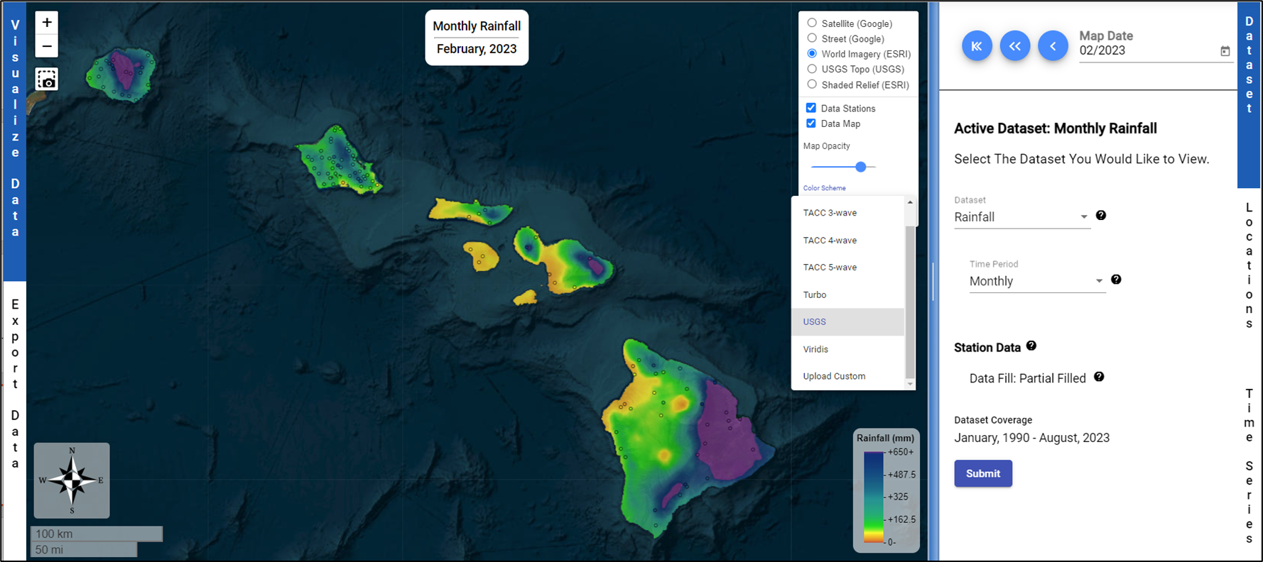
Hawaiʻi Climate Data Portal
Giambelluca, Longman, Lucas, Kodama, Cleveland, McLean, Geis, Wong
Goal: Create a 1-stop shop for all climate data for Hawaiʻi to serve researchers, educators, businesses, government & the general public.
56/100 New
Climate Stations
NSF #OIA-2149133

Slide 36
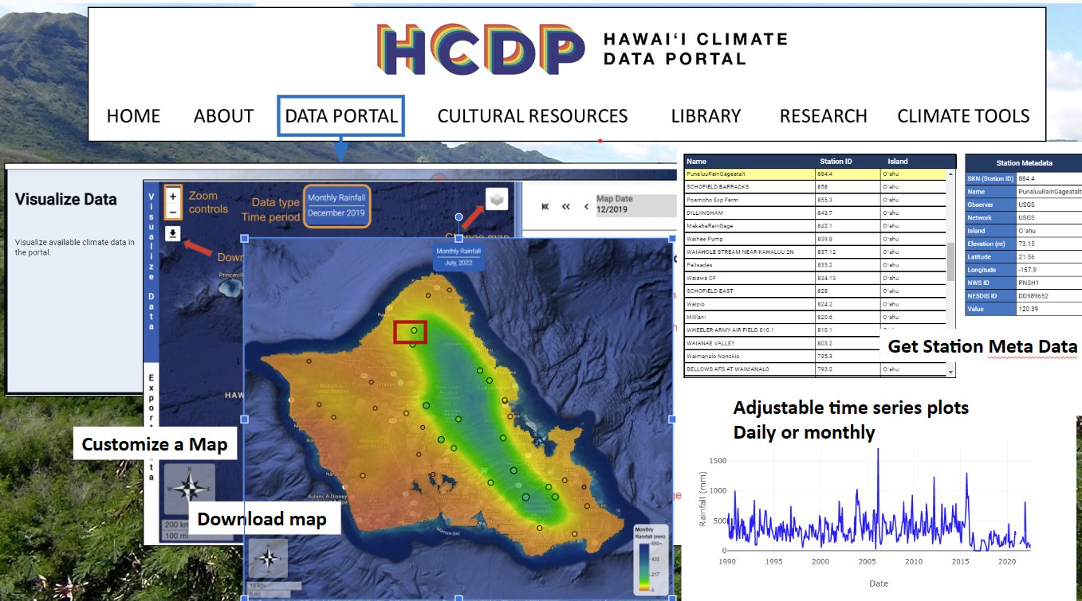
Hawaiʻi Climate Data Portal
HCDP Datasets
104 Years
Monthly
Rainfall
> 1,226 Maps
34 Years
Monthly/Daily Temperature (Max, Mean, Min)
> 35,000 Maps
34 Years
Monthly/Daily
Rainfall & Temperature Station Data
21 Years
Bi-Weekly NDVI (Vegetation)
> 540 maps
Future Climate Projections of Rainfall and Temperature (2-Methods) for
RCP 4.5 & 8.5

Slide 37
Hawaiʻi Climate Data Portal
> 45K
Visitors
> 130
Countries
> 1.2M
API Requests
> 2.2M
Downloads
> 19.9M
Files Accessed
> 432GB
Downloaded

Slide 38
T1: Hawaiʻi Climate Data Portal
Who Has Accessed?
Agencies:
NOAA,
USDA, USGS
State of Hawaiʻi
&
City of Honolulu
Utility:
Hawaiian Electric
Industry:
Microsoft, CartoDB
Engineering, Consulting and Policy Companies

Slide 39
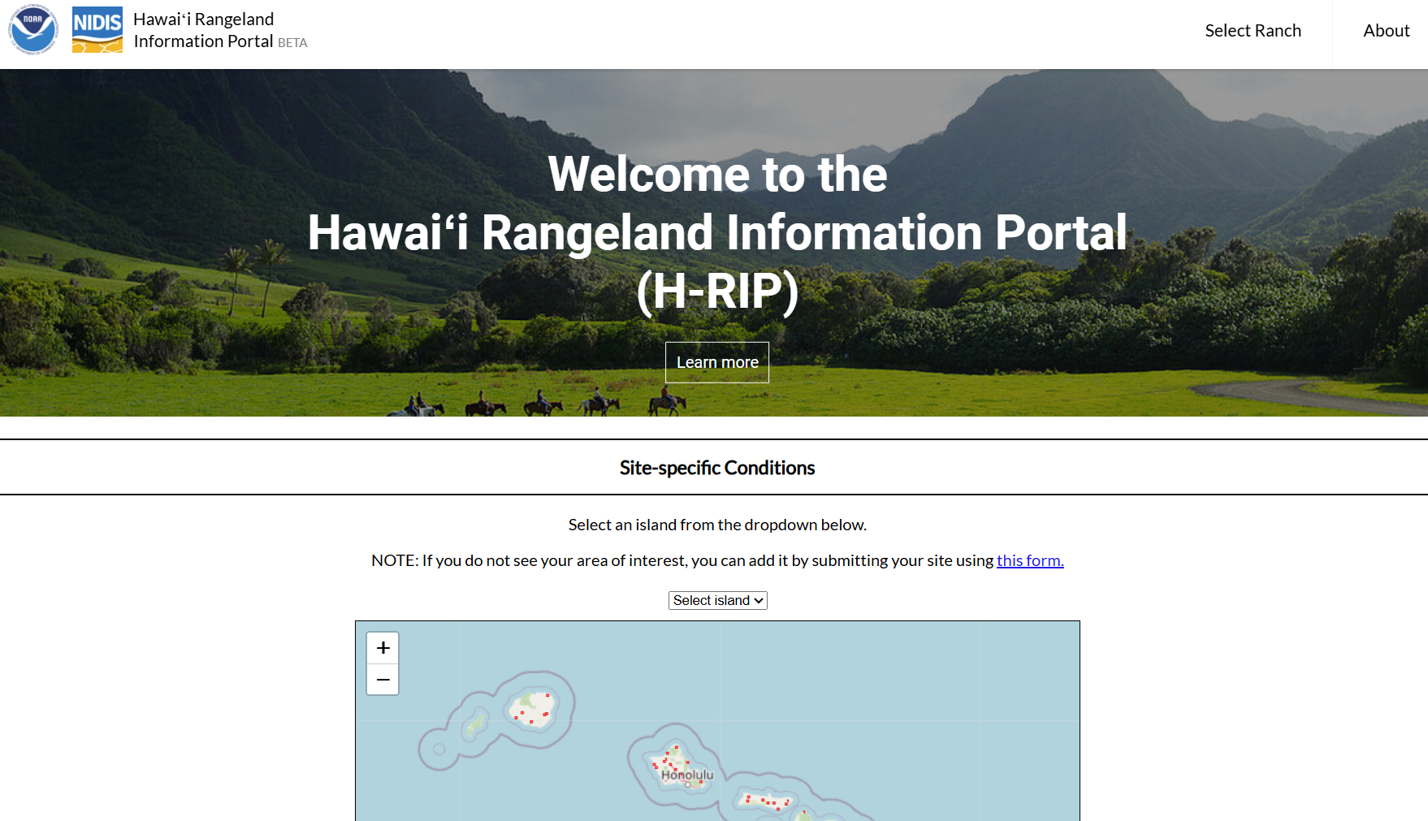
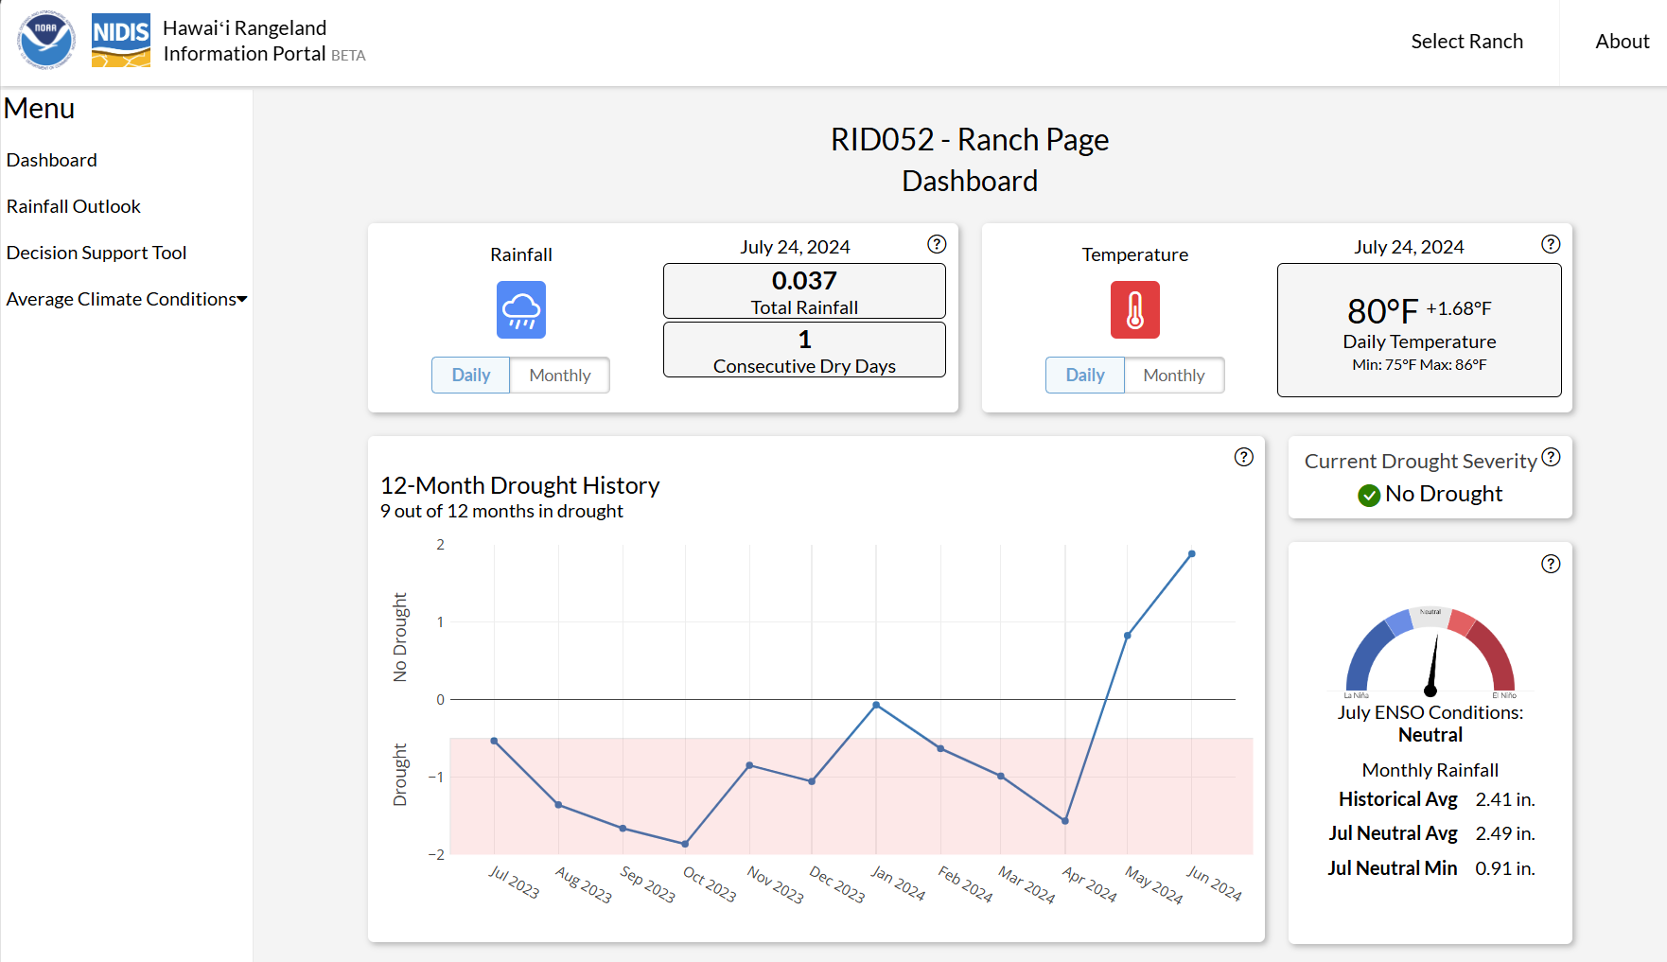
Hawaiʻi Climate Data Portal
Hawaii Rangeland Information Portal

Slide 40
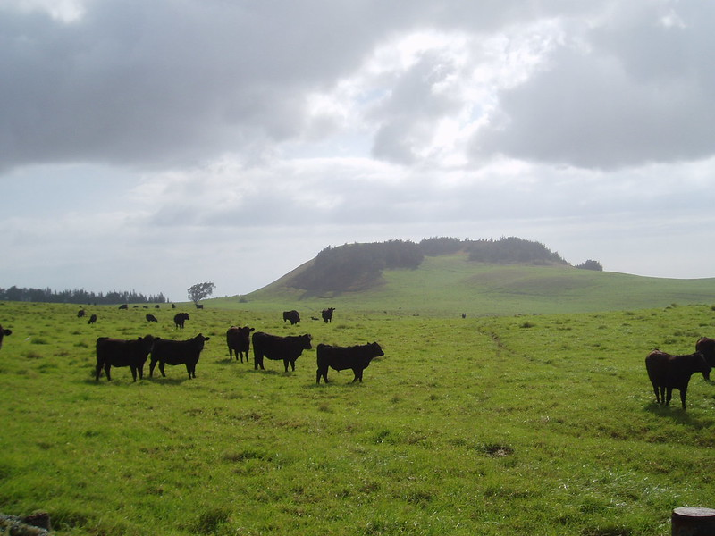
Hawaiʻi Climate Data Portal
Real Impacts!
USDA Expands Pasture, Rangeland, and Forage Crop Insurance to Hawaii

Slide 41
For More Information
Project links:
Change-HI website: http://hawaii.edu/epscor
Hawaiʻi Climate Data Portal: https://www.hawaii.edu/climate-data-portal/
Curriculum modules: https://change-hi.github.io/archive-2022-2023/modules/
Hawaiʻi EPSCoR is funded by the National Science Foundation under EPSCoR Research Infrastructure Improvement Award #OIA-2149133. Any opinions, findings, and conclusions or recommendations expressed in this material are those of the author(s) and do not necessarily reflect the views of the National Science Foundation.

Slide 42
HI-DSI Update

Slide 43
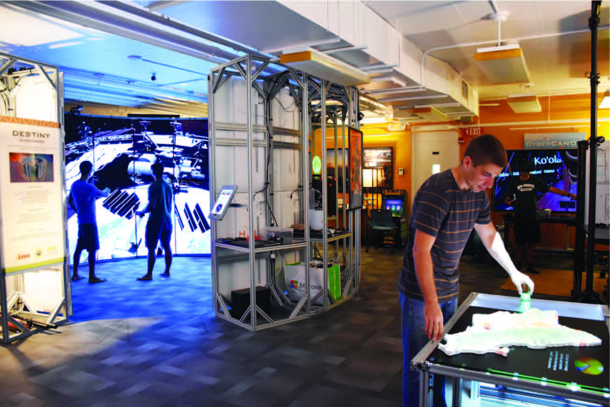
Hawai‘i Data Science Institute
A systemwide initiative to
catalyze research and training capacity in
data science, computation and visualization
Audience
Students
Participate in a cross-disciplinary data science curriculum
Researchers
Promote and support cross-disciplinary data intensive research
Industry
Forge partnerships with industry and government agencies

Slide 44
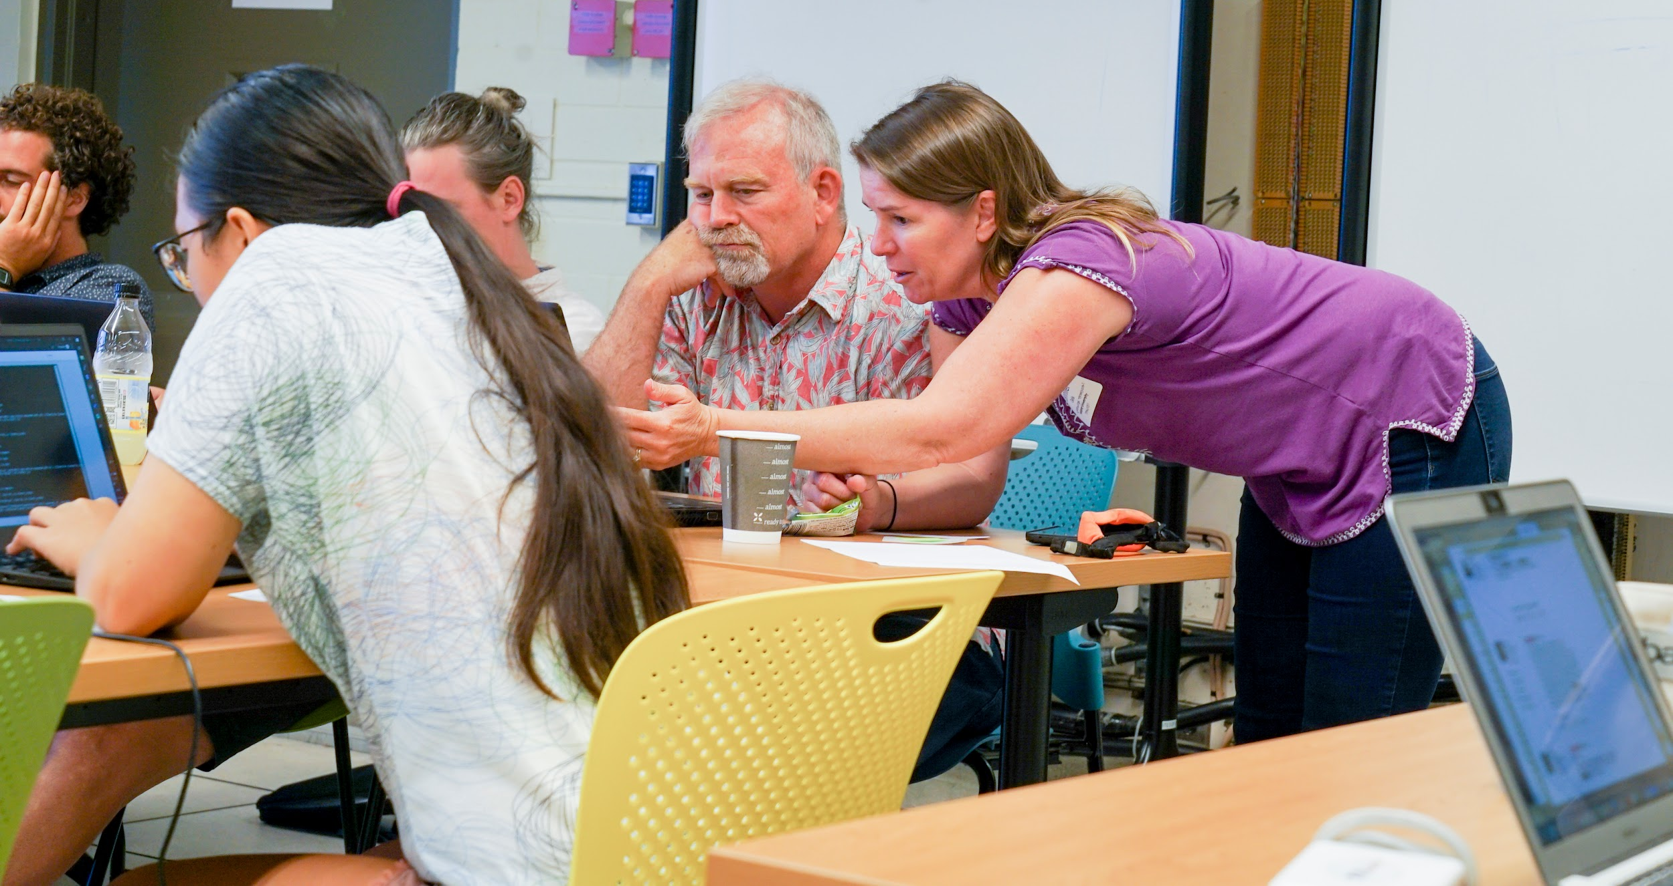
Training and Education
`Ike Wai Scholars
Data Science Fellows
Facilitate the development of data science curricula
Data Science Certificate
Information and Computer Sciences - Manoa
Data Science - UH Hilo
Bachelor of Science in Data Science
UH Hilo
Chaminade
Data science & CI skills training
Open to the UH community at large
Examples:
HPC & Cloud computing
Data Wrangling
Python & R
Visualization
Computational workflows

Slide 45
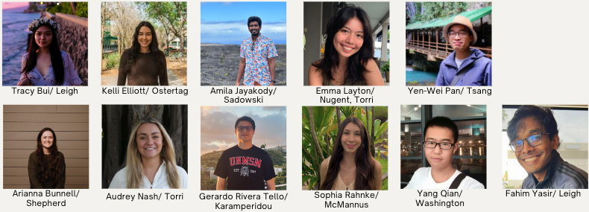
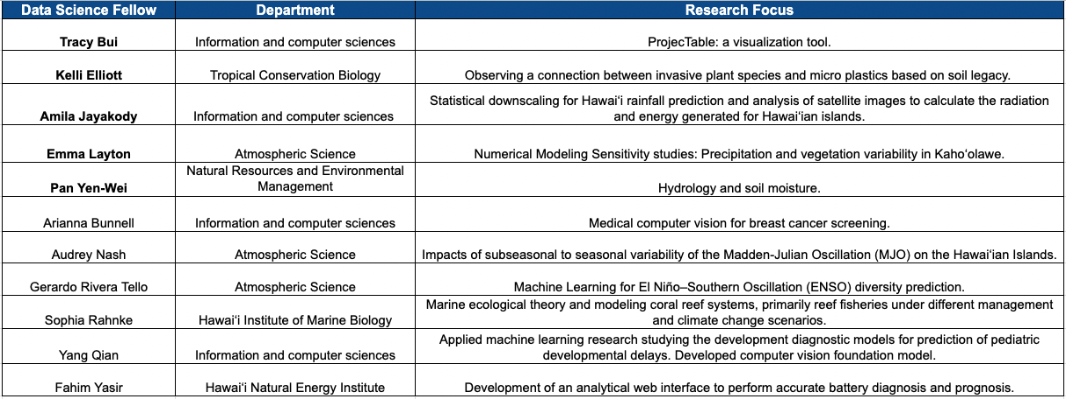
Change(HI)
Data Science Fellows 2024
Tanaka

Slide 46
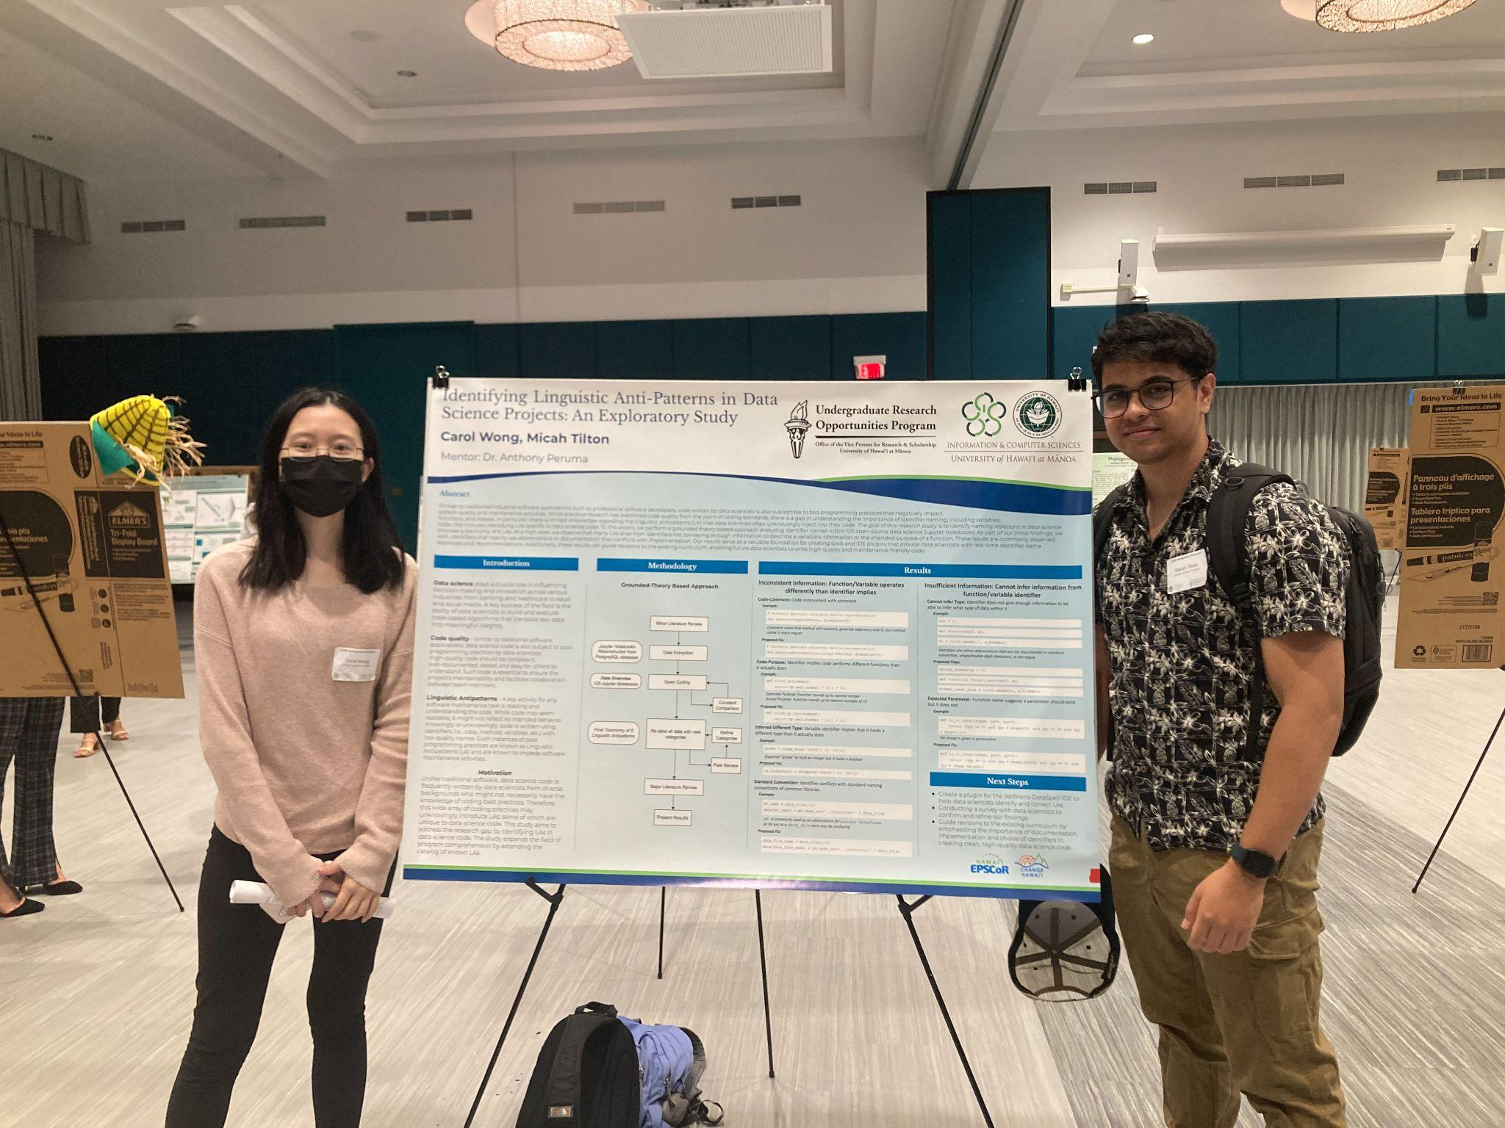
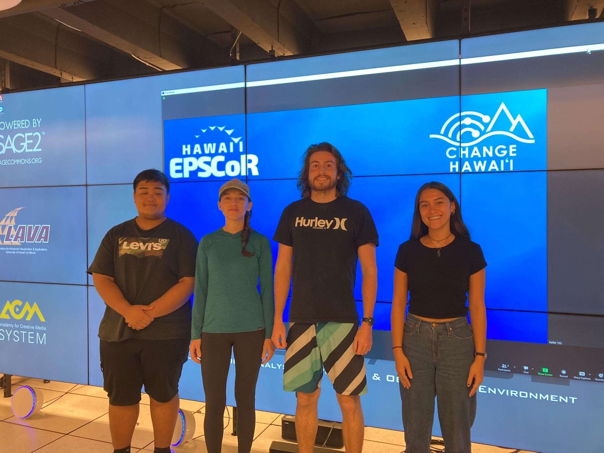
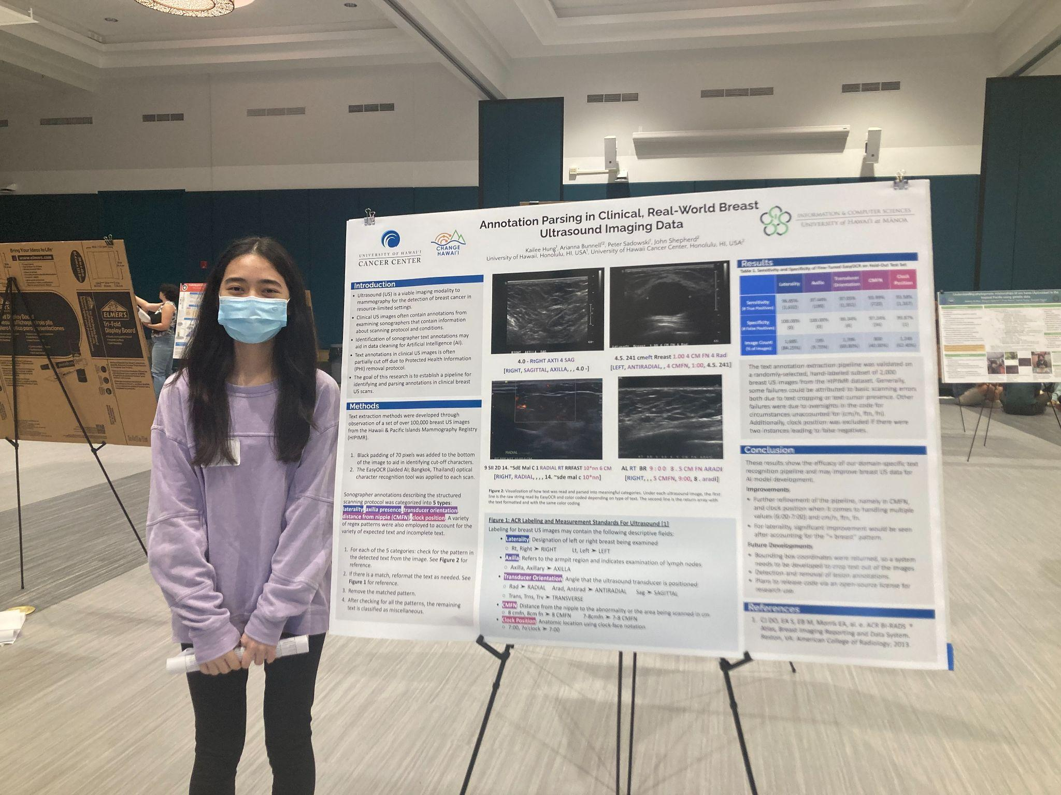
EWD/BP: Change(HI) Opportunity for Research Experience CORE Program
Tanaka
Mentored research program with flexible participation levels.
Program incorporates cohort building activities and professional development opportunities.
Students participated in campus-wide research symposium.

Slide 47
Fall 2023-Summer 2024 Impacts
`Ike Wai Scholars
Data Science Fellows
16 Graduate Fellows
15 Workshops
287 Attendees
4 Seminars
169 Attendees
2 Research Showcases (December, May)
67 Attendees
16 Summer Undergraduates

Slide 48
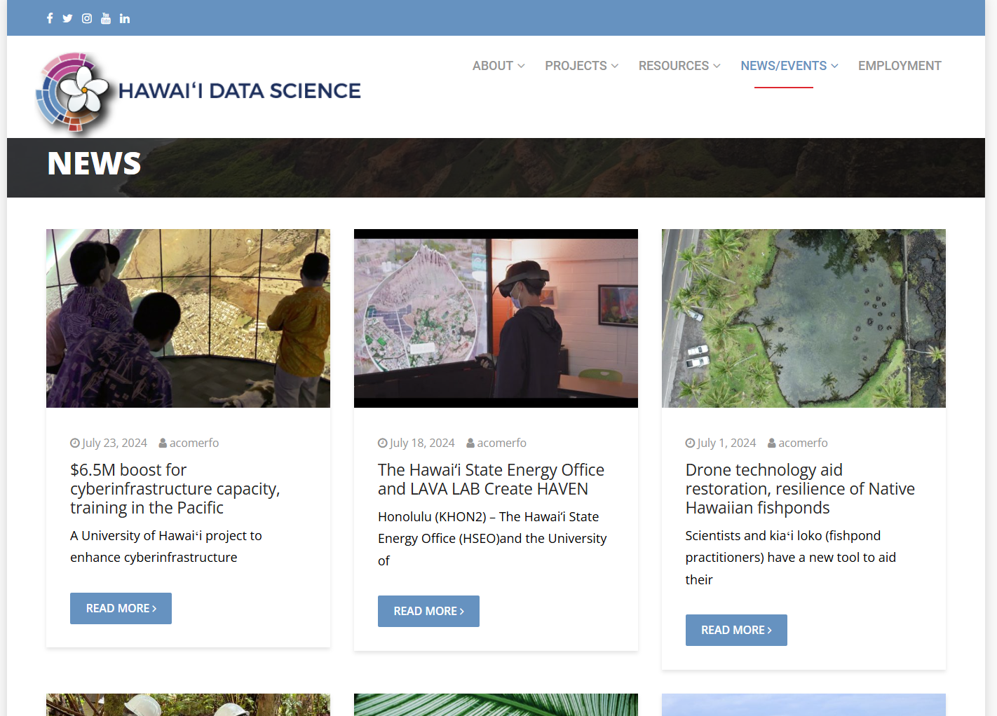
More HI-DSI Faculty Highlights
`Ike Wai Scholars
Data Science Fellows
https://datascience.hawaii.edu/news-2/
Artificial Intelligence
Drones
Quantum
Wildfire
Reef Ecosystems
Coastal Cloud/Rain
Genomic Research
Weather & Climate

Slide 49
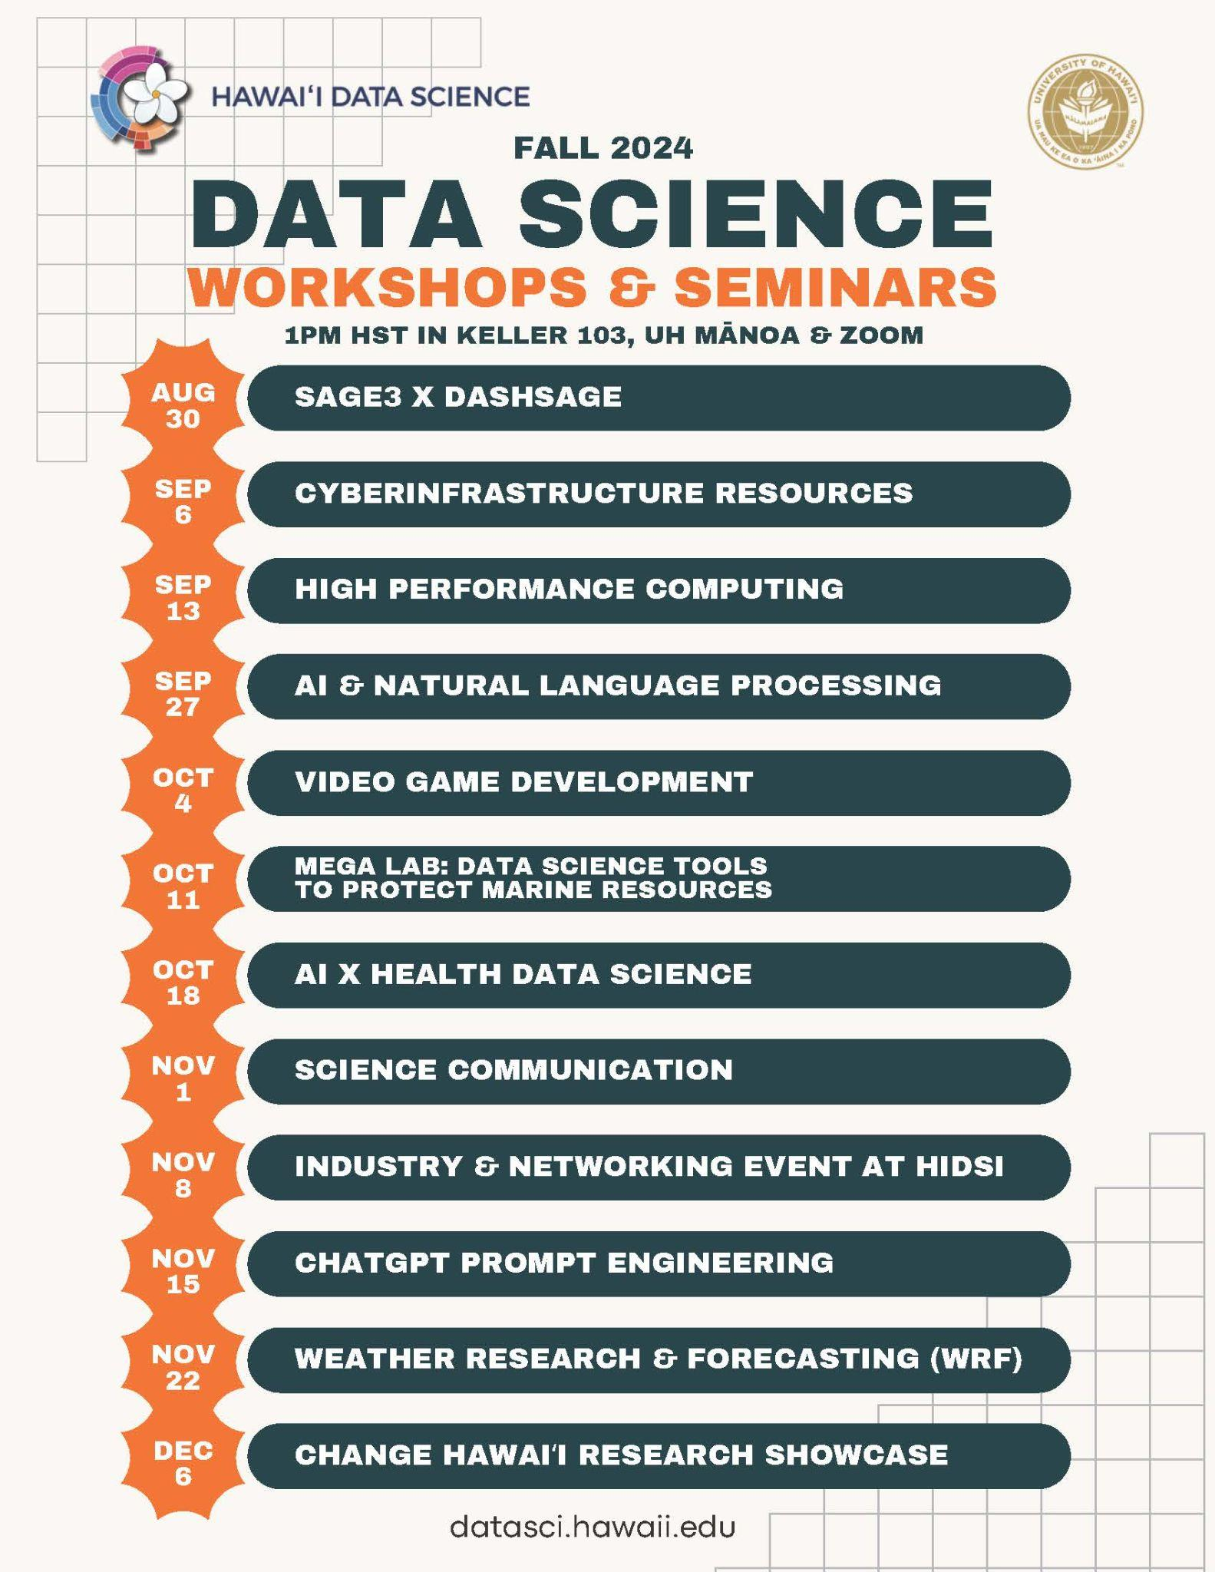
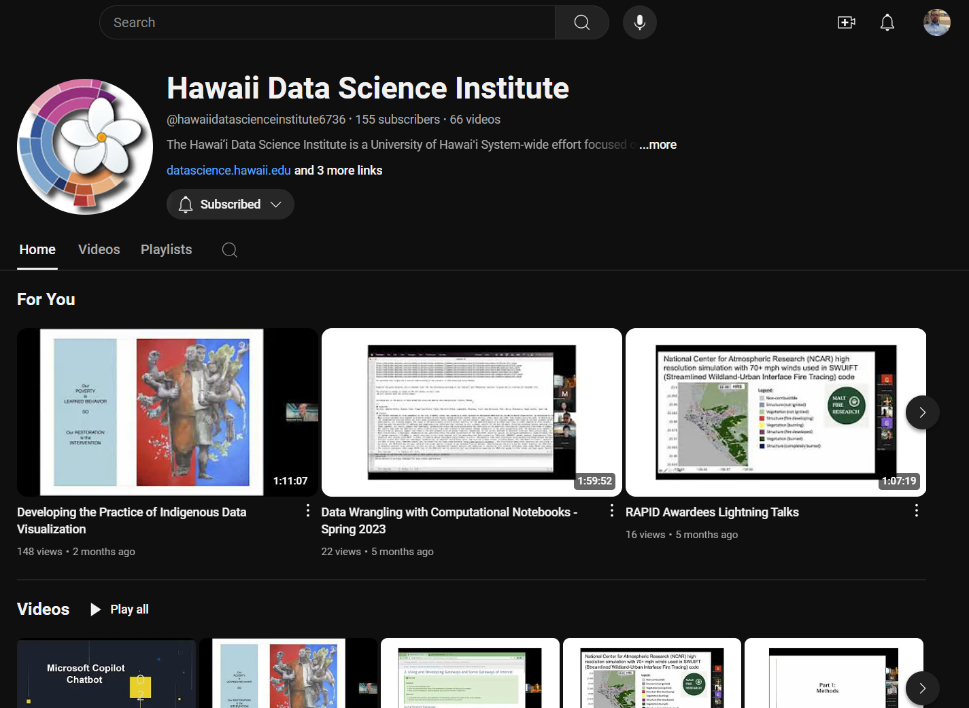
Training
`Ike Wai Scholars
Data Science Fellows
https://www.youtube.com/@hawaiidatascienceinstitute6736
https://go.hawaii.edu/3LF

Slide 50
Google Cloud Update

Slide 51
Commercial Cloud For Research
Data Science Fellows
`Ike Wai Scholars
Motivation
Controlled Unclassified Information (CUI) is sensitive but unclassified information that requires safeguarding and dissemination controls pursuant to law, regulation, or policy. There are FERPA and HIPAA data needs in some research.
Access to the latest GPUs/Accelerators and CPU infrastructure beyond what is available in Koa or National research infrastructure.
Better cost and discounts for researchers already leveraging commercial clouds.
Exploring Artificial Intelligence offerings

Slide 52
Google Cloud Accelerator Program
Data Science Fellows
`Ike Wai Scholars
The programs Goal:
Accelerate the most secure, cost-effective and responsible adoption of industry leading innovation in computing and AI for Enterprise and Academic Research.

Slide 53
Google Cloud Accelerator Program
Data Science Fellows
`Ike Wai Scholars
Security and Compliance
●Reduce lead time for project setup through a scalable yet compliant environment that meets the different needs of each research project (HIPAA, PCI DSS, FedRamp, CMMC 2.0, etc)
●Integrates with our existing IAM and SIEM/SOAR platforms via the Security Command Center Premium

Slide 54
Google Cloud Accelerator Program
Data Science Fellows
`Ike Wai Scholars
Flexible, Repeatable, Powerful environments
●Automate the provisioning, deployment and monitoring of HPC/Computational environments
●Quickly access latest GPUs and TPUs while using the tools our researchers and IT admins are already familiar with
●Researchers can fine tune the environments with a simple configuration file to adjust it to their specific needs.

Slide 55
Google Cloud Accelerator Program
Data Science Fellows
`Ike Wai Scholars
Pricing Benefits - including flat-fee rates
●A centralized deployment maximizes EDU discounts across all Google Cloud (GPUs, TPUs, Vertex AI, GenAI, etc) (up to 25%)
●Easy configuration of budget & spending (not only alarms, but also enforcement). Leverage the option of a flat-fee pricing for your projects using our Subscription Agreement to avoid surprises in costs
●Centralized governance of credits, including enforcement of budgets.
●Automate billing and invoicing.

Slide 56
Google Cloud Accelerator Program
Data Science Fellows
`Ike Wai Scholars
Facilitate access to all Google’s Research Programs and Training opportunities
●Gain access to tailored Google Cloud training opportunities for all our users (Researchers, Security, IT admins and staff)
●Unlock office hours and support from Google’s technical experts and trusted partners

Slide 57
Google Cloud Accelerator Program
Data Science Fellows
`Ike Wai Scholars
Next Steps:
Meetings with Burwood for initial discovery around:
Organization & Security
Networking
Billing
Implementation and testing of the Platform

Slide 58
Mahalo!
`Ike Wai Scholars
Data Science Fellows
Register for Training and Koa Account
http://go.hawaii.edu/G6V
Contact Us
itsci@hawaii.edu
Learn More
datascience.hawaii.edu

Slide 59
Google Cloud Accelerator Program
Data Science Fellows
`Ike Wai Scholars
Next Steps:
Step 1: Design & deploy a flexible centralized environment that aligns with researcher needs and extend all the benefits to everyone

Slide 60
Google Cloud Accelerator Program
Data Science Fellows
`Ike Wai Scholars
Step 2: A powerful environment within minutes for every user
○ Agile creation of an environment that meets the specific needs of the project
○ Automated benefit of EDU discount for all services. Possible to have a flat-fee of cost for an eligible project
○ Automated Billing & Invoicing (including budget alarms and enforcement)
○ Onboarding co-investment: Google will provide credits for a value of 25% of the
total cost of each new project during its first 90 days

Slide 61
Google Cloud Accelerator Program
Data Science Fellows
`Ike Wai Scholars
Step 3: Dedicated support for supporting teams and final users
○ Burwood partner and Google Customer Engineer will support users during their entire project to ensure they get maximum value out of the platform
○ Office hours with our supporting teams (Cyberinfrastructure, Security, TI, etc)
○ Access to Google online training programs every month, for everyone
○ For new workloads, Google will allocate 5% of the expected consumption for Partner Service Funding

