Slide 1
Be Safe, use Password Protection Michael Hodges ITS, Identity and Access Management mhodges@hawaii.edu

Slide 2
Unprotected Passwords, a risky behavior:
In the News:
63% of Data Breaches Result from Weak or Stolen Passwords.
Over 560 Million Passwords Discovered in Anonymous Online Database
Yahoo Says 1 Billion User Accounts Were Hacked
Verizon reports: Weak Stolen Password Still a Leading Factor in Breaches

Slide 3
Password Protection is relevant to each of us:
UH Account Takeovers reported to us by Google
7,669 takeovers since 2011
3,742 takeovers just last year (2016)
Password Protection would have prevented these.

Slide 4
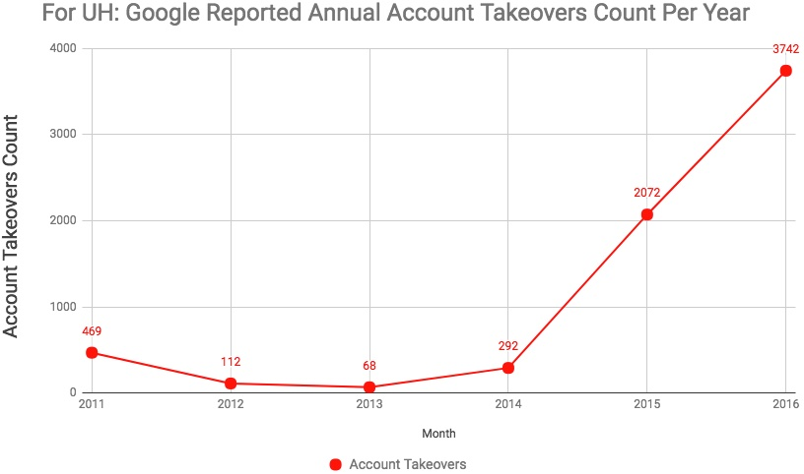

Slide 5
ITS provides Password Protection today:
Duo Security for your phone
Duo Security baked into UH Login (CAS/Shib)
Look for the ITS Fall 2017 awareness campaign.

Slide 6
What can you do?
Be proactive, protect your passwords today.
Spread the word, tell your coworkers and students.
FYI: ITS requires all staff and students to use Duo.
http://www.hawaii.edu/its/mfa

