Slide 1
MaiTai'd – Democratizing Tide Data
David Neely
Technology and Web Coordinator – Manoa Career Center
dneely@hawaii.edu

Slide 2
Agenda:
1. Purple Mai'a Native Hawaiian App contest
2. Declining cost of water management sensors
3. Why does the tide matter so much?
4. Leveraging Open Source Software (OSS)
5. Achievement Unlocked!
6. Water Conference in Punalu'u
7. Follow our progress on Github

Slide 3
1. Purple Mai'a Native Hawaiian App contest

Slide 4
2. Declining costs of water management sensors

Slide 5
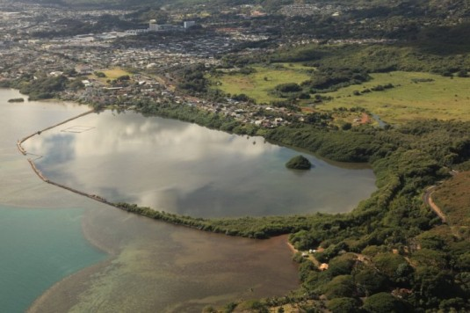
3. Why does the tide matter so much?

Slide 6
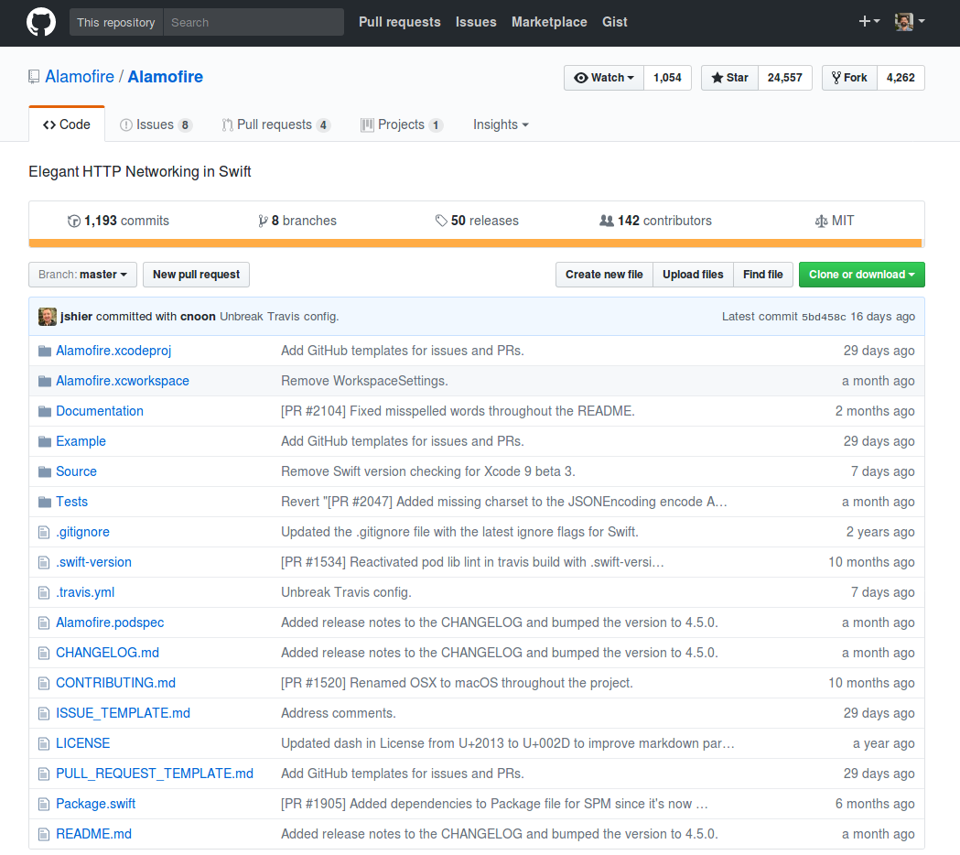
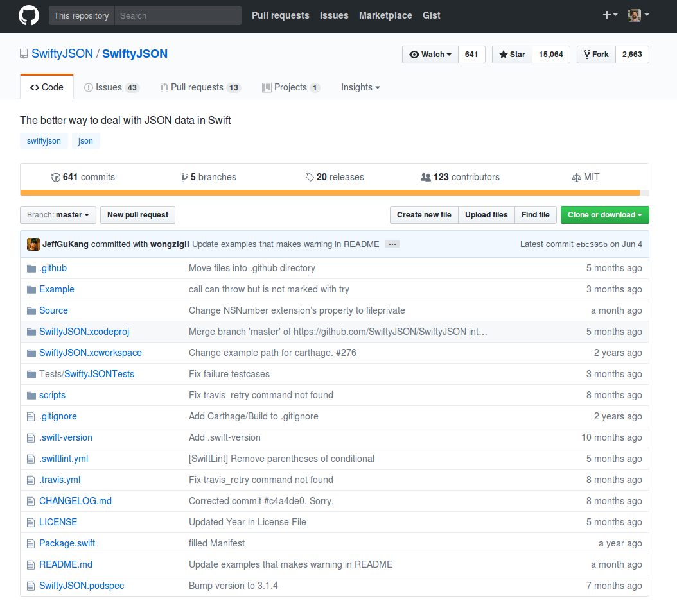
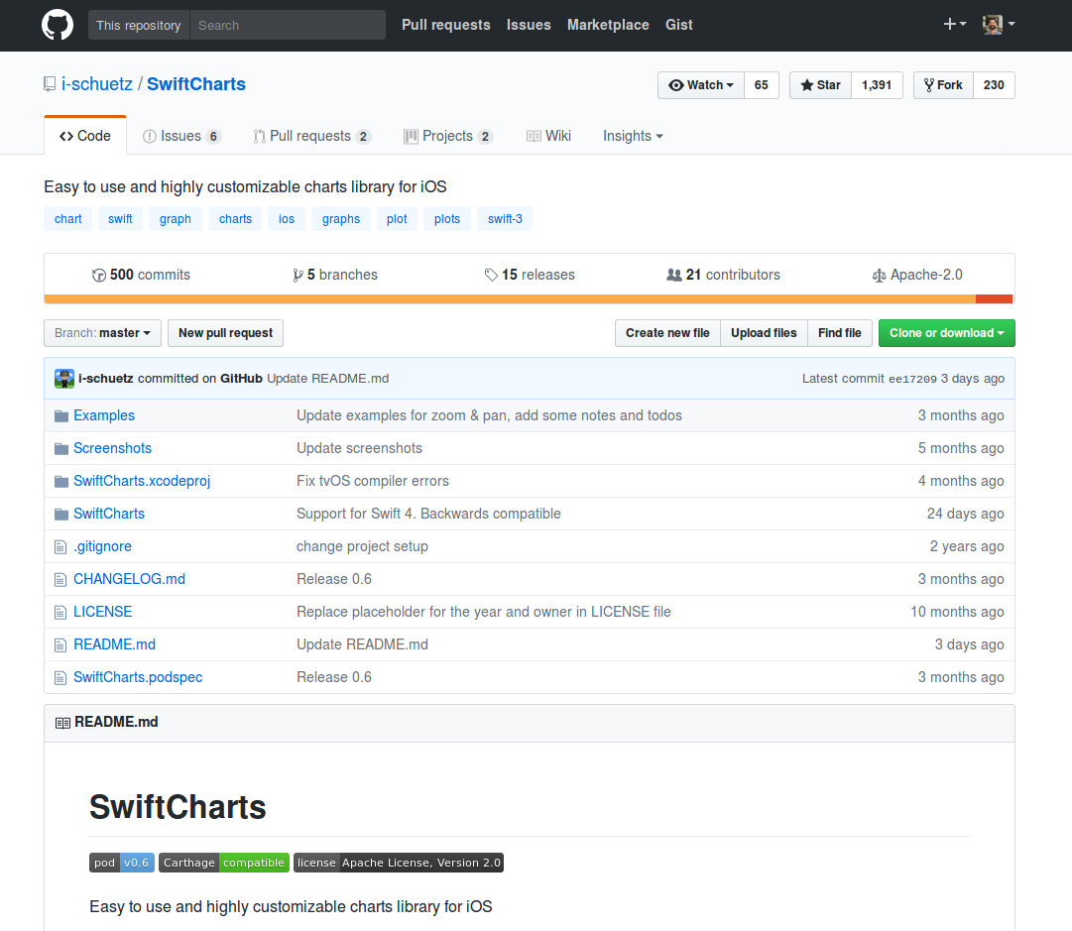
4. Leveraging Open Source Software (OSS)

Slide 7
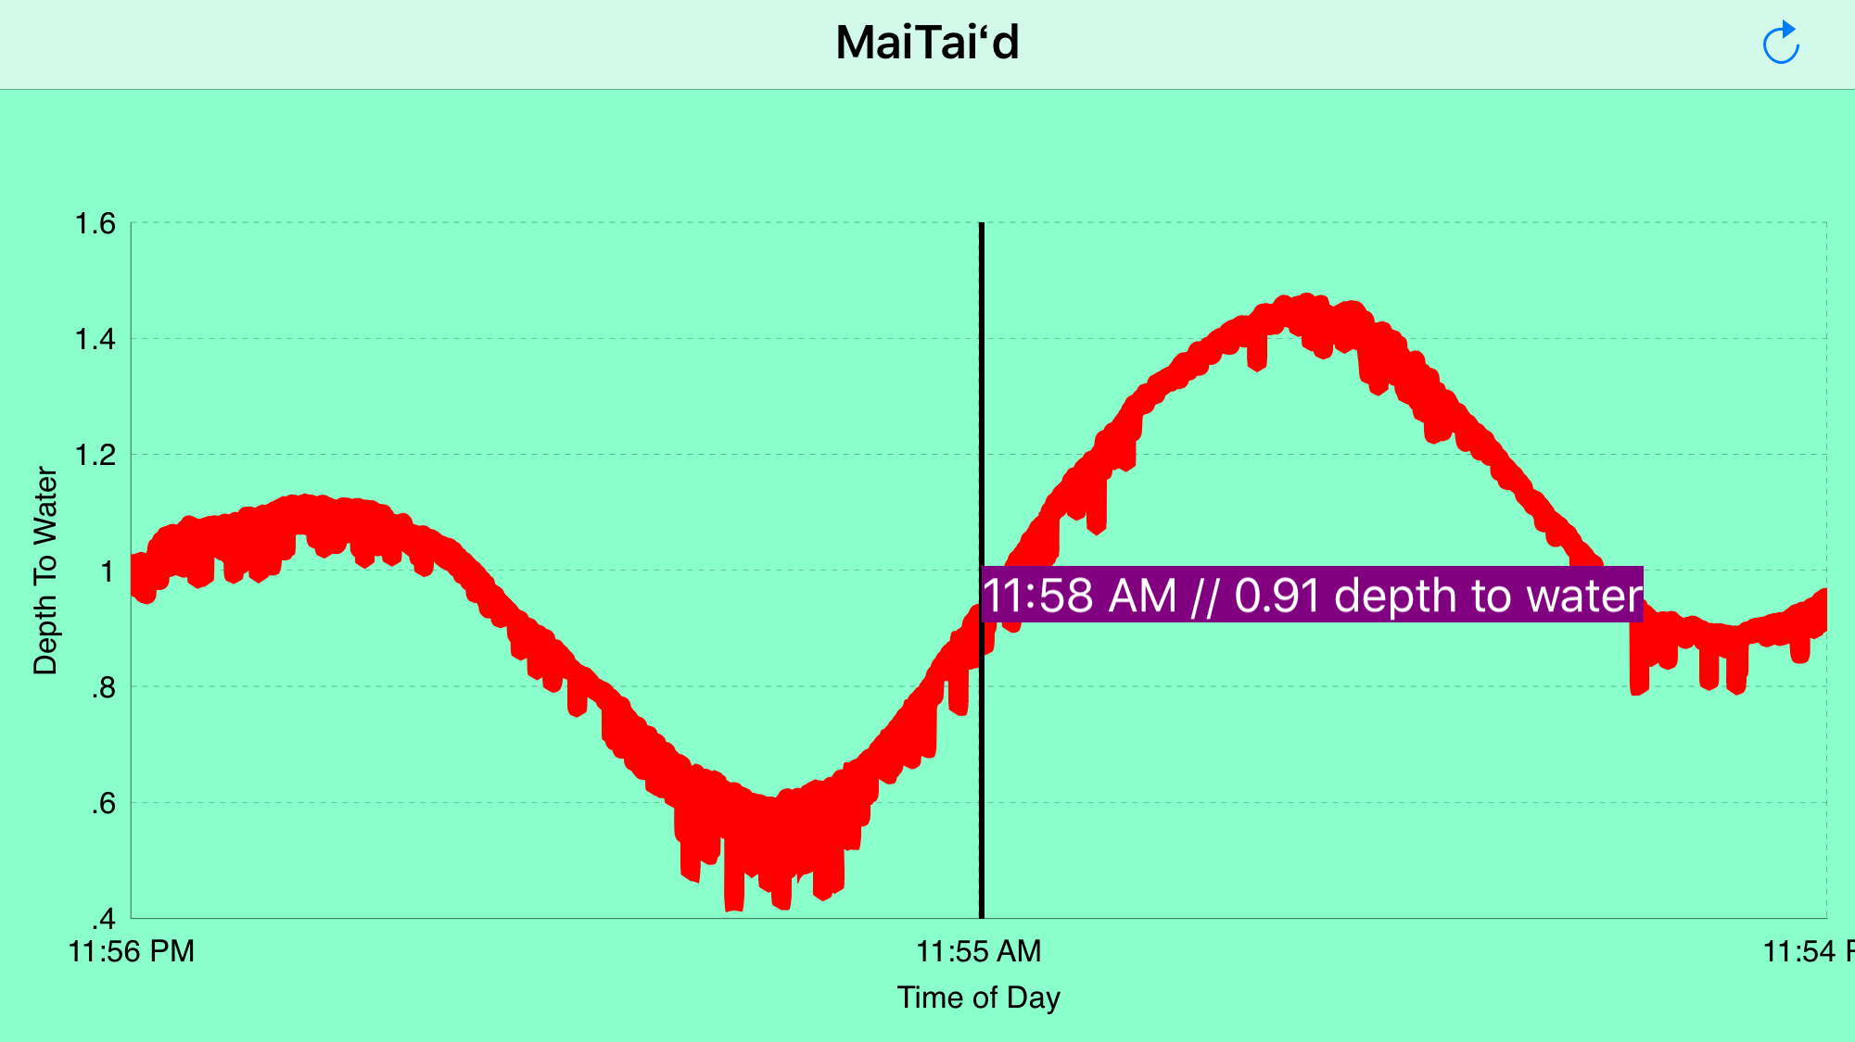
5. Achievement Unlocked!

Slide 8
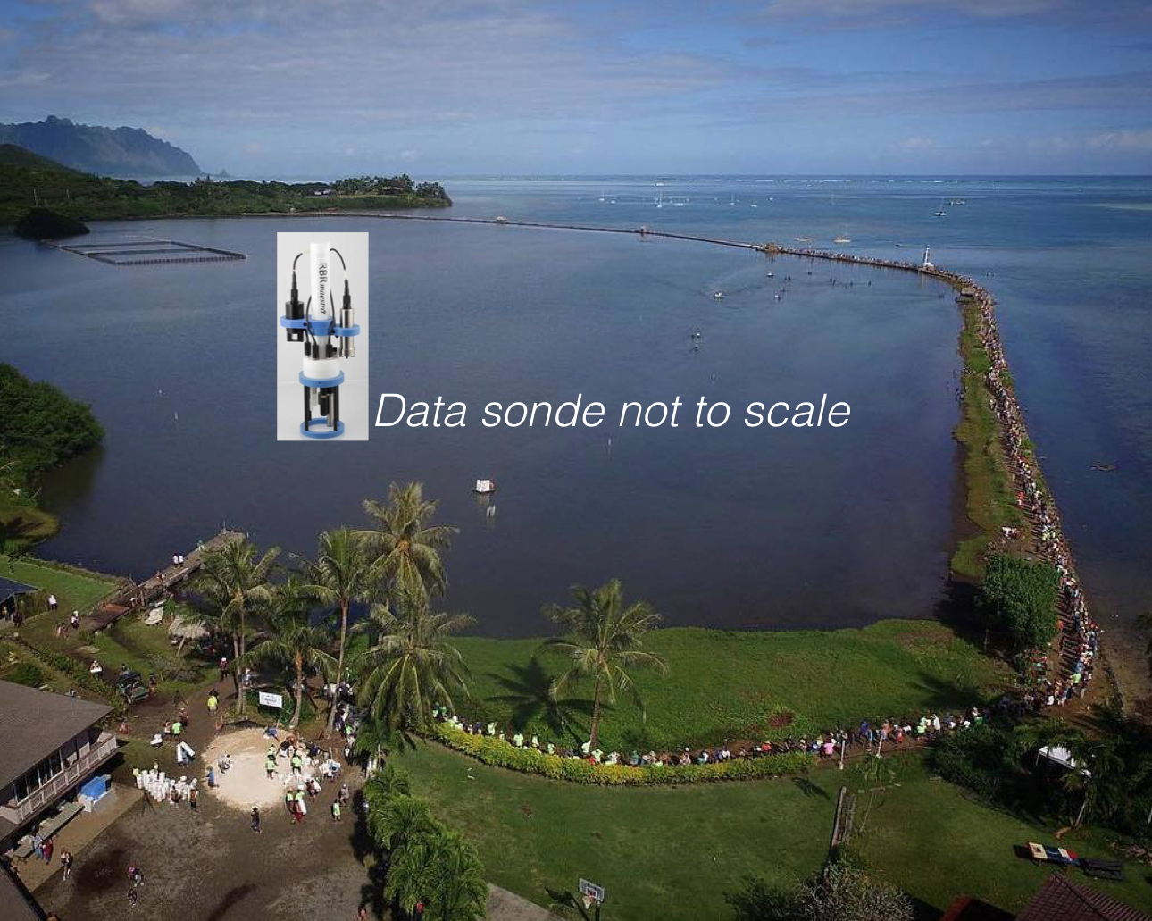
6. Water Conference in Punalu'u

Slide 9
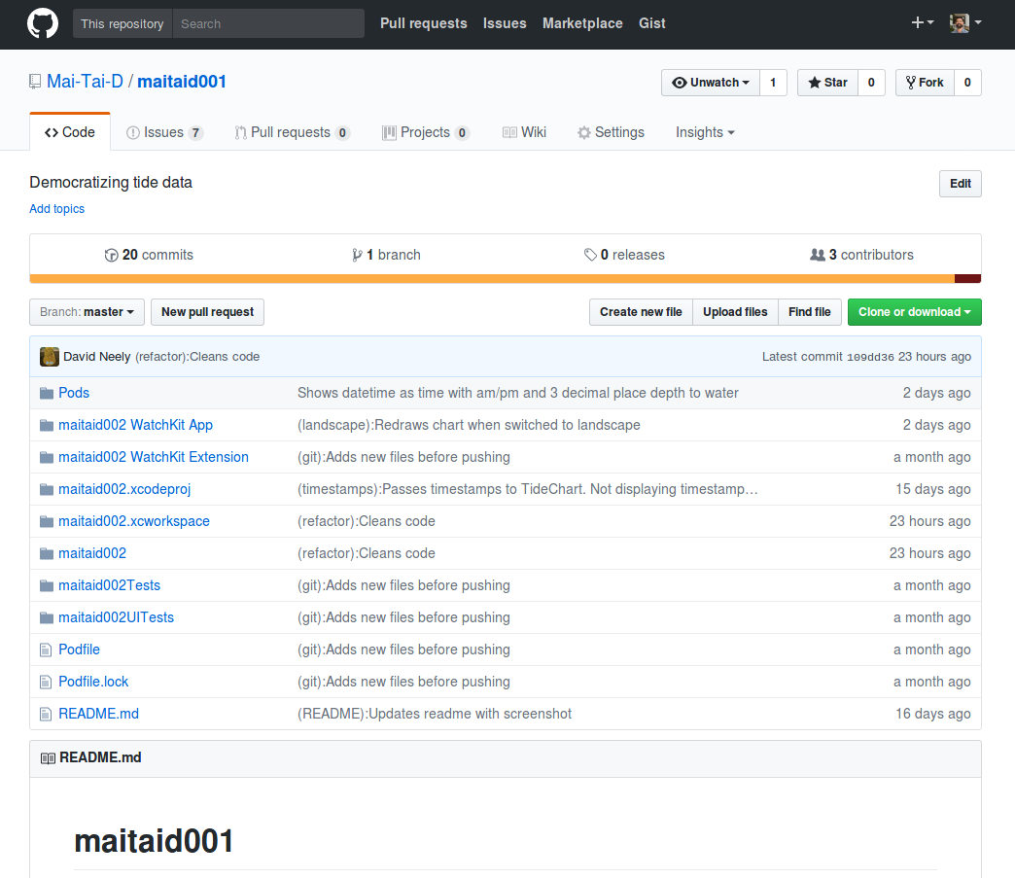
7. Follow our progress on Github

Slide 10
Thank you for your attention :)
If you're interested in reading a transcript of this talk, you can check it out on my blog at: http://davidneely.wordpress.com
David Neely
dneely@hawaii.edu

