Slide 1
Google Team Drives Michael Valentino IT Specialist mavalent@hawaii.edu

Slide 2
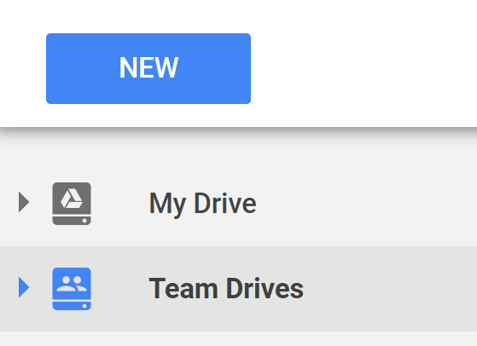
Team Drives
Collaborative workspace for teams to store, share, and access their documents
Uses existing Google Drive interface and functionality
Documents persist as users come and go

Slide 3
My Drive vs. Team Drives
 | My Drive | Team Drives
Ownership | Decentralized | Centralized
Sharing | Manual Doc-by-doc | Automatic Shared to members
Retention | Account-bound documents | Persistent documents

Slide 4
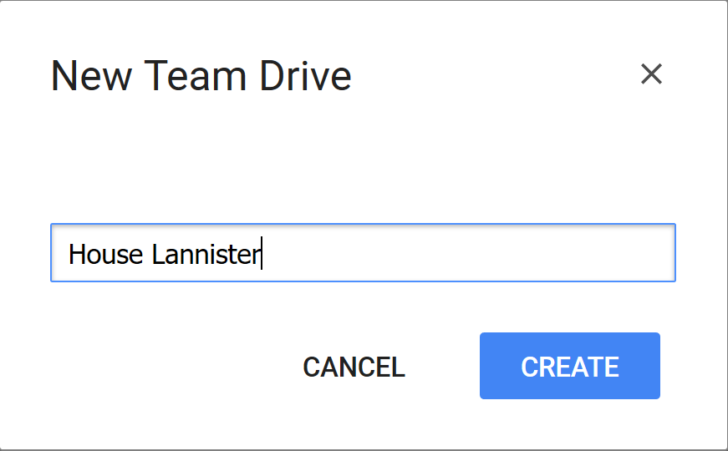
Creating a Team Drive
Navigate to Google Drive
hawaii.edu/google or
gdrive.hawaii.edu
Select “Team Drives” & click “New”
Name your Team Drive

Slide 5
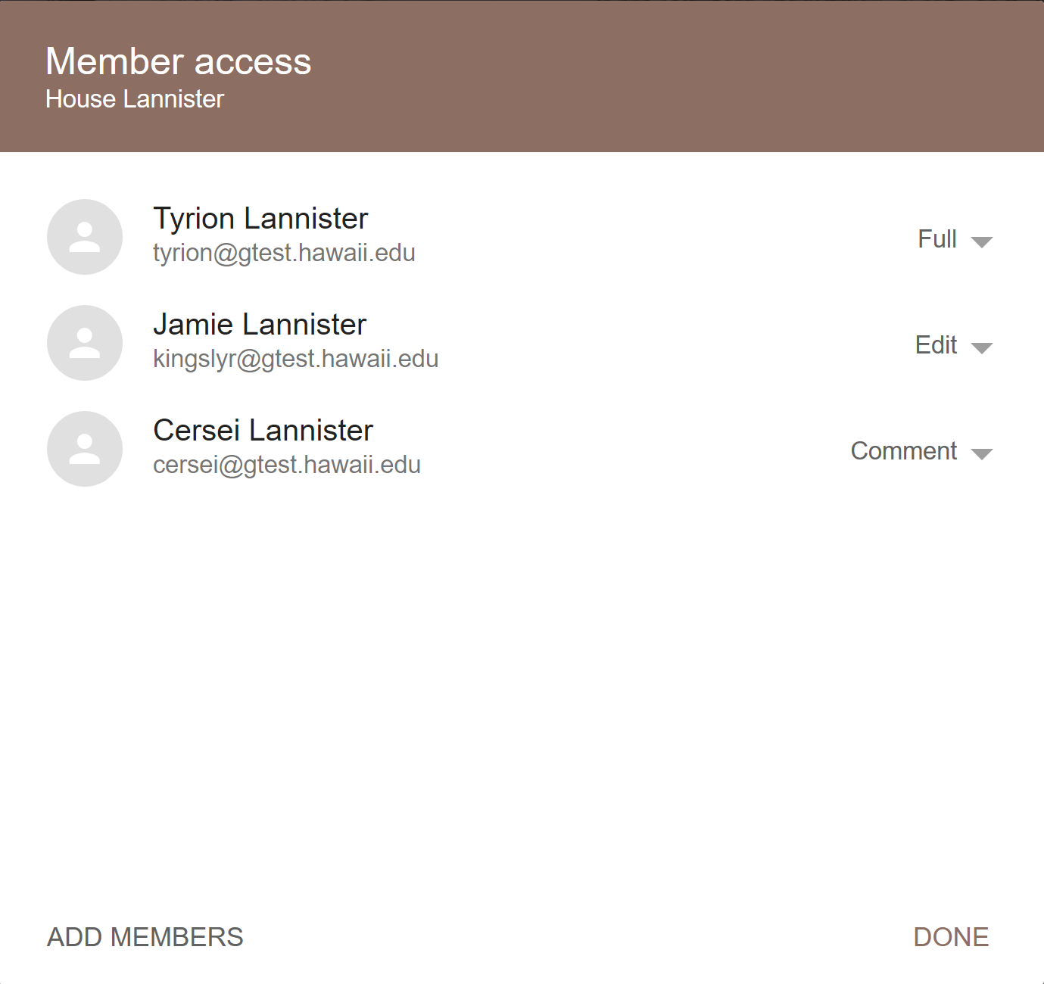
Creating a Team Drive
Add and manage members
Set member permissions: view, comment, edit, and full

Slide 6
Creating a Team Drive
Move existing docs or create new ones in your Team Drive
Documents moved will retain existing collaborators & inherit sharing from the Team Drive

Slide 7
Lightning Announcements
Google Keep is available
keep.google.com
Backup & Sync Desktop Application
ITS Help Desk
Open from 7:00am – 11:00pm
7 Days a Week
Including Holidays

Slide 8
Questions?
ITS Help Desk
Email: help@hawaii.edu
Oahu: (808) 956-8883
Neighbor Islands: (800) 558-2669
Fax: (808) 956-2108

