Slide 1
Cherwell Service Management (CSM) Julius Vea IT Specialist juliusve@hawaii.edu

Slide 2
ITSM
Notes:
In June, we rolled out Cherwell Service Management (or CSM) to ITS staff to support change management, incident management, and service requests.
Avante was contracted to design and implement the product using Cherwell’s hosted infrastructure.
By going to the cloud, this frees us from purchasing and maintaining hardware which equates to lower upfront costs and will lead to quicker time to value.
It also means we don’t have to maintain the underlying operating system or database.
Software upgrades and optimization are performed by Cherwell.
Cherwell works on all major browsers on both desktop and mobile.
Two Windows clients are available; one for ITS analysts in and the other for Cherwell administrators to customize dashboards, forms, reports, visualizations and actions.
CSM uses role-based security which is applied to all processes and capabilities of the system.
It supports the least privilege model where certain forms and records can be encrypted to restrict access to only authorized groups.

Slide 3
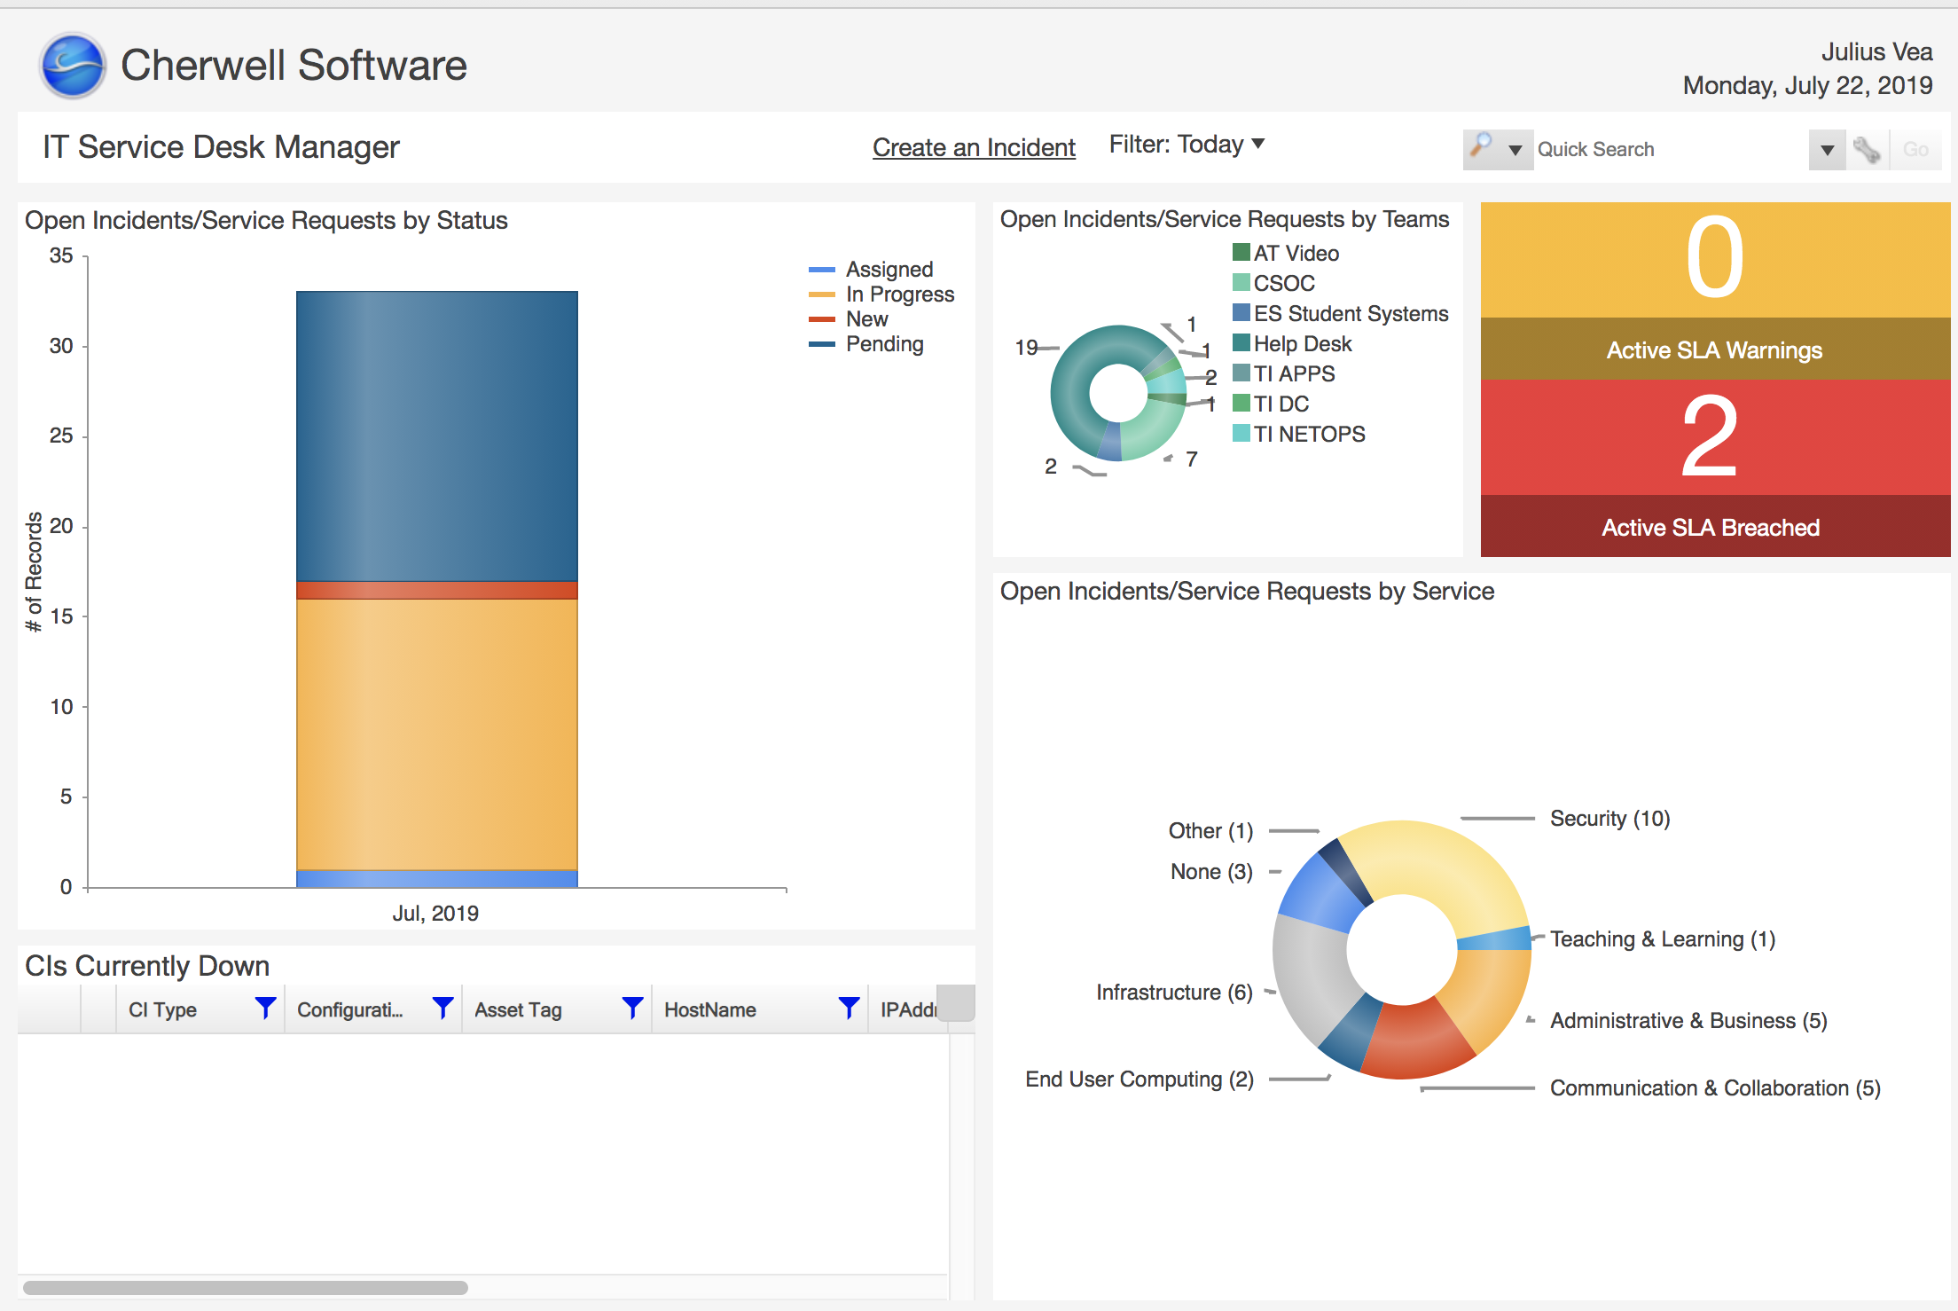
Data ➔ Insight
Notes:
Pictured: tactical dashboard
Before I go over some of the functions, let’s take a look at some of the benefits of an ITSM tool like Cherwell.
better and consistent user experience
more effective communication
reduced operational costs
improved visibility into operations
improved process effectiveness, that is…Cherwell supports existing processes and is capable of maturing as processes mature.
As I said earlier, Cherwell allows full customization on dashboards, forms, reports, visualizations and actions.
Here’s an example of a dashboard for the service desk manager.
It gives an overview of the day’s requests, broken down by status, team and service.
The manager could then click into the different sections to get more information about the tickets involved.
We can also run reports that highlight metrics such as change trends, application uptime, incident duration and SLA breaches.

Slide 4
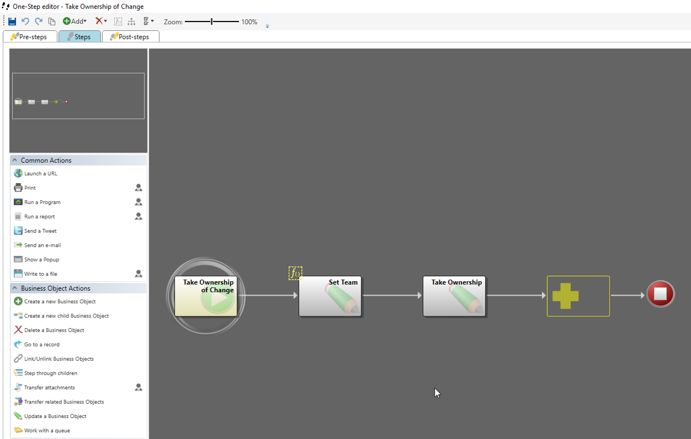
One-steps
Notes:
Pictured: One-step editor.
Manual IT service management processes are inefficient and limit the effectiveness of the service desk team.
One-steps allows us to automate processes without relying on costly development resources.
The Cherwell One-step editor allows us to build simple or complex workflows without coding or scripting.
We can initiate one or more defined actions such as sending email notifications or changing status of records.
Here is an example of a One-step where we define what happens in the backend upon clicking on the Take Ownership link for a record.
This particular action sets both the team and owner of the record based on who clicked on the link.
This saves the analyst around 6 mouse clicks.

Slide 5
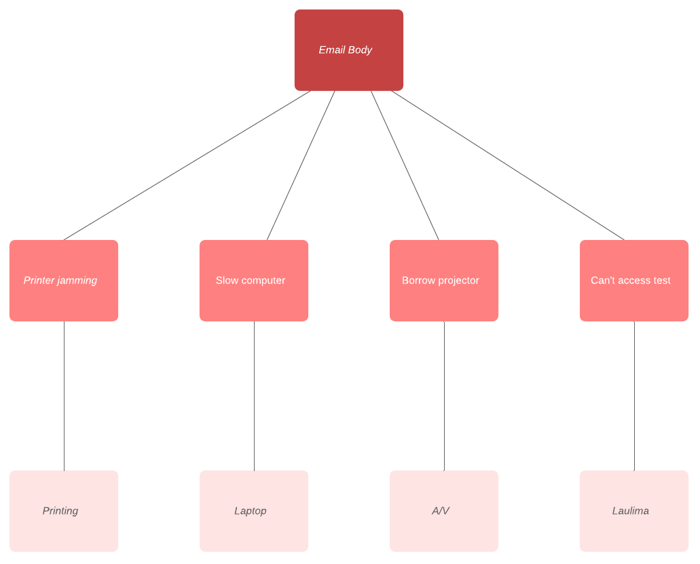
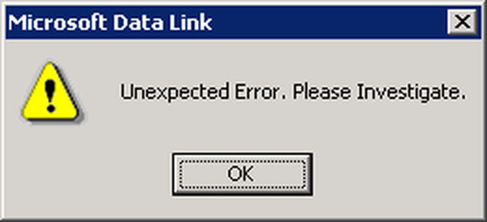
Automation
Notes:
Cherwell Automation Processes allows us to automate behavior by creating rules for the system to follow.
One type of automation is Email monitoring, which creates and updates tickets based on one or more email fields.
Lets use the example of a staff person having issues with their office printer.
After trying to fix it herself she decides to email IT support @ Hawaii.edu.
In the body, she states that her office printer keeps jamming.
With email monitoring set up, Cherwell receives the email and scans it for keywords.
Since it sees the words ”printer” and ”jamming”, it creates a record in CSM and routes it to the printing team.
All the members of the printing team would receive a notification on their dashboard that a new ticket has arrived.
At the same time, the user receives an email acknowledging that her printer request was received and is provided a request number to reference.
At any time, the user can reply to that email message with a note which CSM will then copy to the ticket.

Slide 6
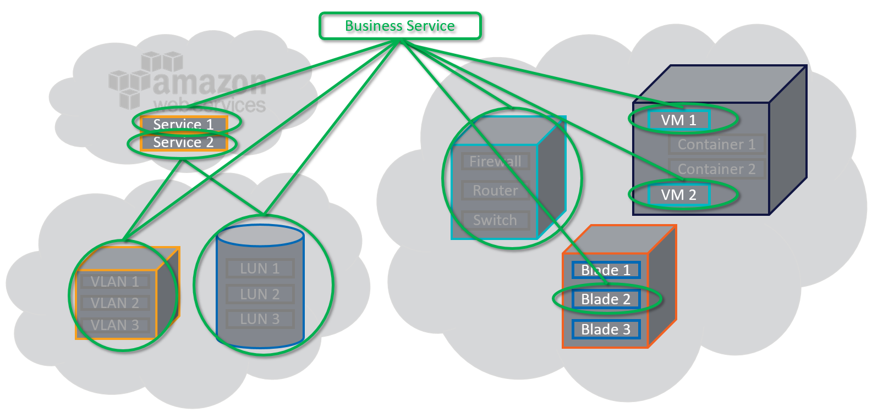
Up Next - CMDB
Notes:
In our next iteration, we plan to rollout Cherwell’s configuration management database (or CMDB).
Once the CMDB is set up we can track servers, switches, applications, locations, documentation, and even people.
But its more than just a list of assets.
It provides us with a total view of our configuration items, their attributes and relationships.
With relationship mapping, we’ll be see which processes, services and hardware will be affected by a change.
On the user side, it’ll save time from having to re-input hardware information every time a new ticket is submitted.
Also, in the next year we plan to roll out a portal whereby our customers can view our service catalog and log incidents and service requests.
Stay tuned!

Slide 7
Cherwell Service Management (CSM) Julius Vea IT Specialist juliusve@hawaii.edu

