Slide 1
IRNC:PIREN->Astroflows
TestDirector
Alan Whinery
Chief Internet Engineer

Slide 2

Astroflows looks at:
Astronomy activities on the UH network
How we can make them work well
Why things work as they do
How to define and disseminate best practices
Example activity
Placing Data Transfer Nodes at key points
  http://fasterdata.es.net/science-dmz/DTN/

Slide 3
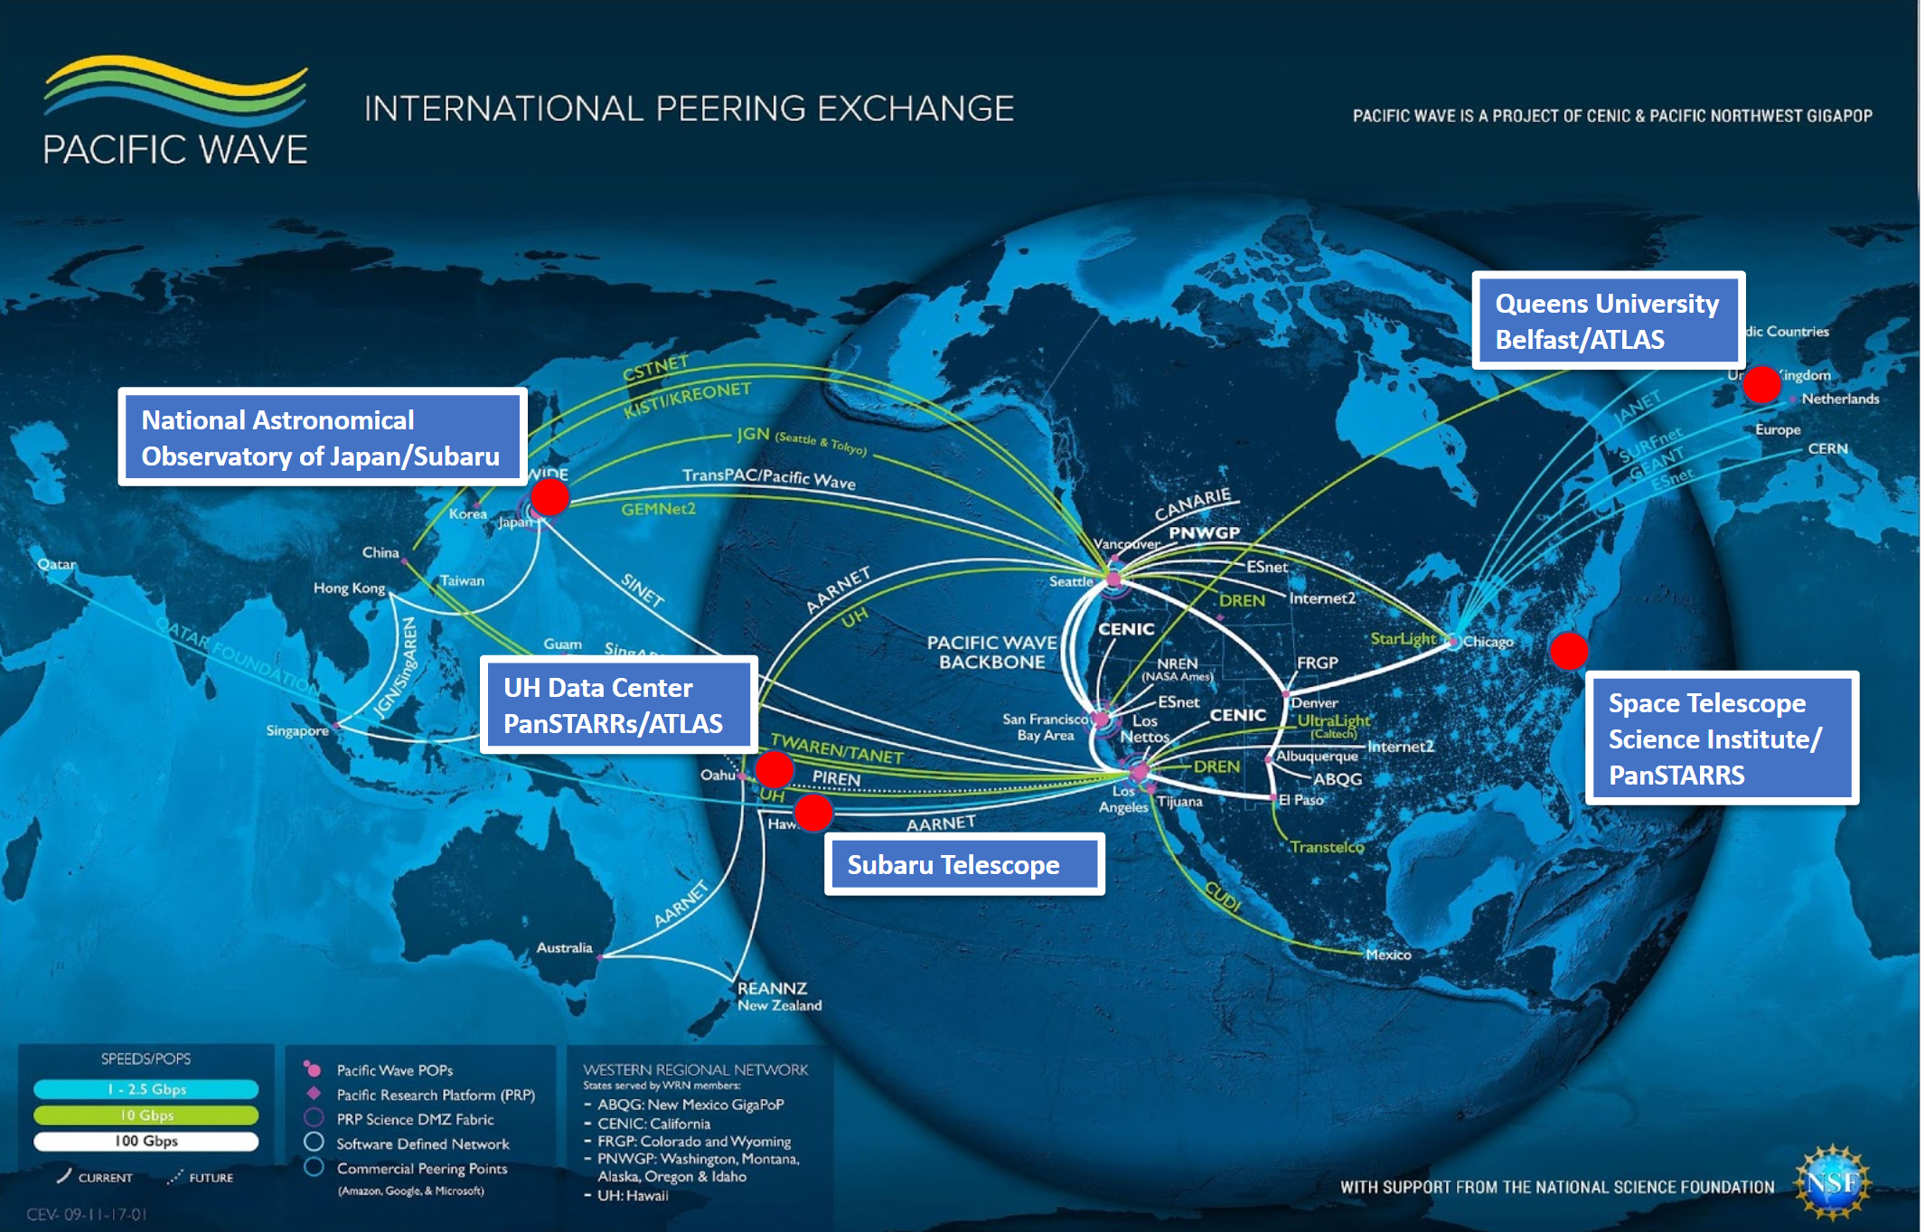
Astronomy Archives Paths Evaluated

Slide 4
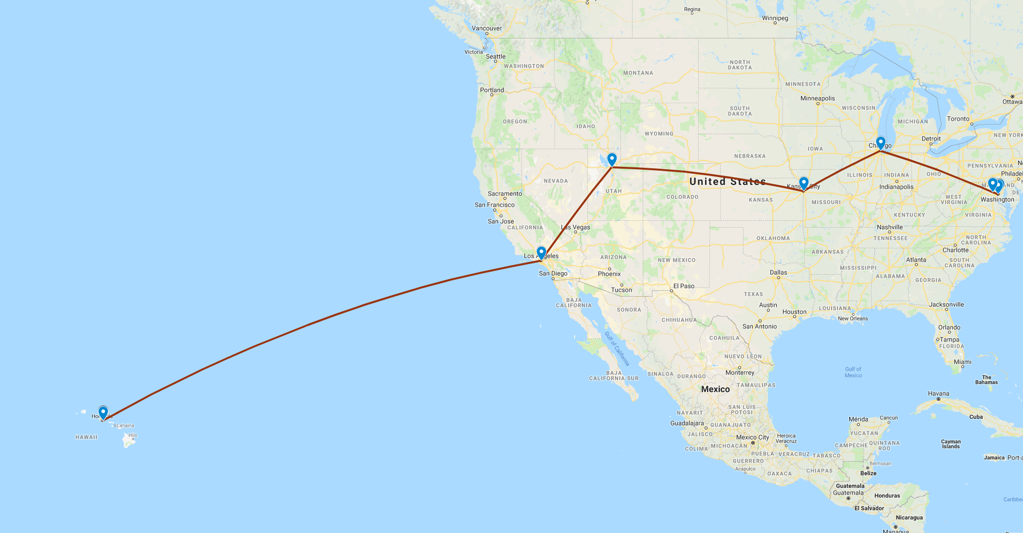
ITC DTN to MAX DTN

Slide 5
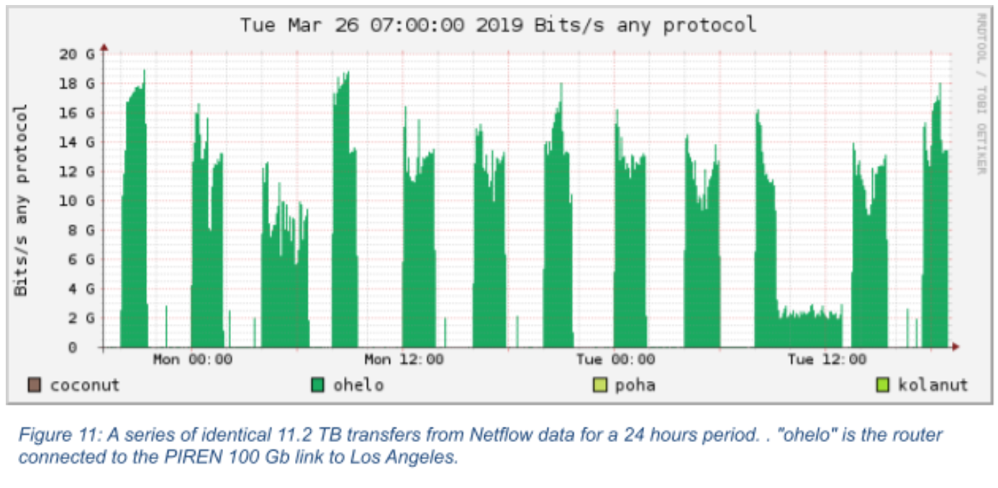
File Transfer Tests (11.2 TB samples, 134.4 TB total)
XX
48

Slide 6
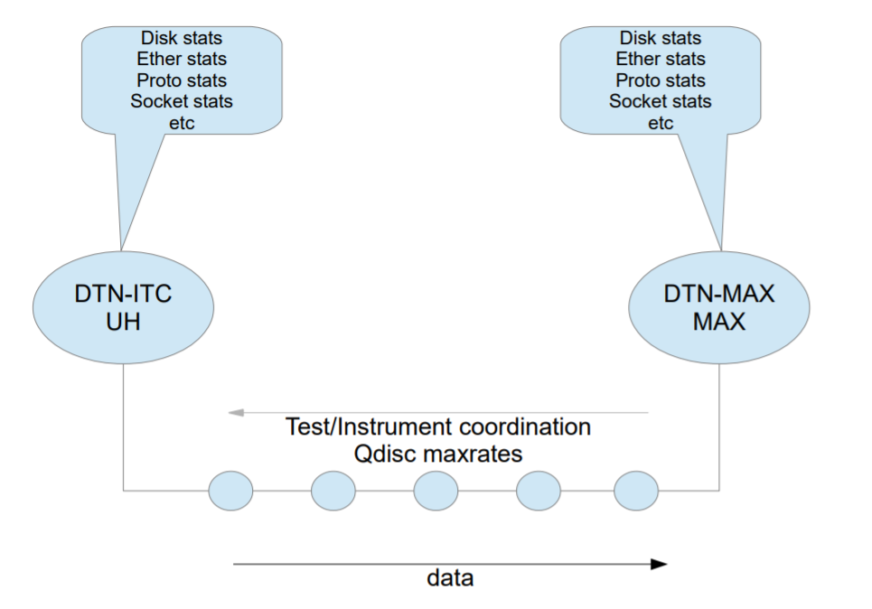
DTN Instrumentation: Phase 1, June 2019

Slide 7
TestDirector
Was the file name of the controller script.
Mentioned it to Gwen, so now it's a "brand".
Orchestrates both endpoints'
  Fair queuing interface pacing (spacing packets for their target rate)
  Periodic logging of network, storage, other system metrics
  Starting the file transfer with various tools
    Parallel wget
    Globus gridftp
    lsftp
Further work will get into kernel instrumentation
  eBPF, bcc, bpftrace (http://www.brendangregg.com/blog/2019-01-01/learn-ebpf-tracing.html)

Slide 8
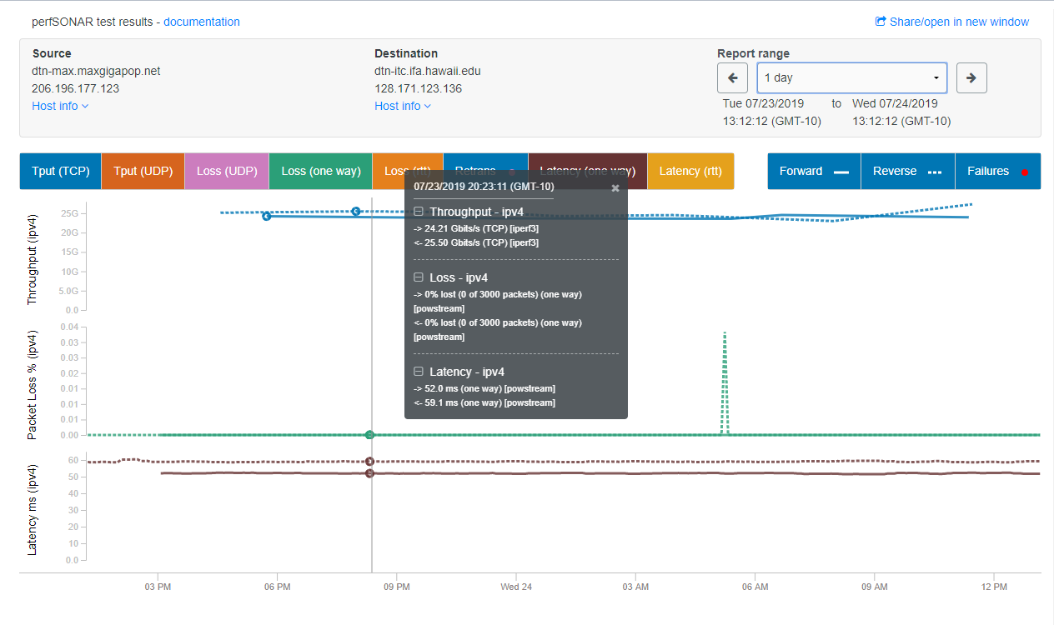
perfSONAR tests (RAM to RAM) same everything

Slide 9
Context
IRNC - (https://www.nsf.gov/funding/pgm_summ.jsp?pims_id=503382 )
PIREN - Pacific Islands Research and Education Network (https://www.hawaii.edu/piren/)
GOREX - Guam Open Research Exchange (https://gorex.uog.edu/ )
Mid Atlantic Crossroads GigaPoP (MAX) (http://www.maxgigapop.net/ ) (local REN point-of-presence in Baltimore
Space Telescope Science Institute - archive site for PanSTARRS data AURA facility near Johns Hopkins in Baltimore ( http://www.stsci.edu/ )

Slide 10
Context (cont’d)
perfSONAR - (https://www.perfsonar.net/ )
NetSAGE - (https://portal.netsage.global )
Faster Data - ( http://fasterdata.es.net/ )
PerfClub.org (http://perfclub.org )

