Slide 1
2019 Network Updates
chris zane
czane@hawaii.edu

Slide 2
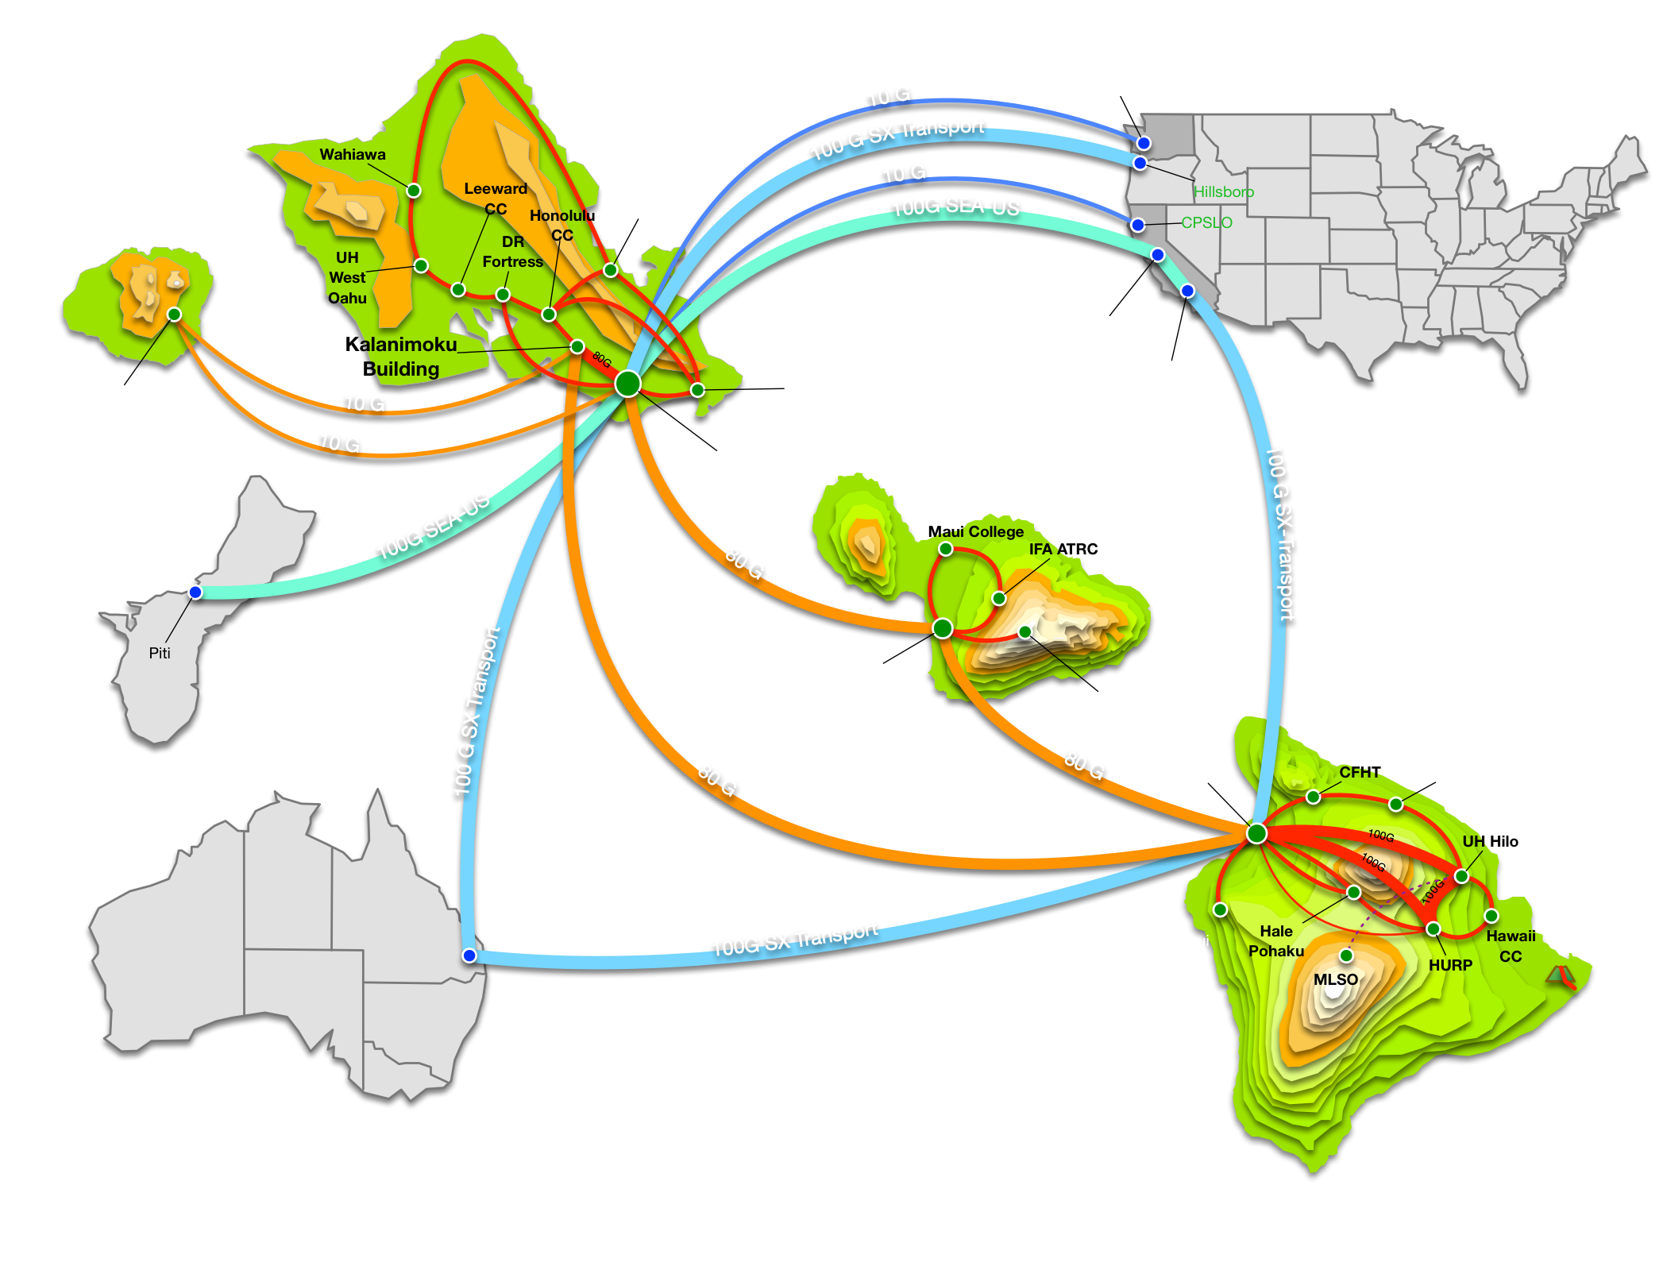
Network Upgrades
Interisland to 80Gbps
Big Island 100Gbps
New Palo Altos
Redundant Internet @ DRF

Slide 3
Asia-Pacific Updates
Guam was so last year...
Hong Kong
Singapore
American Samoa

Slide 4
Asia-Pacific Updates
Next port of call
New Zealand!

Slide 5
Asia-Pacific Updates
What's in New Zealand?
REANNZ
5 Million people
Least corrupt nation in the world
Humans are 5% of the population (animals are the rest)
Longest place name in an English speaking country
Taumatawhakatangihangaoauauotameteaturipukakapikimaungah-oronukupokaiwhenuakitanatahu
Watch Sheep Drink Beer

Slide 6
Asia-Pacific Updates
Watch Sheep Drink Beer

Slide 7
Asia-Pacific Updates
Evolution!

Slide 8
Asia-Pacific Updates
,
Watch Sheep Drink Beer

Slide 9
Upcoming Projects
Critical mass of Arista Switches
Replace old Cisco 6500's
Native VXLAN (Layer 2 tunneling)
Standards Based
EVPN-BGP for control plane
RFC 7348
RFC 7432

Slide 10
Can you hear me now?
Systemwide VoIP replacement
RFI this year
RFP next year

Slide 11
Annual IPv6 Plug

Slide 12
Lunch

